Slide 1
Hadassah
The teenage girl who saved the Jews
Glen Shearer
Glen.Shearer@USM.edu

Slide 2
Esther
Glen Shearer
Glen.Shearer@USM.edu

Slide 3
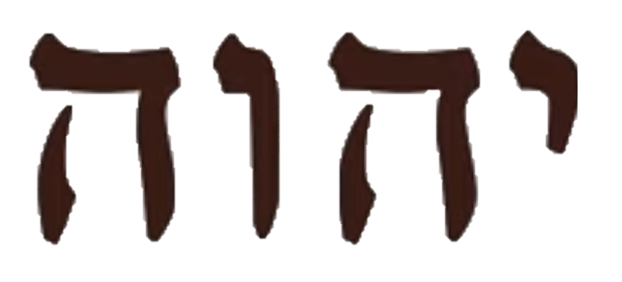
Book of Esther
Hero: a teenage girl
בְּתוּלָה
נַעֲרָה
Not a single mention of “God”
YHWH (Exodus 3)
Notes:
“young virgins” – naarah (young girl, maiden…); bethulah (virgin, maiden)

Slide 4
Jesus
2023
Notes:
Moses ~ 1500 BC
Assyria conquers Israel ~ 720
Babylon conquers Assyria ~ 612
Babylon conquers Judah ~ 600
Persia conquers Babylon ~ 539

Slide 5
Solomon
Cyrus allows people to return home.
5% go: Ezra/Nehemiah
95% stay: Esther
Moses &
Exodus
Saul
David
Divided
Kingdom
|
1500 BC
|
1000 BC
Persia conquers Babylon ~539
Babylon conquers Assyria
Assyria captures Israel
Babylon conquers Judah ~597
Notes:
Joseph ~ 1800 BC
Moses ~ 1500 BC
Assyria conquers Israel ~ 720
Babylon conquers Assyria ~ 612
Babylon conquers Judah ~ 600
Persia conquers Babylon ~ 539
Esther ~ 480

Slide 6
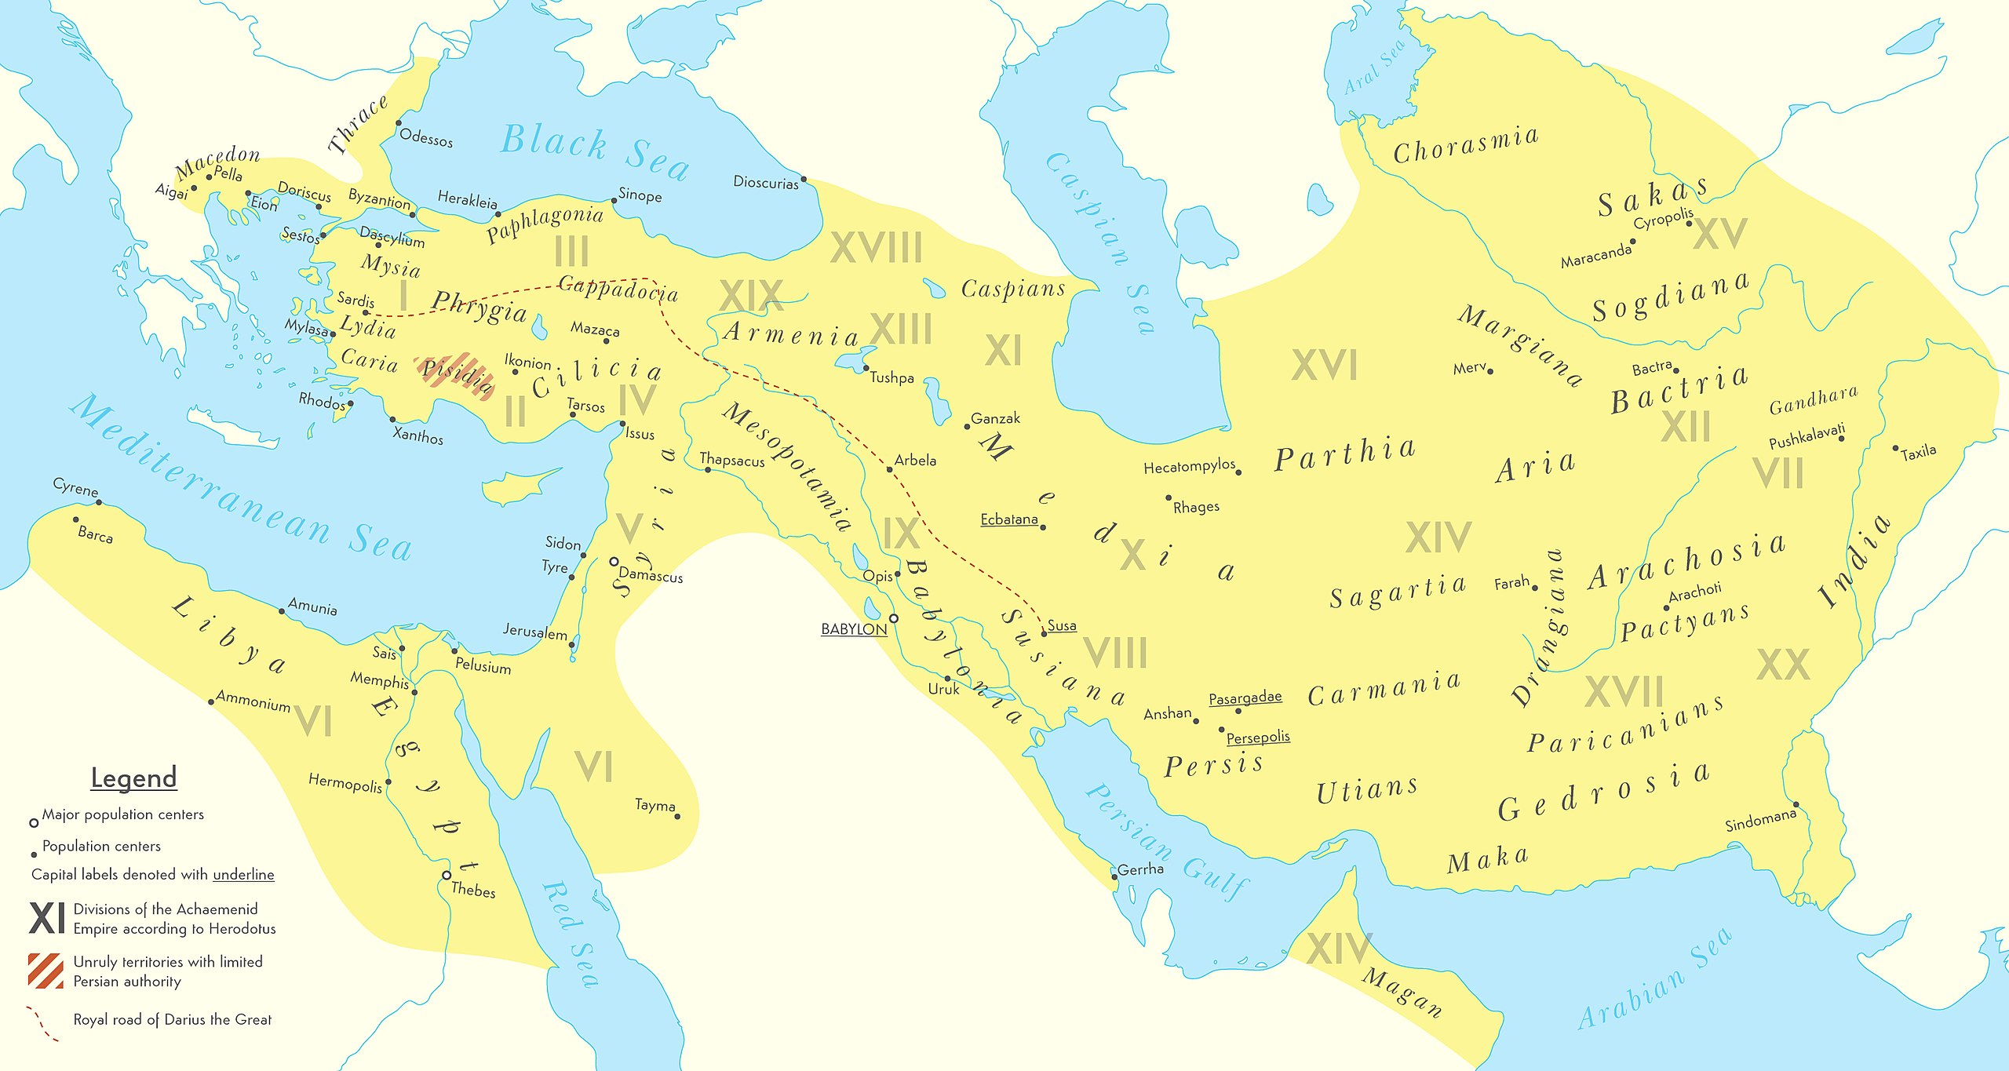
Persian Empire of Khashayar (486–465 BCE)
Heb: Ahasuerus
Susa
Gk: Xerxes I
Jerusalem
Notes:
Approx 44% of world population; over 3000 miles across

Slide 7
1: 187 day feasting & drinking in Susa
Chapters in blue
Drawings modified from BibleProject.org

Slide 8
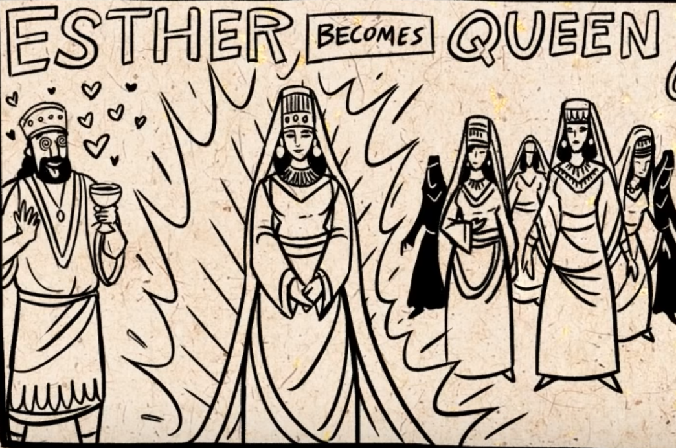
2: Kingdom-wide beauty contest…
Hadassah
Esther “wins”
Cousin
Mordacai likely
government
employee

Slide 9
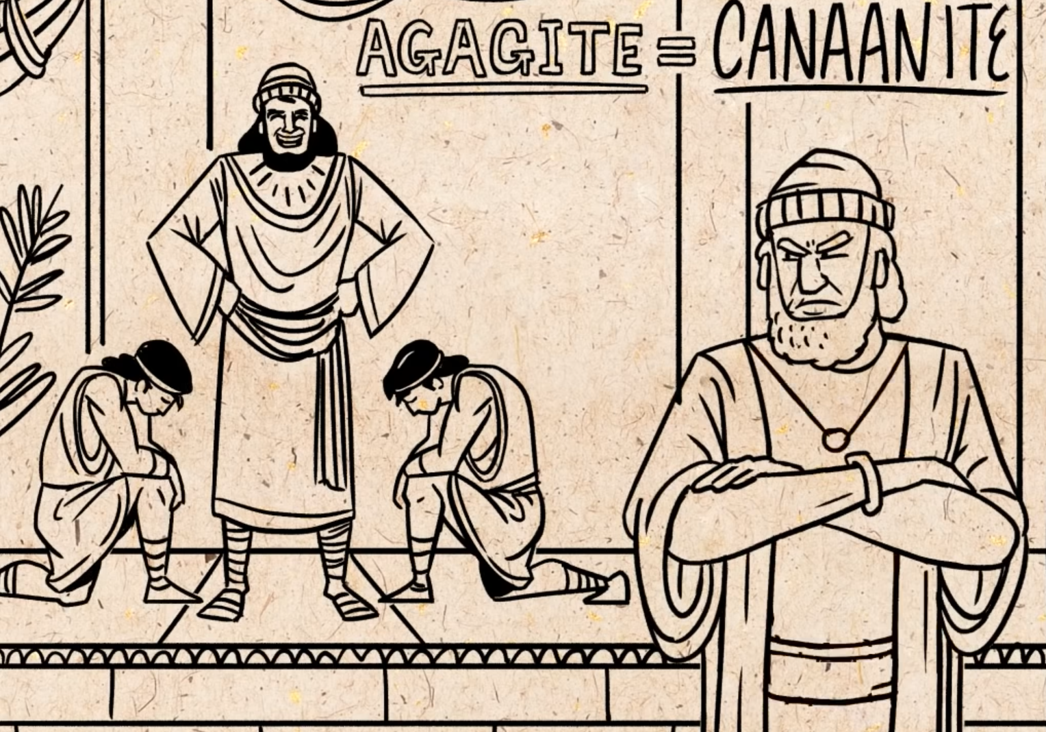
3:5 Mordacai refuses to bow to Haman…
Haman is “filled
With wrath!’(KJV)”
חֵמָה
Notes:
”fury” = chemah…buring rage !

Slide 10
Isaac
Rebekah
Adah
Jacob
Esau
Timna
Eliphaz
12 Tribes of
the Hebrews
Amalek

Slide 11
Amalekites
Ancestral enemies of Israelites
> Attack Israelites immediately after exodus from Egypt
Exodus 17; Deut. 25
> Target the lagging people…old, sick, pregnant, etc.
> ~300 yrs later - King Saul command to“utterly destroy”
the Amalekites…but does NOT (1 Sam. 15)
> King Agag spared; gold/silver/livestock kept!

Slide 12
3: Haman’s plan to kill ALL the Jews …

Slide 13
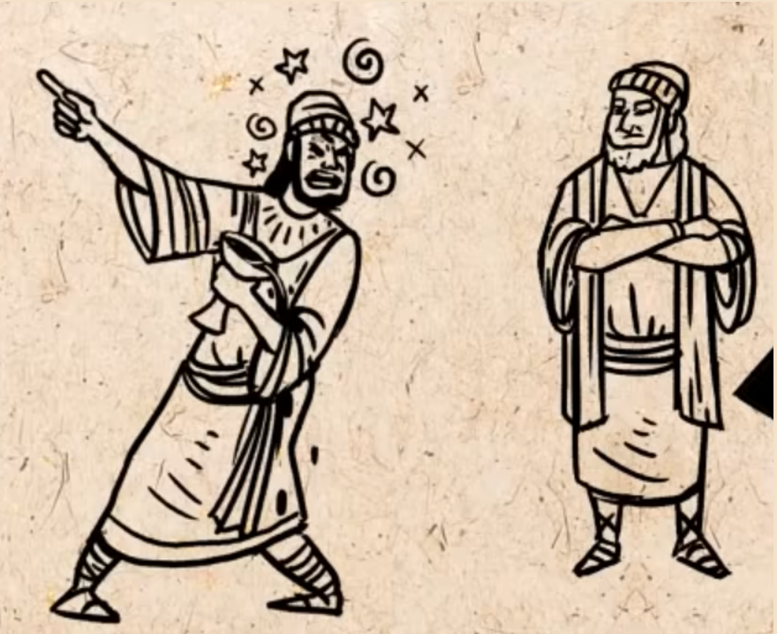
3: Haman’s plan to kill ALL the Jews …
[Haman] cast lots to pick the day to kill every Jew in the Empire

Slide 14
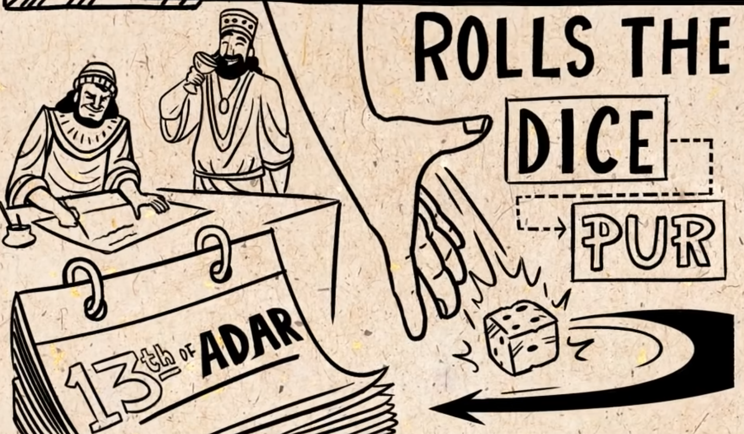
3: Haman’s plan to kill ALL the Jews …
When is the best time?
…1st month…No
…2nd month…No
…3rd month…No
…..
…12th month…YES !

Slide 15
3: Haman’s plan to kill ALL the Jews …

Slide 16
3: Haman’s plan to kill ALL the Jews …
⁸Then Haman said to Xerxes, “There is a certain people scattered abroad and dispersed among the peoples in all the provinces of your kingdom. Their laws are different
from those of every other people, and they do not keep the king’s laws, so that it is not to the king’s profit to tolerate them.

Slide 17
3: Haman’s plan to kill ALL the Jews …
⁹If it please the king, let it be decreed that they be destroyed, and I will pay 10,000 talents of silver into the hands of those who have charge of the king’s business, that they may
put it into the king’s treasuries.” ¹⁰So the king took his signet ring from his hand and gave it to Haman the Agagite, the son of Hammedatha, the enemy of the Jews. ¹¹And the king said to Haman, “…do with them [Jews] as it seems good to you.”

Slide 18
3: Haman’s plan to kill ALL the Jews …
¹³Letters were sent by couriers to all the king’s provinces with instruction to destroy, to kill, and to annihilate all Jews, young and old, women and children, in one day, the thirteenth day of the twelfth month, which is the month of Adar, …

Slide 19
3: Haman’s plan to kill ALL the Jews …
¹³Letters were sent by couriers to all the king’s provinces with instruction to destroy, to kill, and to annihilate all Jews, young and old, women and children, in one day, the thirteenth day of the twelfth month, which is the month of Adar, and to plunder their goods.

Slide 20
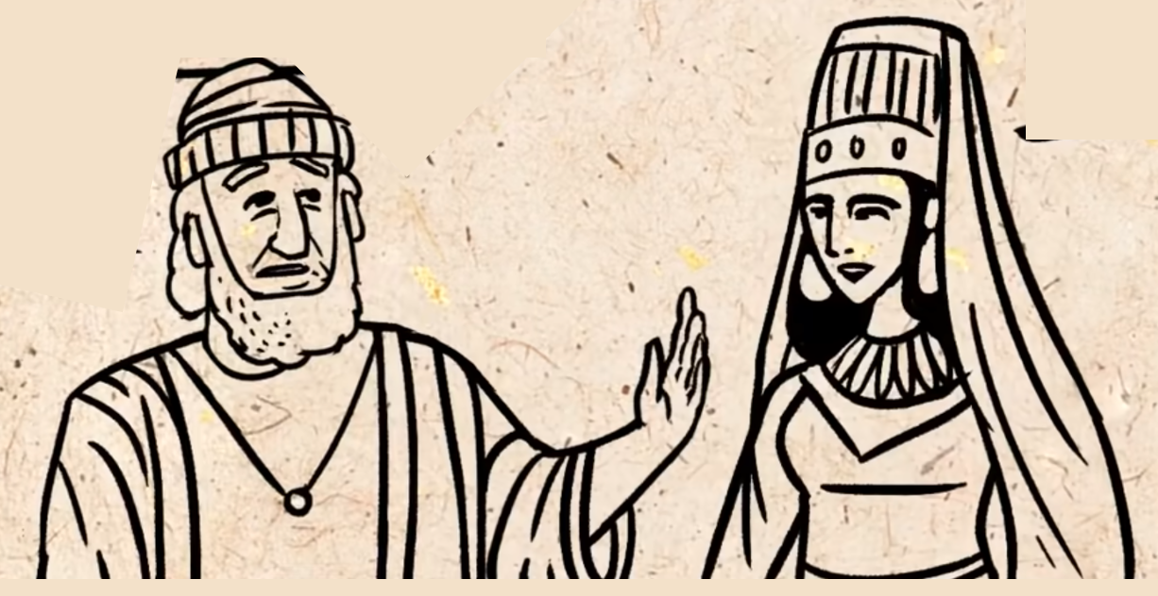
4 Mordecai shows Esther the royal edict----

Slide 21
4:13 Esther risks her life to save the Jews
You must beg the King to save us !
I cannot…to see the King uninvited is but one law…DEATH !

Slide 22
4:13 Esther risks her life to save the Jews
Perhaps you are here “for such a time as this”
I will go to the King and…If I perish, I perish !

Slide 23
4 Esther risks her life to save the Jews
Please ask the people for fast for me 3 days…I will also fast.

Slide 24
5 The royal scepter of the King…
¹⁻² – [Ester enters the throne room]
²And when the king saw Queen Esther standing in the court, she won favor in his sight, and he held out to Esther the golden scepter that was in his hand. Then Esther approached and touched the tip of the scepter. ³And the king said to her, “What is it, Queen Esther? What is your request? It shall be given you, even to the half of my kingdom.” …come to my banquet…the King and Haman.

Slide 25
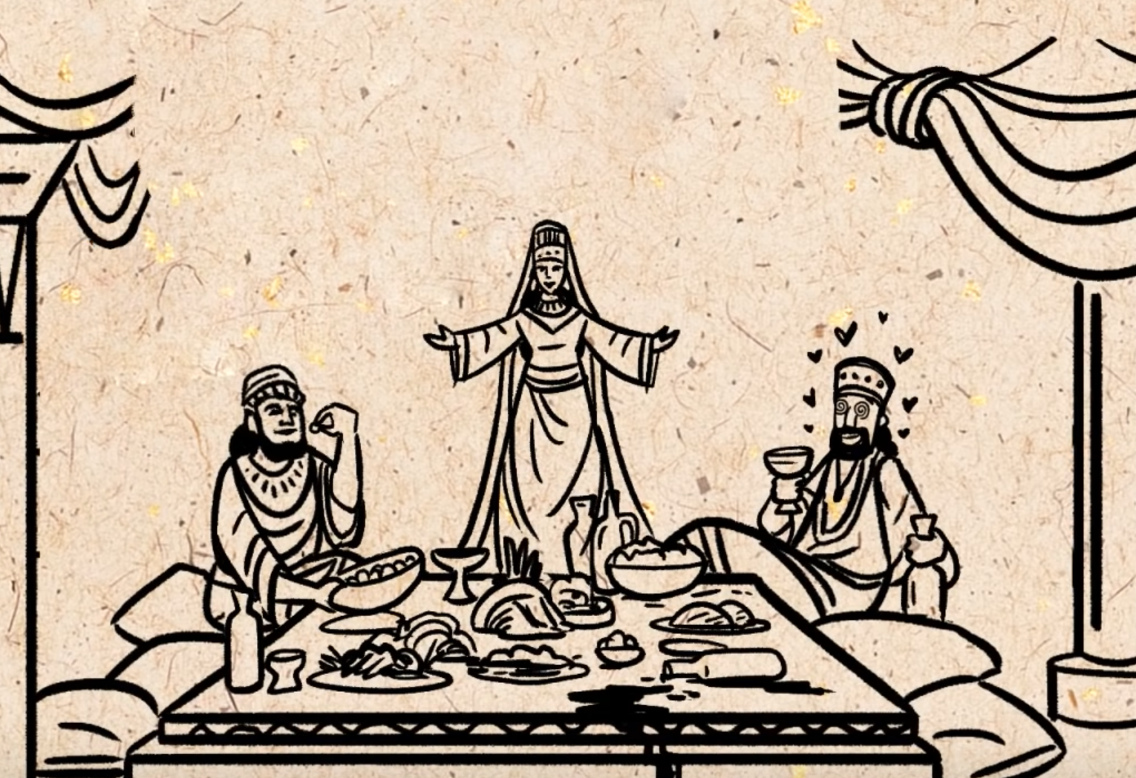
5: Esther’s 1st banquet for Xerxes & Haman
What do you desire, my Queen?…up to half the kingdom”
“…come to my banquet tomorrow…

Slide 26
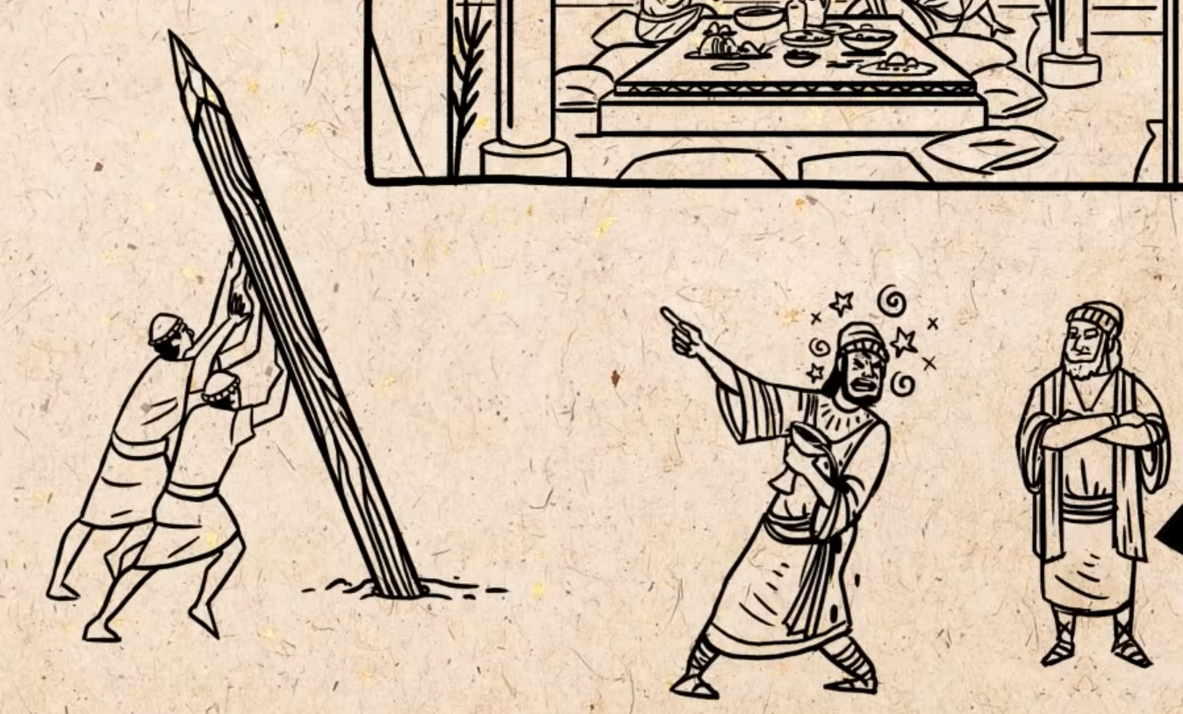
5: Haman’s good mood is ruined…
Mordachai still will not bow…
¹³Yet all this is worth nothing to me, so long as I see Mordecai the Jew sitting at the king’s gate.”

Slide 27
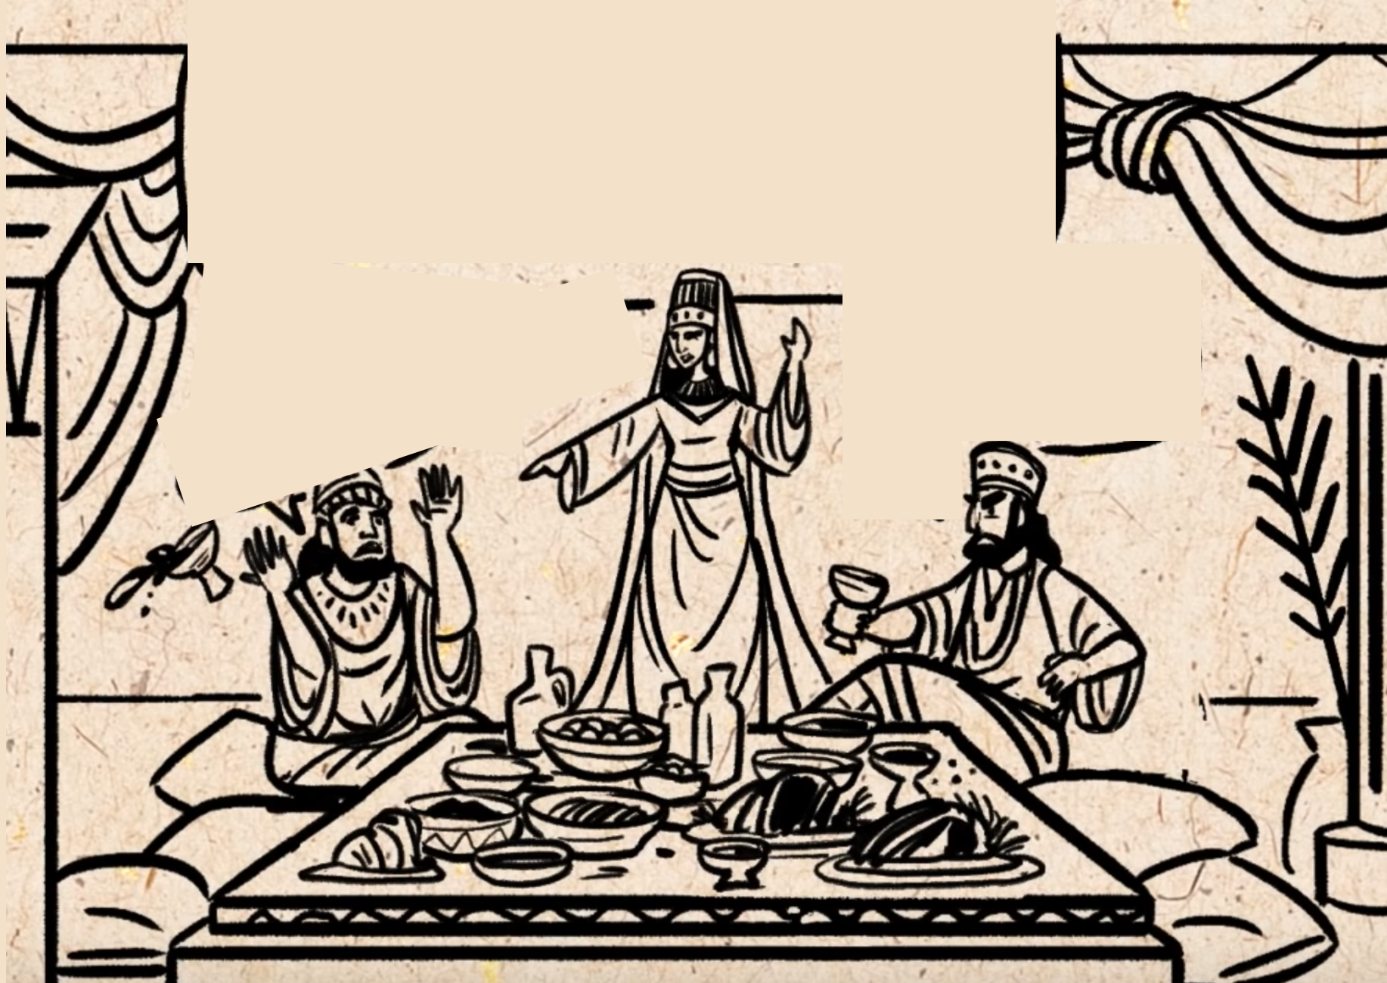
7: Esther’s 2nd banquet for Xerxes & Haman
“What is your desire, my Queen…up to half the kingdom ?

Slide 28
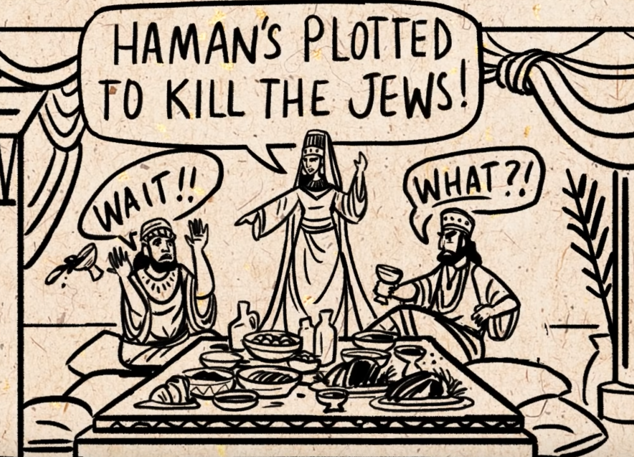
7: Esther’s 2nd banquet for Xerxes & Haman
I am a Jew…save my life my King”
“What !!?
Who dares to
do such a thing?”
The King is so angry…he has to get some air…

Slide 29
7: Esther’s 2nd banquet for Xerxes & Haman
⁸And the king returned …as Haman was falling on the couch where Esther was.

Slide 30
7: Esther’s 2nd banquet for Xerxes & Haman
Will he even assault the Queen in my presence, in my own house?
Notes:
According to Plutarch (Greek historian, d AD 118) (Artaxerxes 27.1), touching the Persian king’s wife/concubine was a capital offense. In Assyrian law, no man was allowed to draw within more than seven paces of a member of the king’s harem (see Clines, 312). Haman must surely have been out of his mind to have made such an error
Tomasino, A. (n.d.). Esther: Evangelical Exegetical Commentary (H. W. House & W. Barrick, Eds.; p. 298). Lexham Press.

Slide 31
7: Xerxes “hangs” Haman
^{9…}Harbona (one of the eunuchs) said, “…there is a 7 storey pole next to Haman’s house…

Slide 32
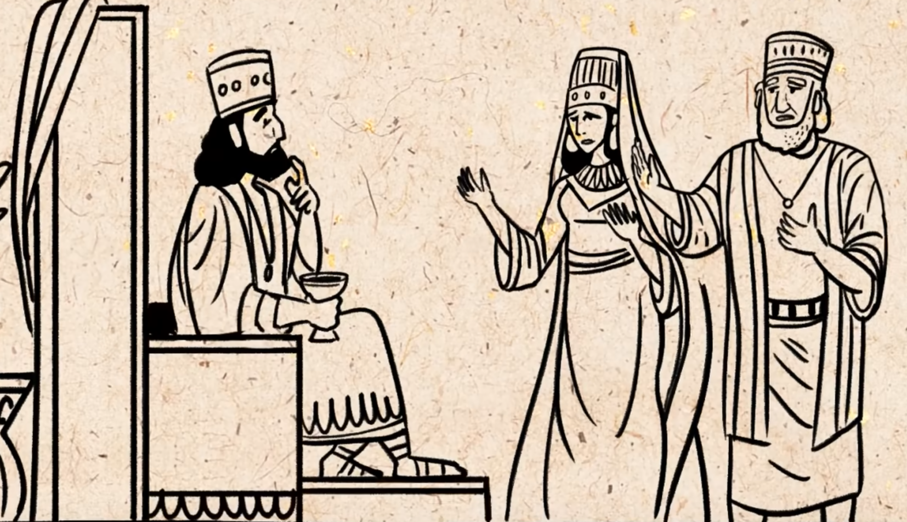
8: How to fix the “unrevokable law”?

Slide 33
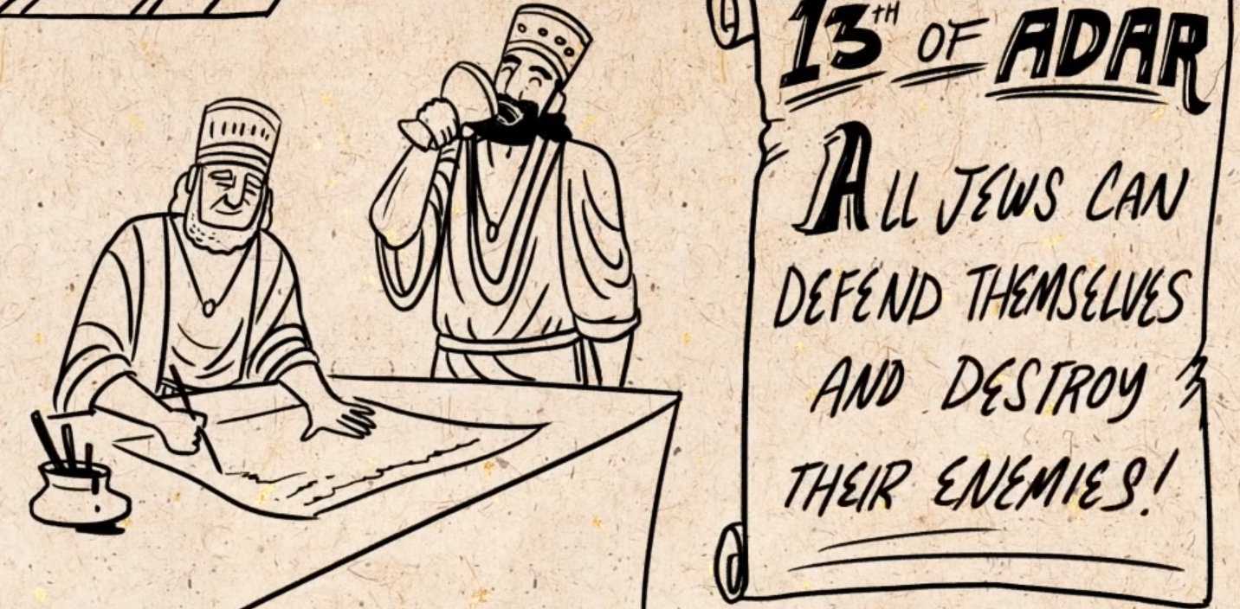
8: How to fix the “unrevokable law”--

Slide 34
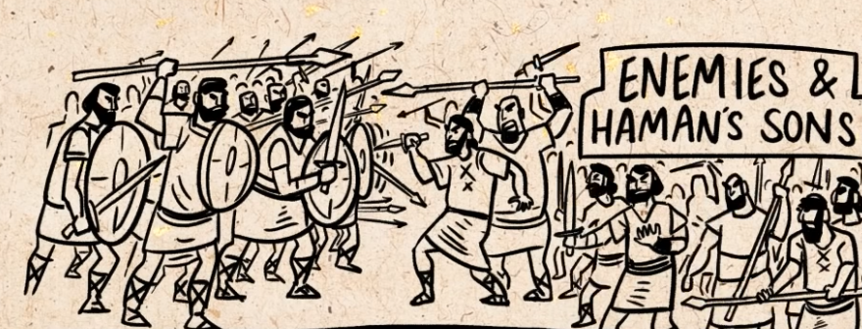
9: Esther’s & Mordacai’s “new law”
500 killed in Susa
75,000
Across the empire
But … the Jews keep no plunder

Slide 35
9: Festival of “Purim” (lots) – 14th Adar to
Remember & celebrate when Esther saved
the Hebrew nation.
Purim celebrated
for over 2,500 years

Slide 36
Happy Purim 2024
Evening of Sat, Mar 23 – Sun, Mar 24
Notes:
Gragger = noisemaker
Babylonian names:
Hadassah → Esther
Daniel (God judge) →Beltashazzar – Bel will protect
Hananiah (grace god) →Shadrach – inspired of Aku
Mishael (who is like god) → Meshach – belonging to Aku
Azariah (helper god) → Abednego – servant of Nebo

Slide 37
So what...what does it mean for us today ?
Are we here ”…for such a time as this…”?
Some things are more important than life…courage, bravery…”if I perish…I perish” (Rom 5:3ff)
Notes:
Romans 5:3b-4 suffering produces endurance, 4and endurance produces character, and character produces hope, 5and hope does not put us to shame, because God’s love has been poured into our hearts through the Holy Spirit who has been given to us.

Slide 38
Hadassah
The teenage girl who saved the Jews
Glen Shearer
Glen.Shearer@USM.edu

