Slide 1
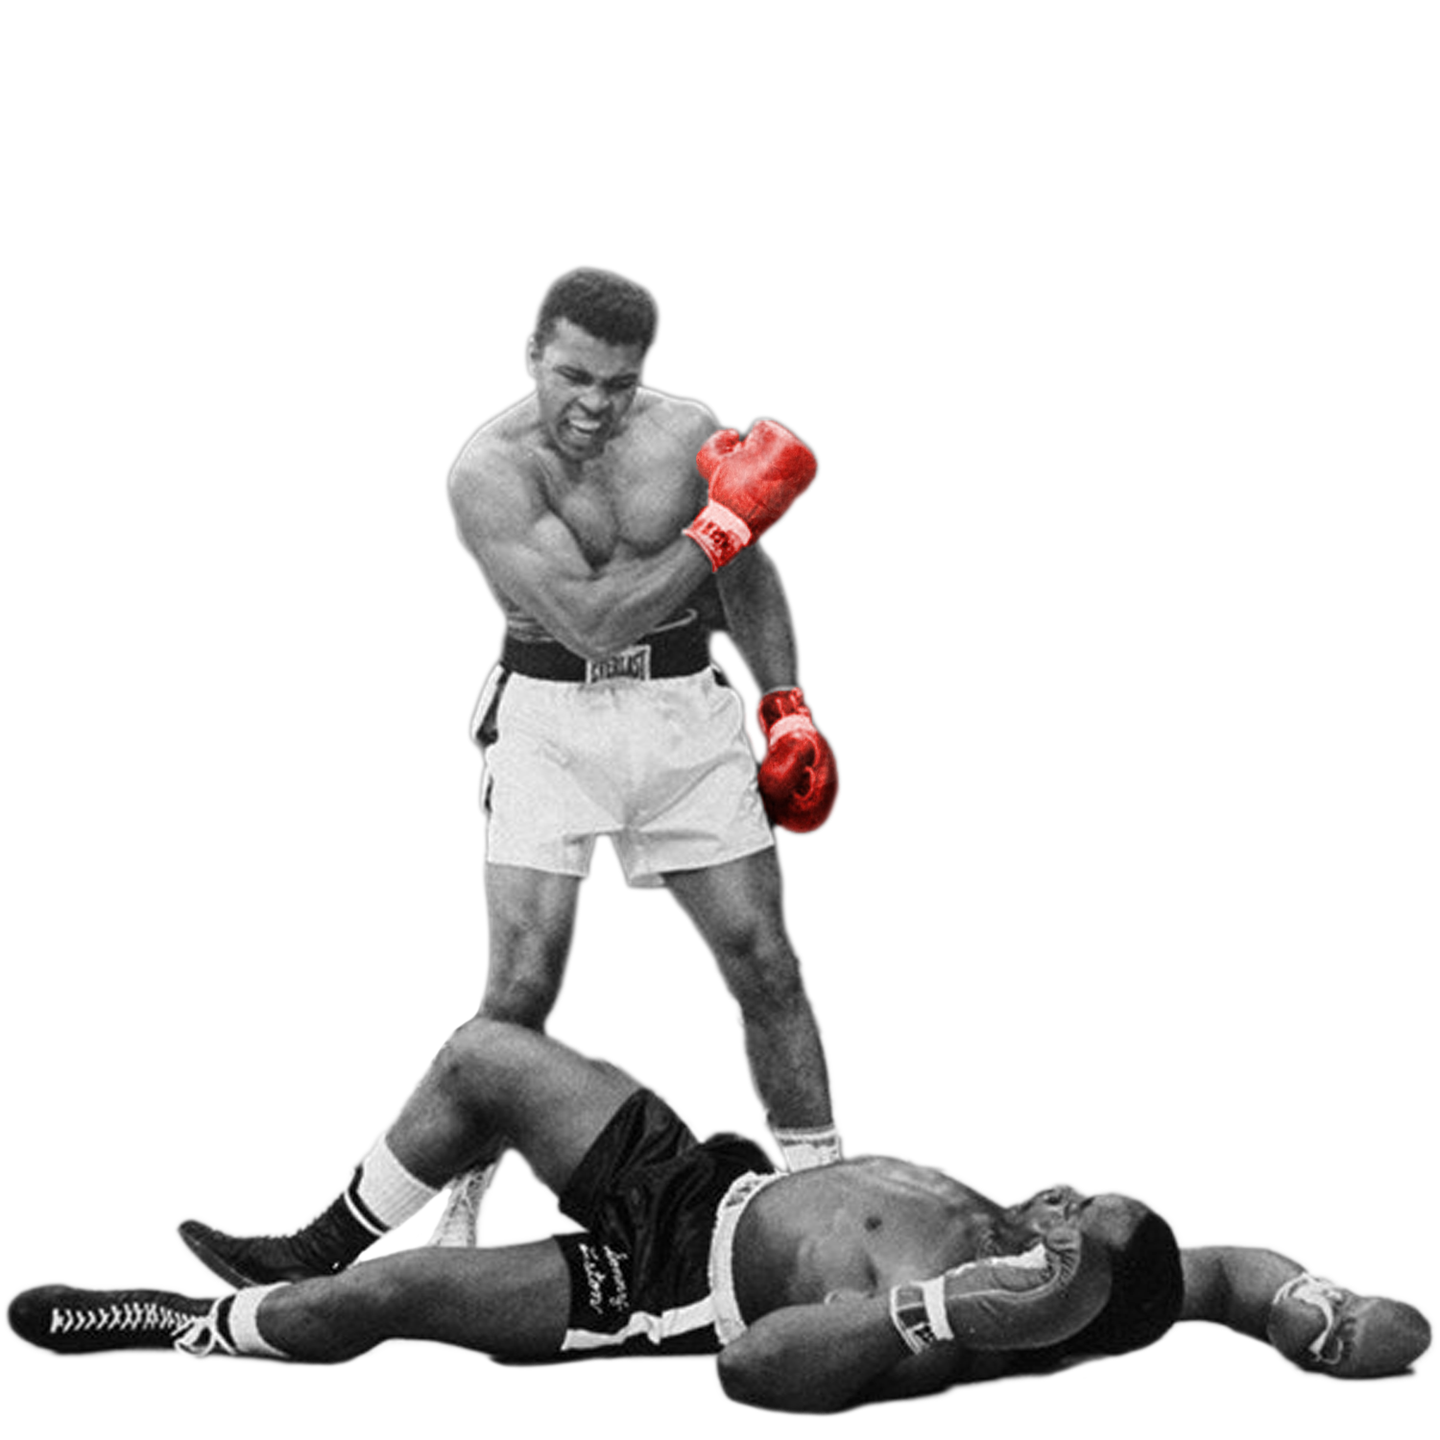
I am the greatest!
Matthew 20:26

Slide 2
Often we might hear people discuss who is the greatest at something. This is often a conversation had among sports pundits. Just such a discussion arose among the disciples. Jesus settled the dispute but leaves me still wondering.
Matthew 18:1-6 & Matthew 19:13-15

Slide 3
Who is the greatest…
When Jesus is asked this question, being the master teacher, He doesn’t come out and answer it directly.
He employs an object lesson & then answers them.
Pulling a child from nearby He sets them in the middle of these men who are all concerned with greatness.
Why a child? What is it about a child that demonstrates humility and greatness?

Slide 4
I think just about every preacher I have ever known has done their best to try to convey what it is about a child that led Jesus to use them to answer the disciples questions.
Matthew 18:1-6 & Matthew 19:13-15

Slide 5
Become the greatest by…
Having a great memory.
All of us adults have made statements about the fact that we seem to forget more as we age.
Children’s minds are sharp. They seem to never forget. What a great characteristic to emulate.
Let’s be like children & remember God & his goodness.

Slide 6
Become the greatest by…
Having a terrible memory.
Each year as a teacher I try to find one less “unimportant” thing to stress about.
I love how quickly my students are willing to set a grudge or disagreement aside.
Are we as willing to forgive & forget? Hopefully.

Slide 7
Become the greatest by…
Acknowledging your dependence on a higher authority.
We are all dependent upon God’s love, His mercy, His kindness, & His forgiveness. Without Him we are nothing. Psalm 124.
Kayla Montgomery knows the meaning of dependence.
Are you willing to throw yourself into the arms of God?

