Slide 2
INTERPRET DIFFICULT PASSAGES IN LIGHT OF EASY TO UNDERSTAND PASSAGES

Slide 3
THE CONFUSION

Slide 4
THE CONFUSION
REALIZED ESCHATOLOGY

Slide 5
REALIZED ESCHATOLOGY
SECOND COMING IS PAST

Slide 6
REALIZED ESCHATOLOGY
SECOND COMING IS PAST
FINAL JUDGMENT IS PAST

Slide 7
REALIZED ESCHATOLOGY
SECOND COMING IS PAST
FINAL JUDGMENT IS PAST
END OF THE WORLD IS PAST

Slide 8
REALIZED ESCHATOLOGY
SECOND COMING IS PAST
FINAL JUDGMENT IS PAST
END OF THE WORLD IS PAST
OLD & NEW COVENANTS IN FORCE

Slide 9
REALIZED ESCHATOLOGY
SECOND COMING IS PAST
FINAL JUDGMENT IS PAST
END OF THE WORLD IS PAST
OLD & NEW COVENANTS IN FORCE
DENIES RESURRECTION OF THE DEAD

Slide 10
REALIZED ESCHATOLOGY
SECOND COMING IS PAST
FINAL JUDGMENT IS PAST
END OF THE WORLD IS PAST
OLD & NEW COVENANTS IN FORCE
DENIES RESURRECTION OF THE DEAD
ALL BIBLE PROPHECY WAS FULFILLED

Slide 11
REALIZED ESCHATOLOGY
2 Timothy 2:17-18 And their message will spread like cancer. Hymenaeus and Philetus are of this sort, ¹⁸ who have strayed concerning the truth, saying that the resurrection is already past; and they overthrow the faith of some.

Slide 12
REALIZED ESCHATOLOGY
2 Thessalonians 2:1-2 Now, brethren, concerning the coming of our Lord Jesus Christ and our gathering together to Him, we ask you, ² not to be soon shaken in mind or troubled, either by spirit or by word or by letter, as if from us, as though the day of Christ had come.

Slide 13
THE CONFUSION
REALIZED ESCHATOLOGY
PREMILLENNIALISM

Slide 14
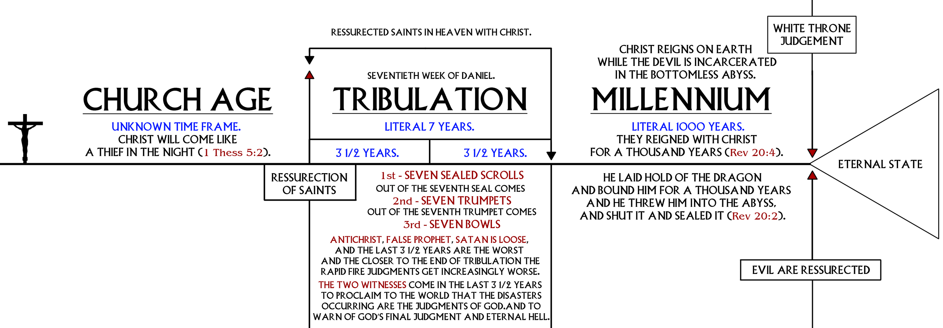

Slide 15
THE CONFUSION
REALIZED ESCHATOLOGY
PREMILLENNIALISM
IGNORANCE

Slide 16
IGNORANCE
Matthew 24:6-7 And you will hear of wars and rumors of wars. See that you are not troubled; for all these things must come to pass, but the end is not yet. ⁷ For nation will rise against nation, and kingdom against kingdom. And there will be famines, pestilences, and earthquakes in various places.

Slide 17
THE CONFUSION
THE COMPREHENSIVE CONTEXT

Slide 18
COMPREHENSIVE CONTEXT
Matthew 21-23 & 25

Slide 19
Matthew 21-23
God’s Coming Judgment Upon the Jews and Jerusalem for the Rejection of Jesus

Slide 20
Matthew 21
Triumphal Entry
Cleansing of the Temple

Slide 21
Matthew 21-22
Two Sons 21:28-32
Wicked Vine Dressers 21:33-44
Marriage Feast 22:1-14

Slide 22
Matthew 23
Stinging Rebuke of the Jewish Leaders for Their Hypocrisy

Slide 23
Matthew 23
Matthew 23:34 Therefore, indeed, I send you prophets, wise men, and scribes: some of them you will kill and crucify, and some of them you will scourge in your synagogues and persecute from city to city,

Slide 24
Matthew 23
Matthew 23:35-36 that on you may come all the righteous blood shed on the earth, from the blood of righteous Abel to the blood of Zechariah, son of Berechiah, whom you murdered between the temple and the altar. ³⁶ Assuredly, I say to you, all these things will come upon this generation.

Slide 25
Matthew 23
Matthew 23:37-38 "O Jerusalem, Jerusalem, the one who kills the prophets and stones those who are sent to her! How often I wanted to gather your children together, as a hen gathers her chicks under her wings, but you were not willing! ³⁸ See! Your house is left to you desolate;

Slide 26
Matthew 23
Matthew 23:39 for I say to you, you shall see Me no more till you say, 'Blessed is He who comes in the name of the LORD!' "

Slide 27
Matthew 23
Matthew 23:36 Assuredly, I say to you, all these things will come upon this generation.

Slide 28
COMPREHENSIVE CONTEXT
Matthew 21-23
God’s Coming Judgment Upon the Jews and Jerusalem for the Rejection of Jesus

Slide 29
Matthew 25
The Second Coming of Christ, the Final Judgment, and the End of the World

Slide 30
Matthew 25
Wise and Foolish Virgins
Talents
Sheep and Goats

Slide 31
THE CONFUSION
THE COMPREHENSIVE CONTEXT
THE CONSTRICTIVE CONTEXT

Slide 32
CONSTRICTIVE CONTEXT
Matthew 24:1-2 Then Jesus went out and departed from the temple, and His disciples came up to show Him the buildings of the temple. ² And Jesus said to them, "Do you not see all these things? Assuredly, I say to you, not one stone shall be left here upon another, that shall not be thrown down."

Slide 33
CONSTRICTIVE CONTEXT
Matthew 23:38 See! Your house is left to you desolate;

Slide 34
CONSTRICTIVE CONTEXT
Matthew 24:3 Now as He sat on the Mount of Olives, the disciples came to Him privately, saying, "Tell us, when will these things be? And what will be the sign of Your coming, and of the end of the age?"

Slide 35
CONSTRICTIVE CONTEXT
When shall these things be?
Verses 4-35

Slide 36
CONSTRICTIVE CONTEXT
When shall these things be?
What will be the sign of Your coming and the end of the age? Verses 36-25:46

Slide 37
Sign of Your Coming?
Matthew 24:36 "But of that day and hour no one knows, not even the angels of heaven, but My Father only.

Slide 38
Sign of Your Coming?
Matthew 23:36 Assuredly, I say to you, all these things will come upon this generation.

Slide 39
Sign of Your Coming?
Matthew 23:36 Assuredly, I say to you, all these things will come upon this generation.
Matthew 24:2 And Jesus said to them, "Do you not see all these things? Assuredly, I say to you, not one stone shall be left here upon another, that shall not be thrown down."

Slide 40
Sign of Your Coming?
Matthew 23:36 Assuredly, I say to you, all these things will come upon this generation.
Matthew 24:3 Now as He sat on the Mount of Olives, the disciples came to Him privately, saying, "Tell us, when will these things be? And what will be the sign of Your coming, and of the end of the age?"

Slide 41
Sign of Your Coming?
Matthew 23:36 Assuredly, I say to you, all these things will come upon this generation.
Matthew 24:6 And you will hear of wars and rumors of wars. See that you are not troubled; for all these things must come to pass, but the end is not yet.

Slide 42
Sign of Your Coming?
Matthew 23:36 Assuredly, I say to you, all these things will come upon this generation.
Matthew 24:8 All these are the beginning of sorrows.

Slide 43
Sign of Your Coming?
Matthew 23:36 Assuredly, I say to you, all these things will come upon this generation.
Matthew 24:34 Assuredly, I say to you, this generation will by no means pass away till all these things take place.

Slide 44
Sign of Your Coming?
Matthew 24:34 Assuredly, I say to you, this generation will by no means pass away till all these things take place. Matthew 24:36 "But of that day and hour no one knows, not even the angels of heaven, but My Father only.

Slide 45
COMPREHENSIVE CONTEXT
Ch. 21-23
God’s Coming Judgment Upon the Jews and Jerusalem for the Rejection of Jesus
Ch. 25
The Second Coming of Christ, the Final Judgment, and the End of the World

Slide 46
CONSTRICTIVE CONTEXT
Matthew 24:4 - 35
Destruction of Jerusalem
Matthew 24:36 - 51
The Second Coming of Christ, the Final Judgment, and the End of the World

