Slide 1
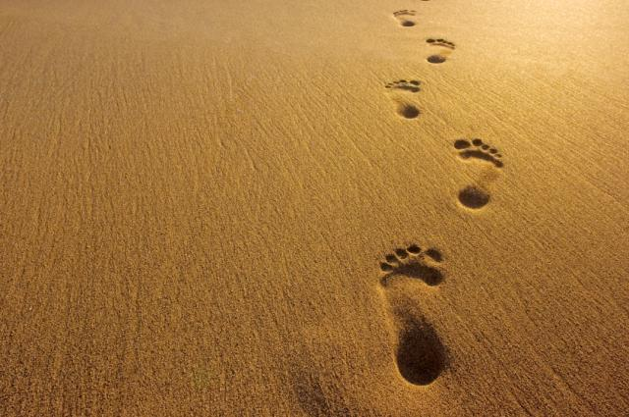
Farther in His Steps

Slide 2
I Peter 3:21
“For to this you have been called, because Christ also suffered for you, leaving you an example, that you should follow in His steps.” (RSV)

Slide 3
I Peter 3:21
“For to this you have been called, because Christ also suffered for you, leaving you an example, that you should follow in His steps.” (RSV)

Slide 4
I Peter 3:22
"Who committed no sin, Nor was deceit found in His mouth"

Slide 5
I Peter 3:23
who, when He was reviled, did not revile in return; when He suffered, He did not threaten, but committed Himself to Him who judges righteously;

Slide 6
I Peter 3:24
who Himself bore our sins in His own body on the tree, that we, having died to sins, might live for righteousness--by whose stripes you were healed.

Slide 7
The God of the Towel
The God who loves humans
The God who died
The God who majors in
forgiveness
The God who loves the weak
The God who wore a towel…

Slide 8
Romans 5:8
“But God demonstrates His own love toward us, in that while we were still sinners, Christ died for us.”

Slide 9
Worship Service
Work
A little “Me” time

Slide 10
McGuiggan’s Suggestions
Let’s get around to serving…
when we can.
where we can.
how we can.
who we can.

