Slide 1
Luke 23:33
Preaching Christ and Him Crucified!
1 Corinthians 1:18; 2:2

Slide 2
PLACE
Golgotha is the Aramaic name (John 19:16-18; Matthew 27:32-34; Mark 15:21-22).
Calvary is the Latin name (Luke 23:33).
Located outside City Walls of Jerusalem (Heb. 13:12).
Location: “The Place of the Skull.” WHY?

Slide 3
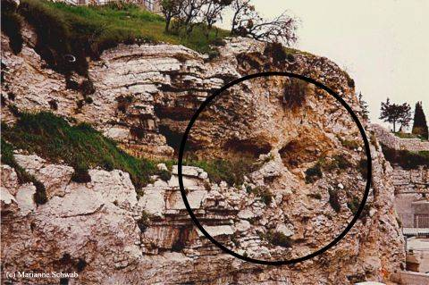
The Place Called Calvary/Golgotha!
Resembles A Skull!
Adam’s Scull found there!
Skulls scattered – execution!
Terrible place, terrible things!

Slide 4
PEOPLE
Luke 23:1-2
Then the whole multitude of them arose and led Him to Pilate. And they began to accuse Him, saying, “We found this fellow perverting the nation, and forbidding to pay taxes to Caesar, saying that He Himself is Christ, a King.”
Jesus was a Revolutionary!
Jesus incited people not to pay taxes!
Jesus claimed to be a King!

Slide 5
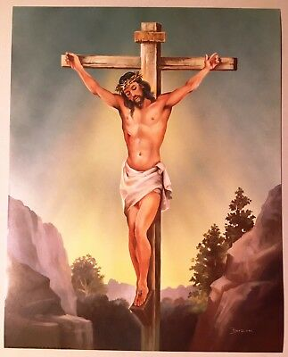
Who crucified the Lord Jesus Christ?
Romans (Matt. 27:27-37).
Jewish Leaders (Matt. 26:3-4).
Jews (Luke 23:21; Acts 2:22-23).
God (2 Cor. 5:21; Isa. 53:10).
Roman Soldiers (Matt. 27:35-37; Revelation 1:7).
I am responsible (Rom 5:8; 6:23).
Thank You God (2 Cor. 9:15).

Slide 6
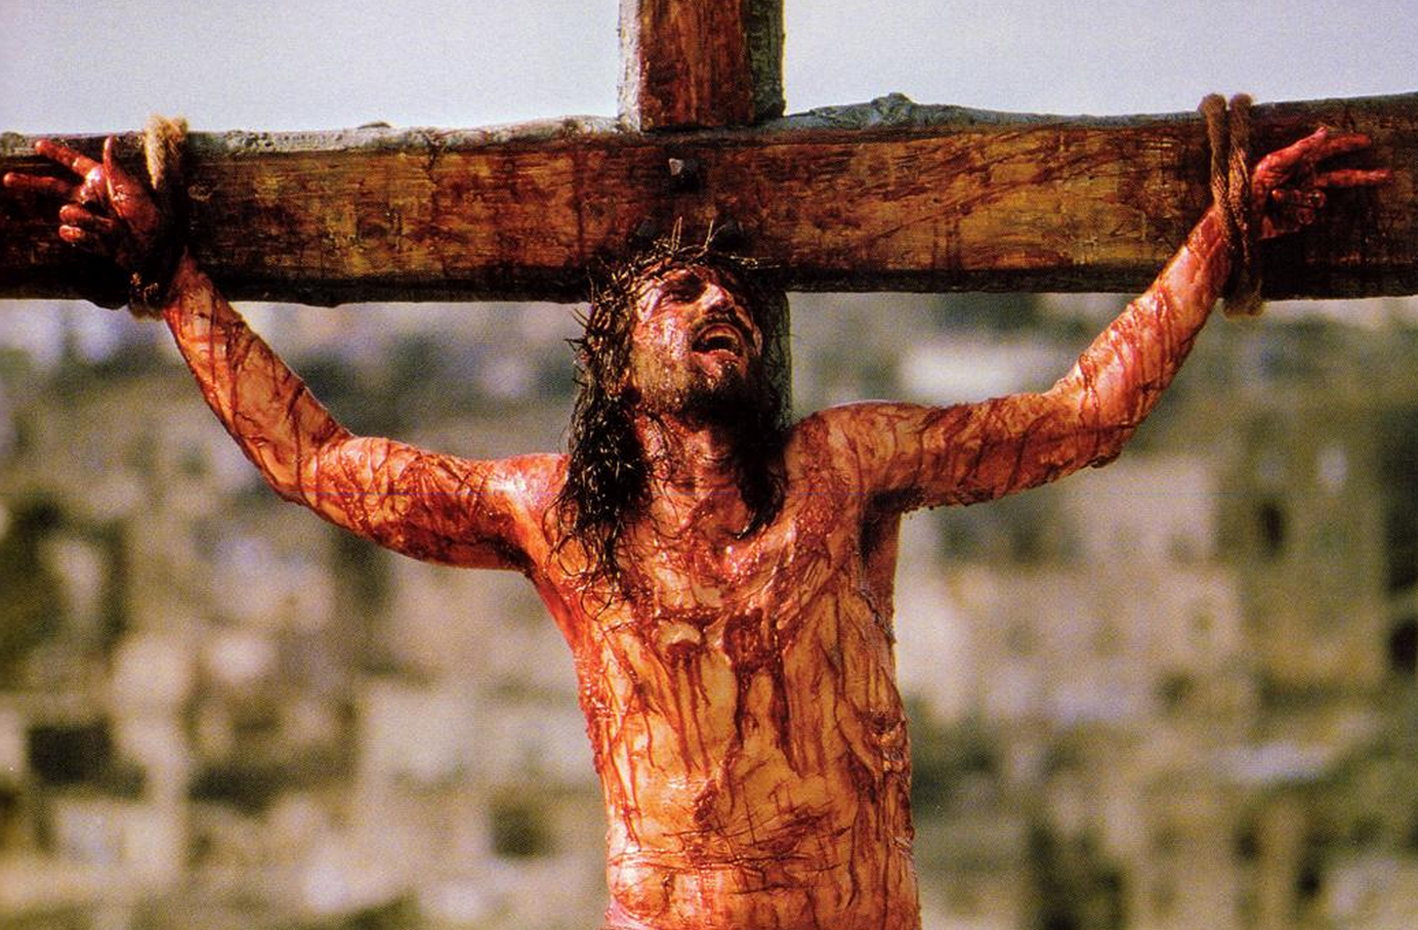
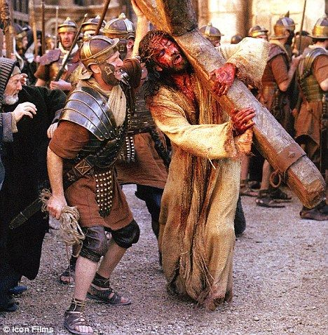
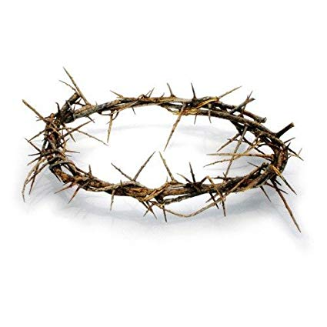
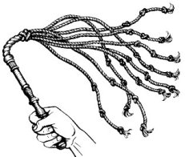
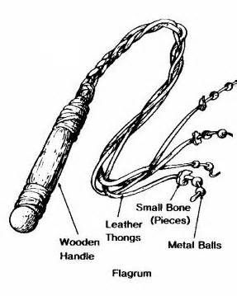
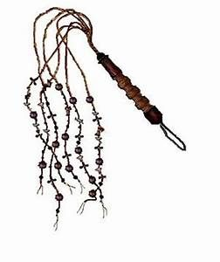
PENALTY
Crucifixion: invented by the Persians, perfected by the Romans!
Began with a scourging or flogging of the victim’s back: flagellum. John 19:1
Jesus carried the Cross – weighing 100-300 lbs.
Jesus hung on the Cross for 6 hours (9am-3pm).

Slide 7
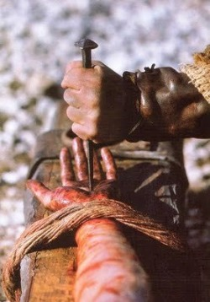
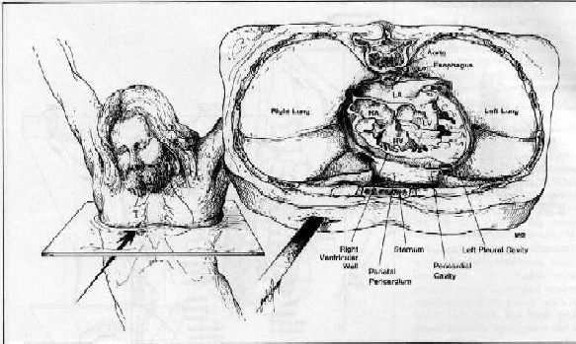
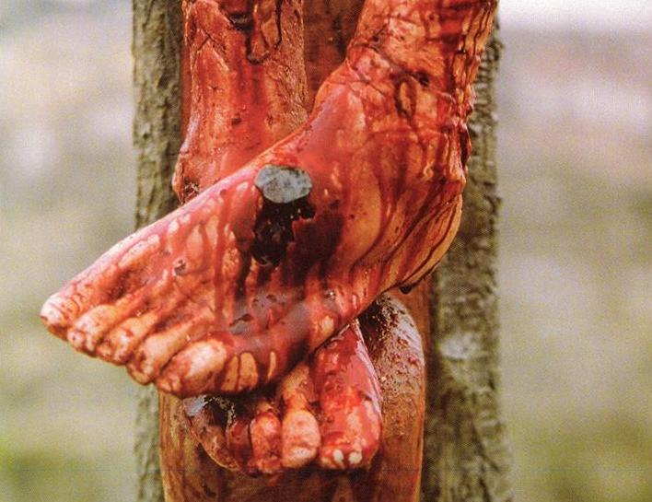
Crucifixion – horrible way to die!
1 Corinthians 5:7
1 Peter 2:24; 3:18
Phil. 2:8; Gal. 2:20

Slide 8
PERSON
Christ, the Son of God!
He had no sin!
He knew no sin!
He did not sin!
1 Peter 1:18-19
1 Peter 2:22
2 Corinthians 5:21
Hebrews 4:15

Slide 9
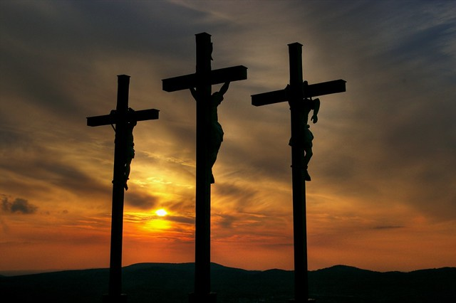
Three Crosses of Calvary!
REBELLION - Luke 23:40-43!
REPENTANCE - Luke 23:39!
REDEMPTION - 1 Peter 2:22, 24!

