Slide 1
Go and do in the community!
“…As Jesus went, the people pressed around him.” Luke 8:42

Slide 2
Has the great commission ever seemed or felt stressful to you? A bit overwhelming? Where do I start? How do I “go?” Don’t worry. You’re not alone.

Slide 3
Go into all the world!?!?
The World!

Slide 4
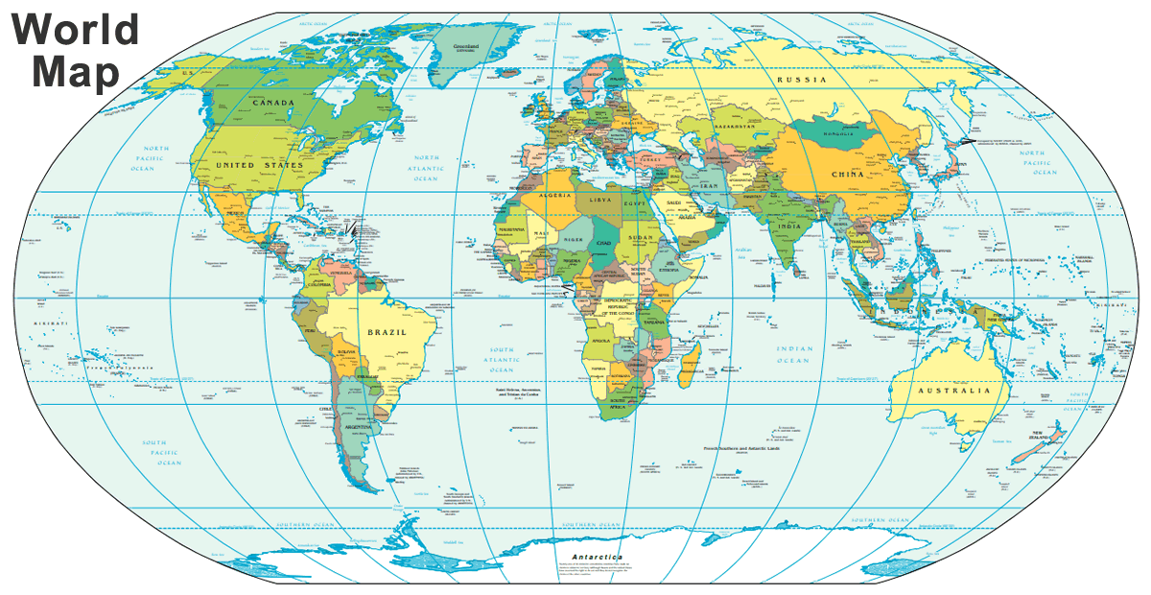

Slide 5
Go into all the world!?!?
The World!
North America

Slide 6
Go into all the world!?!?
The World!
North America
South East

Slide 7
Go into all the world!?!?
The World!
North America
South East
Alabama

Slide 8
Go into all the world!?!?
The World!
North America
South East
Decatur

Slide 9
Jesus cared for his community.
Your community is composed of the people around you & the circle of influence you are able to work in! Everyone’s circle is different
Jesus spent time with people. Over 20 times in the gospel accounts of Jesus’ life we read the phrase “great crowd.”
You can’t be a Christian and withdraw yourself from human contact. Romans 12:2

Slide 10
Jesus cared for his community.
Jesus comforted the bereaved (John 11), the spiritually sick (John 8), and the physically sick (mark 7).
Jesus fed people when they were hungry. Jesus was a man of action. Mark 6:34
Jesus noticed them & expected his followers to notice people. Matthew 25:31-46

Slide 11
Jesus helped unconditionally
Even when there was little/no thanks for what he did. Luke 17:11-19
Even when he might have been taken advantage of. Luke 8:40-56
Even when there were people just trying to “get something.” Judas. John 12:1-8; Luke 7:36

Slide 12
Jesus helped those who were different from him.
He helped the leper who was “a foreigner.” Luke 17
He interacted with and changed the life of the woman at the well. John 4:7-27; 39-42
He gave the ultimate example of who your “neighbor” is in a controversial story. Luke 10:25
It’s ok to help those who are different from you! If everyone were just like you or me, the church would be boring & ineffective place. 1 Cor 12:12-31

Slide 13
His disciples followed his lead
Peter and John meet a man on Solomon’s portico. Before they ever began to teach this man about Jesus and Christianity, they met his physical needs first. Acts 3: 1-10 (11-26).
Acts 6:1-7, while this passage may highlight this work being done within a group of Christians, the example looking for people who needed help can guide us in our efforts to serve in our community.
When we see a need, do something about it.

Slide 14
Practical applications
Find some common ground. Paul did this. Acts 17
Are you a sports guy? Volunteer or mentor a ball team…volunteer to lead a prayer and say an encouraging verse before or after the game.
Love to read? Find a school and tell them you’d love to help students read.
Are you a great organizer? Throw an even that the church supports to get kids and parents involved.

Slide 15
Practical applications
Volunteer at a boys and girls club or community sports organization.
Do you enjoy art? Have an art camp. Invite some kids to help them express their creativity.
Mentor a single mother or father. Show them what Christian parenting looks like.
When Jesus had compassion, he did something. He didn’t just feel sorry for them.
Matthew 5:14-16; Philippians 2:14,15; Micah 6:6-8

