Slide 1
Mental Health and Christianity by Tim A. Thrasher, LMSW

Slide 2
Mental Health and Christianity
CRAZY, COMMITTED, OR NEED TO BE COMMITTED?

Slide 3
Mental Health and Christianity-Objectives
To assist in helping each of us realize that Mental Health is important.
To help us identify that all have and will face challenges and difficulties that can cause poor mental health which can lead to mental illness.
To provide Biblical examples of men with challenges and difficulties that caused mental health concerns in their lives.
To look at ways to cope with difficulties and challenges through the support of the Lord and His Church without judgment or stigma compared with defense mechanisms that we utilize on a daily basis.

Slide 4
Mental Health and Christianity
Ways to get help?
Talk to your doctor
Connect with other individuals or family
Educate yourself on your diagnosed mental illness
Talk to the great physician
Find solace in God’s word
Connect with supportive members of the Church

Slide 5
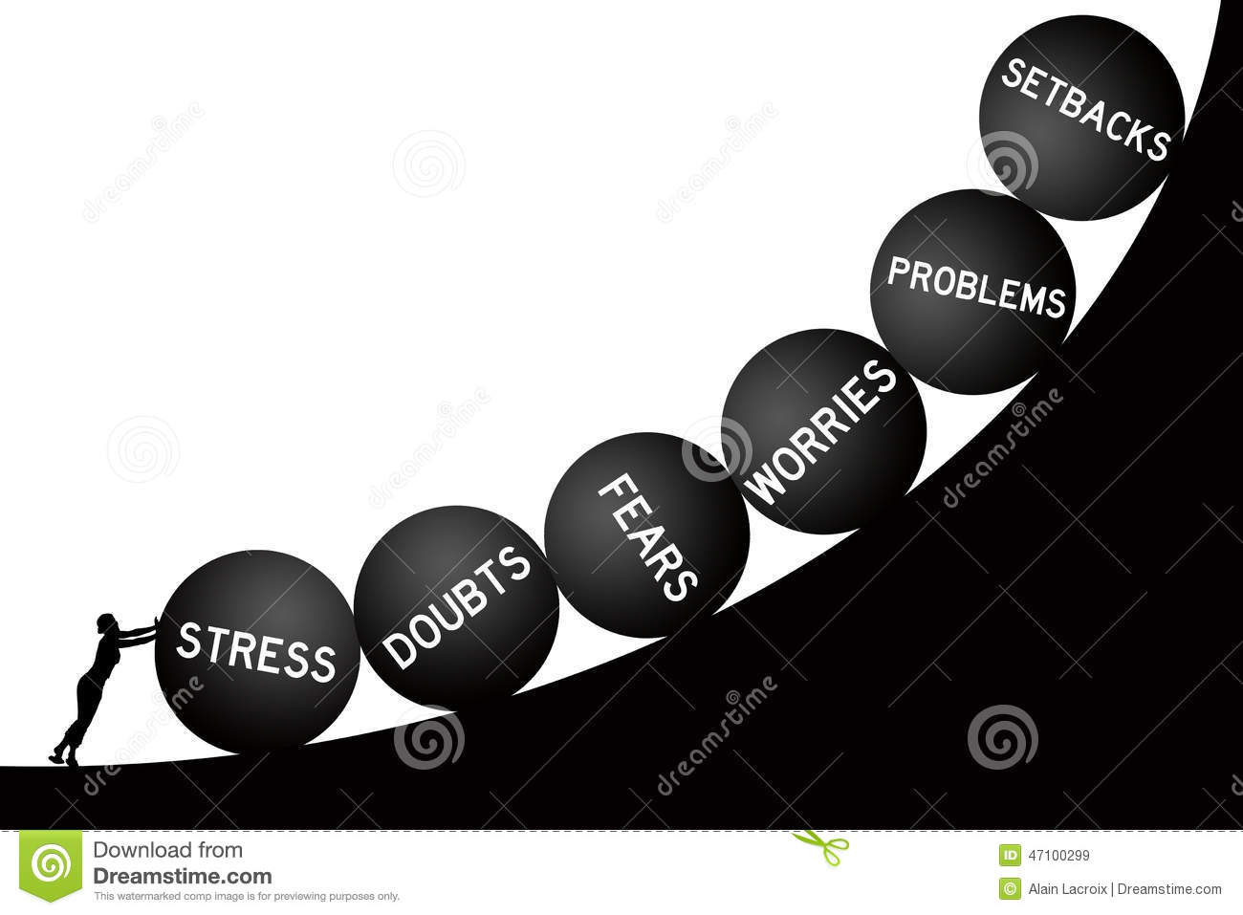
Mental Health and Christianity
In your mind circle the things below you and/or someone you know has struggled through or with:
Finances Autism
Illness Suicide
Death Divorce
Substances/Alcohol Unemployment
Homelessness Hunger
Sexuality of yourself, children or friends

Slide 6
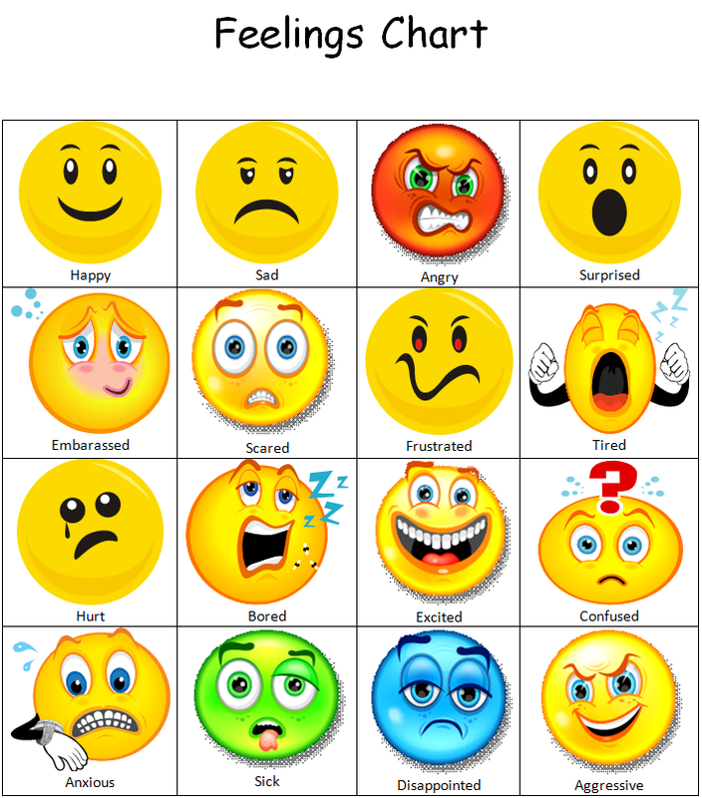
Mental Health and Christianity
How did you or the person close to you feel?
Overwhelmed? Hopeless?
Limited knowledge of mental/physical illness
Guilty? Betrayed?
Anxious? Sad?
Disgusted? Angry?
Unfulfilled? Left needing more?

Slide 7
Mental Health and Christianity
DSM V-Diagnostic and Statistical Manual of Mental Disorders
For example: Major Depressive Disorder requires 2 weeks of depressed mood or loss of interest or pleasure in nearly all activities plus an additional 4 symptoms including changes in weight or appetite, sleep and psychomotor activity; decreased energy; feelings of worthlessness or guilt; difficulty thinking, concentrating or making decisions; or recurrent thoughts of death or suicidal ideation or suicide plans or attempts. All of these must persist most of the day, every day for 2 weeks straight.
As opposed to a difficult decision regarding finances, children, etc. that causes you to lose sleep, appetite, energy and makes you irritable.

Slide 8
Mental Health and Christianity
Autism Spectrum Disorder-involves persistent deficits in social communication and interactions across multiple contexts, made known by the following: Deficits in social-emotional reciprocity, deficits in non-verbal communication behaviors, deficits in relationship development, maintenance, and understanding.
As opposed to introverted behavior which allows communication only in certain settings

Slide 9
Mental Health and Christianity
Can mental health difficulties become mental illness?
Yes challenges can cause mental illness based on an individuals:
Genetic make up-brain chemistry
Life experiences-multiple traumatic events
Spiritual inward strength-no ours to determine or judge if adequate
Ability to cope with challenging and difficult situations
But with God, illness and challenges can be addressed…

Slide 10
Mental Health and Christianity
Wherefore gird up the loins of your mind, be sober, and hope to the end for the grace that is to be brought unto you at the revelation of Jesus Christ
I Peter 1:13

Slide 11
Mental Health and Christianity
Finally, be ye all of one mind, having compassion one of another, love as brethren, be pitiful, be courteous: Not rendering evil for evil, or railing for railing: but contrariwise blessing; knowing that ye are thereunto called, that ye should inherit a blessing.
I Peter 3:7-9

Slide 12
Mental Health and Christianity
Broken Shells represent people who are hurting… People who have lost loved ones… People who are frightened or alone… People with unfulfilled dreams. These broken shells had to fight so hard to keep from being totally crushed by the pounding surf…Just as I have had to…

Slide 13
Mental Health and Christianity
People today have the same feelings, thoughts, emotions, temptations, and stresses that people in the Bible displayed.

Slide 14
Mental Health and Christianity
King Saul
Narcissistic personality-head and shoulders above, bothered about killing his 1000’s as opposed to David’s 10,000’s, set up altar to himself
Coping by illegally-offering unauthorized burnt sacrifices-I Samuel 13: 7-14
Coping by changing God’s rules-kept the best of the Amalekite spoils when told to utterly destroy-I Samuel 15: 1-26
David’s rise in power lead Saul to fits of rage and revenge-to the point of obsessing over how to kill David-I Samuel 18
The death of Samuel caused tremendous grief-I Samuel 28
Didn’t call for divine help but called for counsel from Samuel by
asking the witch of Endor to conjure up the prophet-I Samuel 28: 13-14

Slide 15
Mental Health and Christianity
Moses
Hid three months and placed him in the Nile to avoid the death of a Hebrew male newborn-treacherous waters/wildlife-traumatic event-Exodus 2:1-3
Discovered by Pharoah’s daughter-unfamiliar surroundings and face-Exodus 2:4-6
Nursed by his mother-then given back to Pharoahs daughter-attachment disorder-Exodus 2:9
Raised in an Egyptian home learning his Hebrew roots from his sister and Egyptian customs from Pharoah’s house-Exodus 2:10
Moses protected a Hebrew by killing an abusive Egyptian-witnessed domestic violence-became violent and vengeful
Moses feared after realizing others had witnessed the murder-anxiety
Pharoah sought to slay Moses and he fled to the land of Midian.

Slide 16
Mental Health and Christianity
Jonah
Didn’t face his fears of going into Nineveh and preaching against their wickedness
Coped by going away from the Lord
Jonah was fast asleep during a terrible storm-possible depression from not following God’s instructions?
Rejected by those on the boat and cast into the sea after responding that he feared the Lord that made the sea and dry land. He also informed them that he had fled from the Lord’s presence.
Jonah was swallowed by a great fish and stayed in its belly three days and nights. Jonah stated, “out of the belly of hell cried I” Jonah 2:2

Slide 17
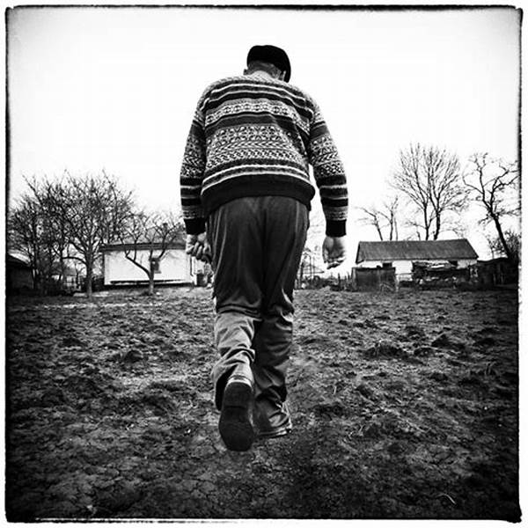
Mental Health and Christianity
How do you cope with challenges and difficulties in your life?
Saul-turn to the occult
Moses-turn to violence-murder
Jonah-turn completely away from
the important
Have you turned your back on God/others?

Slide 18
Mental Health and Christianity
How do normally defend against these challenges and difficulties?

Slide 19
Mental Health and Christianity
Common Defense Mechanisms:
Denial-refusal to accept reality or fact, acting as if a painful event thought or feeling did not exist-Example: Alcoholic will deny having a drinking problem

Slide 20
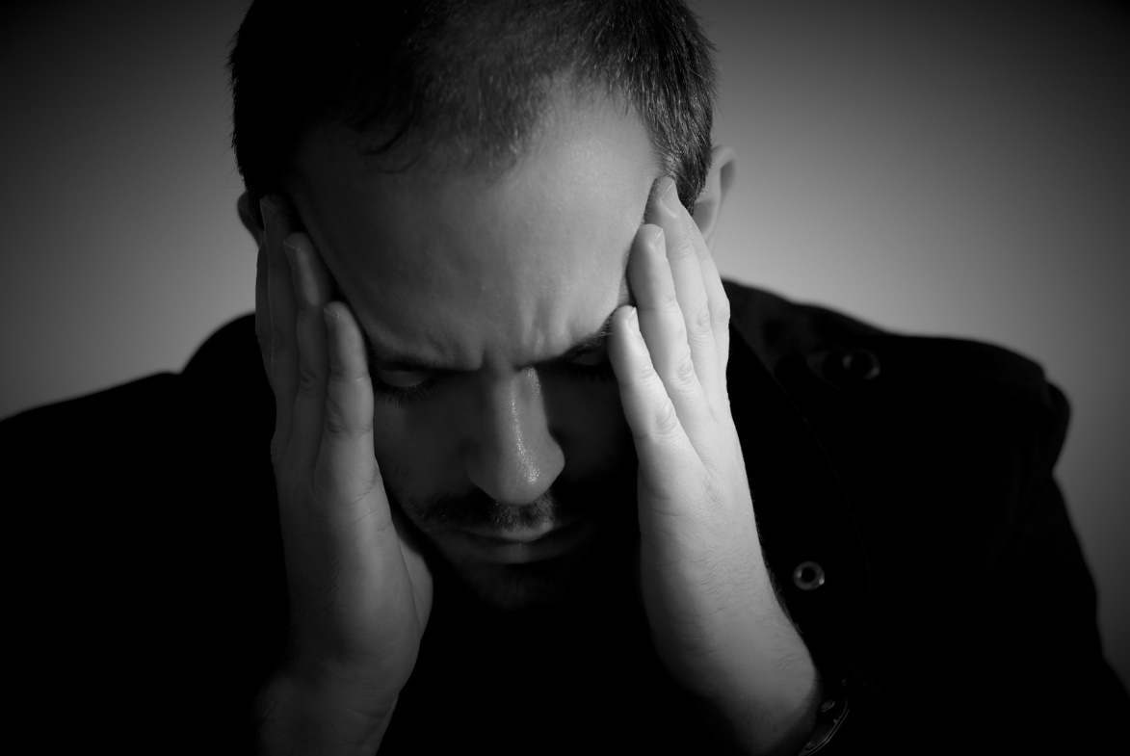
Mental Health and Christianity
Common Defense Mechanisms:
Regression-reversion to an earlier stage of development in the face of unacceptable thoughts or impulses-Example: An adult may regress under stress to refusing to leave their bed and not engaging in normal activities

Slide 21
Mental Health and Christianity
Common Defense Mechanisms:
Acting Out-performing an extreme behavior in order to express thoughts or feelings the person feels incapable of otherwise expressing-Example: Children’s temper tantrum or punching a hole through a wall when one doesn’t get their way or becomes angry

Slide 22
Mental Health and Christianity
Common Defense Mechanisms:
Dissociation-When a person loses track of time and/or person, and instead finds another representation of their self in order to continue in the moment-Example: Many children abused dissociate from the traumatic event

Slide 23
Mental Health and Christianity
Common Defense Mechanisms:
Compartmentalization-a form of dissociation, where parts of oneself are separated from awareness of other parts and behaving as if one had separate sets of values-Example: An honest person who cheats on an exam or income tax return

Slide 24
Mental Health and Christianity
Common Defense Mechanisms:
Projection-attributing a person’s undesired thoughts, feelings or impulses onto another person who does not have those thoughts, feelings or impulses-Example: A spouse who is angry at their husband/wife for not listening, when in fact the angry spouse does not listen.

Slide 25
Mental Health and Christianity
Common Defense Mechanisms:
Reaction Formation-converting unwanted or dangerous thoughts, feelings or impulses into their opposites-Example: One who is angry with their boss and would like to quit their job but continues to be overly kind and generous toward their boss; expressing a desire to keep working there forever.

Slide 26
Mental Health and Christianity
Common Defense Mechanisms:
Repression-unconscious blocking of unacceptable thoughts, feelings and impulses-Example: Sexual abuse is sometimes repressed by victims so as not to relive the experience

Slide 27
Mental Health and Christianity
Common Defense Mechanisms:
Rationalization-Putting something into a different light or offering a different explanation for one’s perceptions or behaviors in the face of a changing reality-Example: Perceiving your grandchild being hit by a stranger at the park and rationalizing it is ok to retaliate toward the stranger, when in reality the stranger was brushing off fire ants from the child after he stepped into the mound.

Slide 28
Mental Health and Christianity
Common Defense Mechanisms:
Undoing-taking back an unconscious behavior or thought that is unacceptable or hurtful-Example: You spend the next hour praising the beauty and intellect or your spouse after realizing you insulted them unintentionally.

Slide 29
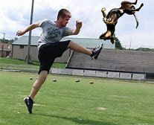
Mental Health and Christianity
Common Defense Mechanisms:
Displacement-redirecting of thoughts, feelings and impulses directed at one person or object, but taken out upon another person or object-Example: Individual kicks dog or assaults another individual instead of being angry at the boss and getting fired.

Slide 30
Mental Health and Christianity
Common Defense Mechanisms:
Intellectualization-overemphasis of thinking when confronted with an unacceptable impulse, situation or behavior without employing any emotions to help mediate such-Example: Someone with a recent terminal diagnosis instead of expressing sadness or grief focuses instead on the details of all possible medical procedures

Slide 31
Mental Health and Christianity
“The answer to dealing with difficulties and problems is depending on the grace and mercy of God, changing what we can and, with God’s help, accepting what we cannot change. Jesus, our perfect example, teaches us how to accept the will of God when it may not be our own desire or will and how to accept the circumstances that come our way that we cannot change.”
The Christian and Good Mental Health-Larry Swaim, Ph.D.

Slide 32
Mental Health and Christianity
I can do all things through him who strengthens me.
Philippians 4:13
And the peace of God, which passeth all understanding, shall keep your hearts and minds through Christ Jesus. Finally, brethren, whatsoever things are true, whatsoever things are honest, whatsoever things are just, whatsoever things are pure, whatsoever things are lovely, whatsoever things are of good report; if there be any virtue, and if there be any praise, think on these things.
Philippians 4: 7-8

Slide 33
Mental Health and Christianity
For as a man thinketh in his heart, so is he.
Proverbs 23:7
Be anxious for nothing, but in everything by prayer and supplication, with thanksgiving, let your requests be made known to God;
Philippians 4:6

Slide 34
Mental Health and Christianity
For those who live according to the flesh set their minds on the things of the flesh, but those who live according to the Spirit, the things of the Spirit. For to be carnally minded is death, but to be spiritually minded is life and peace.
Romans 8:5-6

Slide 35
Mental Health and Christianity
Who has put wisdom in the mind? Or who has given understanding to the heart?
Job 38:36
I am forgotten as a dead man out of mind: I am like a broken vessel.
Psalms 31:12

Slide 36
Mental Health and Christianity-“For as a man thinks in his heart (mind), so is he.” Proverbs 23:7
How is your brain wired?
“I beseech you therefore, brethren, by the mercies
of God, that you present your bodies a living sacrifice,
holy, acceptable to God, which is your reasonable
service. And do not be conformed to this world, but
be transformed by the renewing of your mind, that
you may prove what is that good and acceptable and
perfect will of God.” Romans 12:1-2

Slide 37
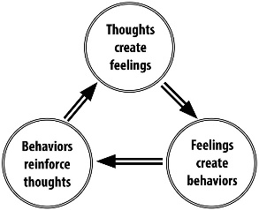
Mental Health and Christianity
“For as a man thinks in his heart (mind), so is he.” Proverbs 23:7

Slide 38
Mental Health and Christianity

Slide 39
Mental Health and Christianity

Slide 40
Mental Health and Christianity

Slide 41
Mental Health and Christianity
The brain is the most important organ of the human body, responsible for regulating involuntary bodily functions, muscle movement, consciousness, memory and thought. It uses the most energy of any organ, and the body could not function without the brain. Science has yet to fully understand how the brain works.

Slide 42
Mental Health and Christianity
The part of the brain responsible for involuntary bodily functions is the medulla oblongata, located at the base of the skull near the brain stem. It controls the heartbeat, breathing, digestion and other functions without conscious thought.

Slide 43
Mental Health and Christianity
The cerebellum is responsible for muscle movement, balance and posture. It also is responsible for relaying procedural memory, also known as muscle memory. This includes learned skills, such as driving, riding a bicycle or shooting a basketball.

Slide 44
Mental Health and Christianity
The cerebrum is responsible for processing sensory input, dealing with cognitive function and emotions as well as handling short- and long-term memory. It also controls logic and problem-solving.

Slide 45
Mental Health and Christianity
It is a common myth that people only use 10 percent of available brain power. Actually, people use much more of their brains, but not all at once. The majority of brain activity consists of background processes that most people don't think about. With such an energy-hungry organ, it makes little sense to have so little of it actually used. Most of the brain's systems work together constantly to process information about the world and react accordingly.

Slide 46
Mental Health and Christianity
The function of grey matter is to route sensory or motor stimulus to interneurons of the CNS in order to create a response to the stimulus through chemical synapse activity. Grey matter structures (cortex, deep nuclei) process information originating in the sensory organs or in other gray matter regions. Grey matter continues to be produced throughout our lifetime if utilized.

Slide 47
Mental Health and Christianity
Complex brain structure is designed by God
Areas where we are most vulnerable are positioned for protection by God. Brain stem is at lower back part of brain and along with the Medulla Oblongata protects the heart beat, digestion and breathing.

Slide 48
Mental Health and Christianity
Brain halves have distinct traits which work together based on our building bridges within the brain. As mother’s rock their children the brains hemispheres are joined with synapses.
Medication can be used to alter brain function when the part of the brain is not working effectively due to mental illness.
Environment has an intense effect on our brain and its mental health.

Slide 49
Mental Health and Christianity
The overall content of the mind is the pattern. When you perceive something, the mind matches it to a pattern and then uses that pattern to bring meaning to awareness. (this is perception)
Vincent Guidry

Slide 50
Mental Health and Christianity
What should our pattern be as Christians? I Timothy 1:16-”Jesus Christ might show all longsuffering, as a pattern to those who are going to believe on Him for everlasting life.” 2 Timothy 1:13-”Hold fast the pattern of sound words” Titus 2:7-”See that you make all things according to the pattern shown you on the mountain.”

Slide 51
Mental Health and Christianity
The patterns themselves are the domains of intellect, wisdom, ego and identity. Each of these functions can be ‘stacked’ on top of the lower ones. Wisdom is stacked on top of intellect, ego on top of that, identity on top of the whole lot. The reason for that order is because as you gather more and more of one of them, the next step becomes clearer.
Vincent Guidry

Slide 52
Mental Health and Christianity
“The mind builds on the pattern of Christ as he grew in wisdom, stature, and favor with God and man.” Luke 2:52

Slide 53
Mental Health and Christianity
The more intellectual knowledge you gain about a thing, the more the transcendent understandings of those things stand out. When you find transcendent understanding, you can apply it to other things that aren’t the things you gleaned them from. This is wisdom.
Vincent Guidry

Slide 54
Mental Health and Christianity
“Therefore settle it in your hearts not to meditate beforehand on what you will answer; for I will give you a mouth and wisdom which all your adversaries will not be able to contradict or resist.”
Luke 21: 14-15
“Oh, the depth of the riches both of the wisdom and knowledge of God! How unsearchable are His judgments and His ways past finding out!”
Romans 11:33

Slide 55
Mental Health and Christianity
When you gather enough wisdom, the wisdom eventually collects into a big blob and makes it hard to gather more. This is ego. You have to lessen the ego in order to collect more wisdom. The technique of lessening ego is usually called surrender. Once you surrender ego, your identity becomes more clear.
Everything in mind can be fit along the continuum from intellect to identity.
Vincent Guidry

Slide 56
Mental Health and Christianity
I surrender all, all to thee my precious Savior, I surrender all.
“And they straightway left their nets, and followed him.”
Matthew 14: 20

