Slide 1
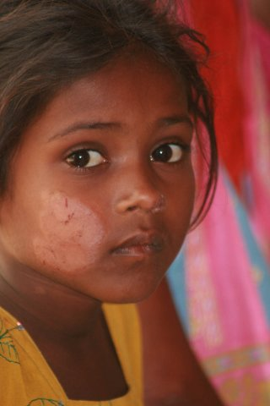
10 LEPERS
Luke 17:11-19

Slide 2

10 LEPERS
On the way to Jerusalem he was passing along between Samaria and Galilee. And as he entered a village, he was met by ten lepers, who stood at a distance and lifted up their voices, saying, “Jesus, Master, have mercy on us.” When he saw them he said to them, “Go and show yourselves to the priests.” And as they went they were cleansed. Then one of them, when he saw that he was healed, turned back, praising God with a loud voice; and he fell on his face at Jesus' feet, giving him thanks. Now he was a Samaritan. Then Jesus answered, “Were not ten cleansed? Where are the nine? Was no one found to return and give praise to God except this foreigner?” And he said to him, “Rise and go your way; your faith has made you well.”

Slide 3

10 LEPERS
Let’s explore what it was like to be a leper.
  Dreaded disease- Lev. 13
  Disfiguring disease- Lev. 13:1-44
  Distancing disease- Lev. 13:45-46
What we know about these lepers:
  They knew about Jesus.
  They knew about his power.

Slide 4
10 LEPERS
What we know about these lepers (cont.):
  They acted with faith. - Heb. 11:6
  They weren’t even healed when they initially went to go see the priest.
  Why are we waiting to see what is going to happen. Why don’t we trust enough to go and do and then observe the power of God at work.
  Notice John 20:29

Slide 5
10 LEPERS
This one leper was a SAMARITAN!
  Very disliked person.
  For political and religious reasons.
  The only one to give thanks.
  This was not a parable but a real story.

Slide 6
10 LEPERS
This leper was THANKFUL.
He teaches us:
  When to be thankful- Luke 17:11-15
  How to be thankful - Luke 17:16
    Luke 18:14
    Micah 6:8
  Who should be thankful- Luke 17:17-19

