Slide 1
Get Right Church
Numbers 13:25-33

Slide 2
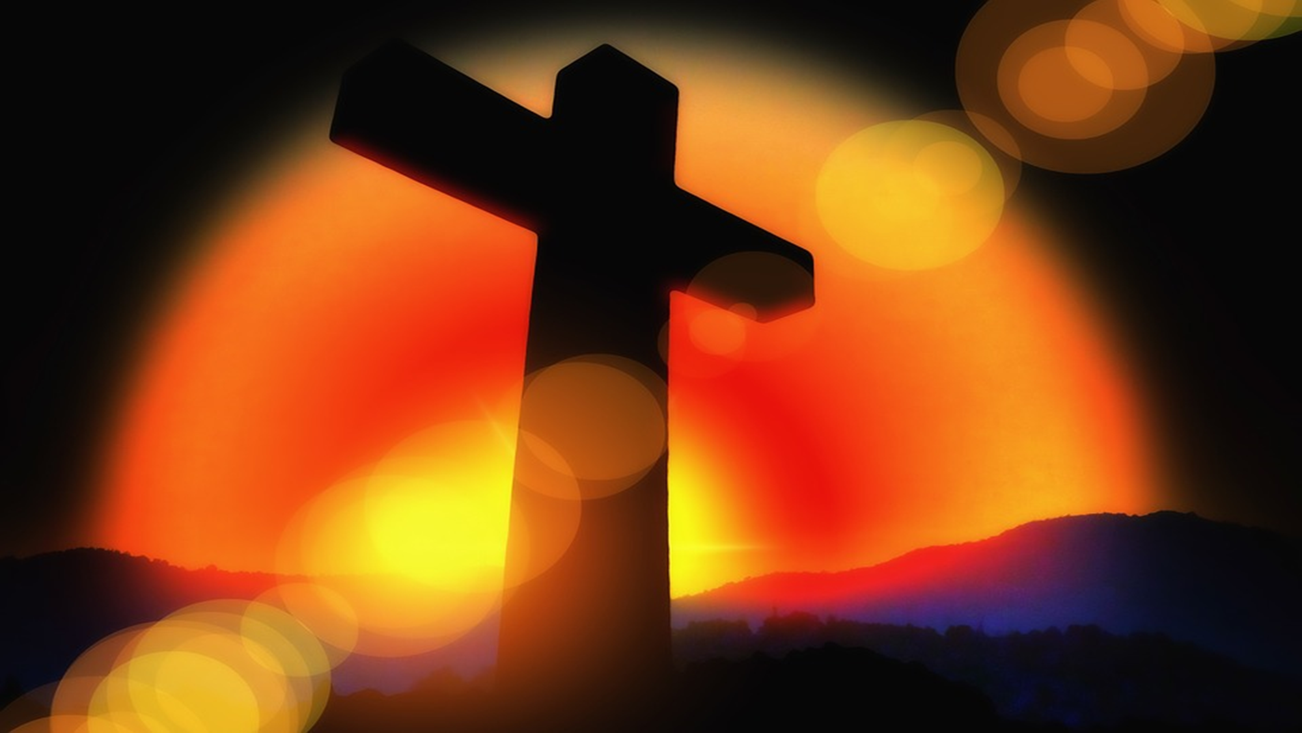
Get Right Church
Joshua and Caleb believed that God could do great things through His people.
Lots of excuses:
Too Big
Too Powerful
Too Entrenched
Have we ever heard this before?

Slide 3
Get Right Church
The media is too humanistic.
The entertainment industry is too inappropriate.
The behaviors of society are too immoral.
The Bible is too irrelevant.
God is too forgotten.
The family is too fractured.
People are too selfish
AMERICA IS A LOST CAUSE!!!

Slide 4
Get Right Church
Can God do great things through the church?
“The church of Christ is a ‘sleeping giant.’
We have more resources.
We have more people.
We have more facilities.
We have the truth.
We need to get the right spirit.

Slide 5
Get Right Church
Christianity does not meet its maturity within these walls.
The answer is a resounding NO!!!!!
Assembly participation is a good developmental program.
When does this start translating into practice and production? When do we move from being hearers to the doers?
We need people with the heart to do what God wants

