Slide 1
I AM THE DOOR
John 10

Slide 2
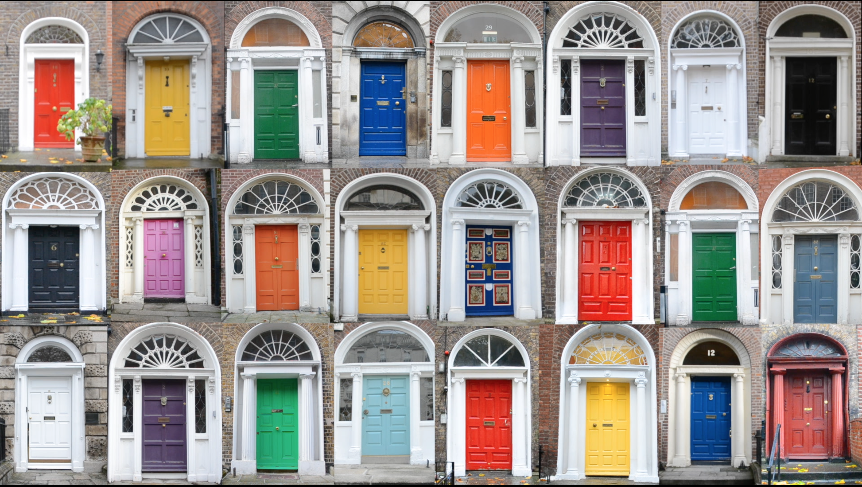

Slide 3
John 10:1-10
1 “Truly, truly, I say to you, he who does not enter by the door into the fold of the sheep, but climbs up some other way, he is a thief and a robber. 2 But he who enters by the door is a shepherd of the sheep. 3 To him the doorkeeper opens, and the sheep hear his voice, and he calls his own sheep by name and leads them out. 4 When he puts forth all his own, he goes ahead of them, and the sheep follow him because they know his voice. 5 A stranger they simply will not follow, but will flee from him, because they do not know the voice of strangers.”

Slide 4
John 10:1-10
6 This figure of speech Jesus spoke to them, but they did not understand what those things were which He had been saying to them. 7 So Jesus said to them again, “Truly, truly, I say to you, I am the door of the sheep. 8 All who came before Me are thieves and robbers, but the sheep did not hear them. 9 I am the door; if anyone enters through Me, he will be saved, and will go in and out and find pasture. 10 The thief comes only to steal and kill and destroy; I came that they may have life, and have it abundantly.

Slide 6
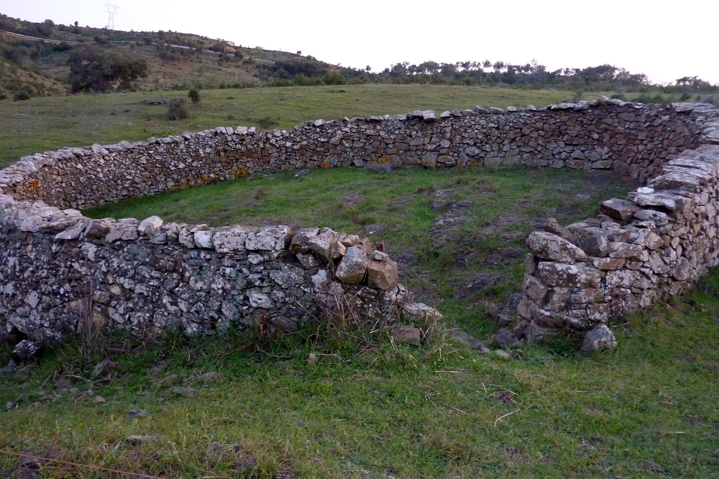

Slide 7
Isaiah 40:11
Jesus is the door to the church
Like a shepherd He will tend His flock, In His arm He will gather the lambs and carry them in His bosom

Slide 8
Acts 2:41
Jesus is the door to the church
Those who accepted his message were baptized, and about three thousand were added to their number that day.
Acts 2:47
And the Lord added to their number daily those who were being saved.

Slide 9
John 10:5
A stranger they simply will not follow, but will flee from him
John 10:8
All who came before Me are thieves and robbers, but the sheep did not hear them.

Slide 10
Acts 4:12
Jesus is the door to salvation
And there is salvation in no one else, for there is no other name under heaven given among men by which we must be saved.

Slide 11
John 14:6
Jesus is the door to god
I am the way and the truth and the life. No one comes to the Father except through me.

Slide 12
Hebrews 10:19-20
Jesus is the door to the living way
we have confidence to enter the Most Holy Place by the blood of Jesus, 20 by a new and living way opened for us through the curtain, that is, his body.

Slide 13
Isaiah 59:2
Sin separates
But your iniquities have separated you from your God; your sins have hidden his face from you, so that he will not hear.

Slide 14
How did the children
of Israel get to god?

Slide 15
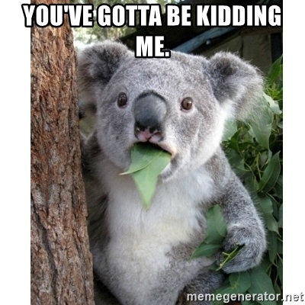
I need 11 volunteers
I’ll call you up 1 at a time
Whoever comes up first has to stand the longest
Whoever goes towards the end has a 50/50 chance of being Holy

Slide 16
ISRAEL
?
?
?
?
?
?
?
GOD

Slide 17
ISRAEL
?
Priests
?
?
?
?
?
?

Slide 18
Priests
Levites
Robes
Sacrifices

Slide 19
ISRAEL
Sacrifices
Priests
?
?
?
?
?
?

Slide 20
Sacrifices
Burnt
Grain
Fellowship
Sin
Guilt

Slide 21
ISRAEL
Sacrifices
Priests
High Priest
?
?
?
?
?

Slide 22
Hebrews 5:1-3
Every high priest is selected from among the people and is appointed to represent the people in matters related to God, to offer gifts and sacrifices for sins. 2 He is able to deal gently with those who are ignorant and are going astray, since he himself is subject to weakness. 3 This is why he has to offer sacrifices for his own sins, as well as for the sins of the people

Slide 23
ISRAEL
Sacrifices
Priests
High Priest
Holy Place
?
?
?
?

Slide 24
ISRAEL
Sacrifices
Priests
High Priest
Holy Place
Curtain
?
?
?

Slide 25
ISRAEL
Sacrifices
Priests
High Priest
Holy Place
Curtain
Most Holy Place
?
?

Slide 26
ISRAEL
Sacrifices
Priests
High Priest
Holy Place
Curtain
Most Holy Place
Annual Sacrifice
?

Slide 27
ISRAEL
Sacrifices
Priests
High Priest
Holy Place
Curtain
Most Holy Place
Annual Sacrifice
SIN

Slide 28
Hebrews 10:1-5
The law is only a shadow of the good things that are coming—not the realities themselves. For this reason it can never, by the same sacrifices repeated endlessly year after year, make perfect those who draw near to worship. 2 Otherwise, would they not have stopped being offered? For the worshipers would have been cleansed once for all, and would no longer have felt guilty for their sins. 3 But those sacrifices are an annual reminder of sins. 4 It is impossible for the blood of bulls and goats to take away sins. 5 Therefore, Christ came into the world

Slide 29
ISRAEL
Sacrifices
Priests
High Priest
Holy Place
Curtain
Most Holy Place
Annual Sacrifice
Sin Atoned
GOD

Slide 30
Christian
Sacrifices
Priests
High Priest
Holy Place
Curtain
Most Holy Place
Annual Sacrifice
Sin
GOD

Slide 31
Christian
Sacrifices
High Priest
Holy Place
Curtain
Most Holy Place
Annual Sacrifice
Sin
GOD

Slide 32
Christian
High Priest
Holy Place
Curtain
Most Holy Place
Annual Sacrifice
Sin
GOD

Slide 33
Christian
Jesus
Holy Place
Curtain
Most Holy Place
Annual Sacrifice
Sin
GOD

Slide 34
Christian
Jesus
Holy Place
Most Holy Place
Annual Sacrifice
GOD
Sin

Slide 35
Christian
Jesus
Annual Sacrifice
Sin
GOD

Slide 36
Christian
Jesus
Sin
GOD

Slide 37
Christian
Jesus
GOD

Slide 38
