Slide 1
Thank you
FLINT!

Slide 2
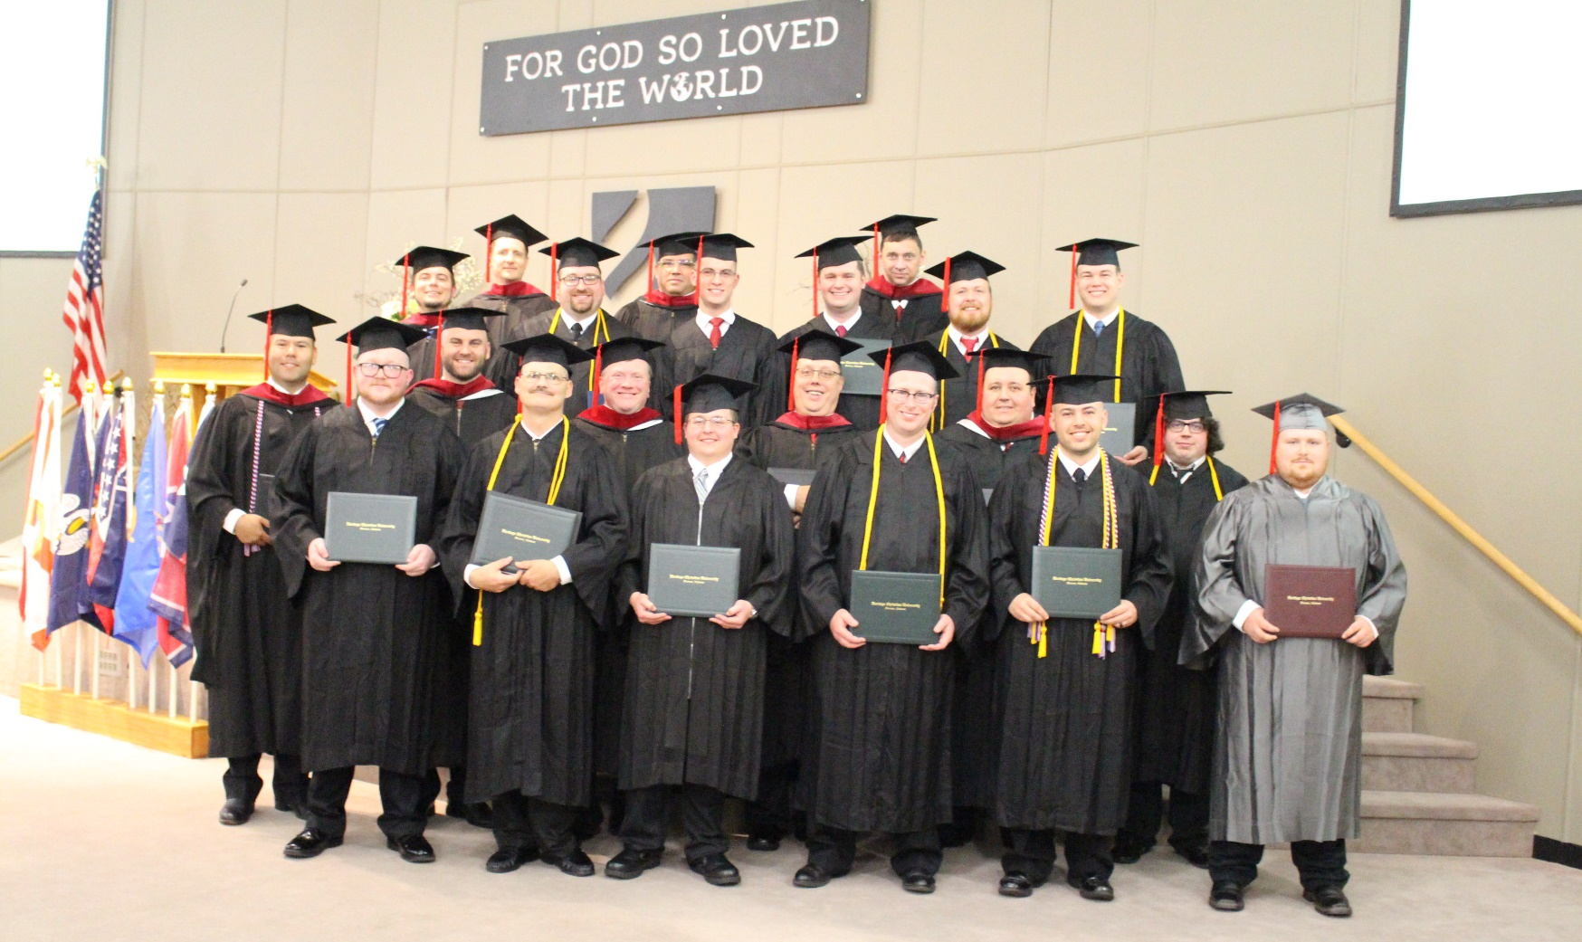
87 graduates in the last four years…
2018 GRADUATING
CLASS
3,480 YEARS of preaching, ministry and saving souls!

Slide 3
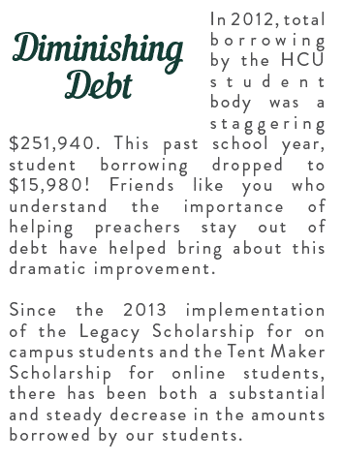
2012-13 Student Borrowing…
$251,940
2016-17 Student Borrowing…
$15,980
2017-18 Student Borrowing…
$12,435

Slide 4
The “I Am” Statements from John
JESUS AND THE SAMARITAN WOMAN
(John 4:26)

Slide 5
A look at John 4…
Jesus has traveled north into Samaria – (1-6)
Getting to know Jesus – (7-15)
You don’t yet know Me, but I know you! – (16-26)
Knowing Jesus changes everything! – (28-30, 39-42)

Slide 6
Key Learning #1
If God can use her, he can use you!

Slide 7
Key Learning #2
Knowing Jesus should get us out of our comfort zone!

Slide 8
Does KNOWING result in us GOING?

Slide 9
Key Learning #3
A plan for evangelism that will still work today!

Slide 10
Plan for evangelism
A life-changing encounter with Jesus
Step #1

Slide 11
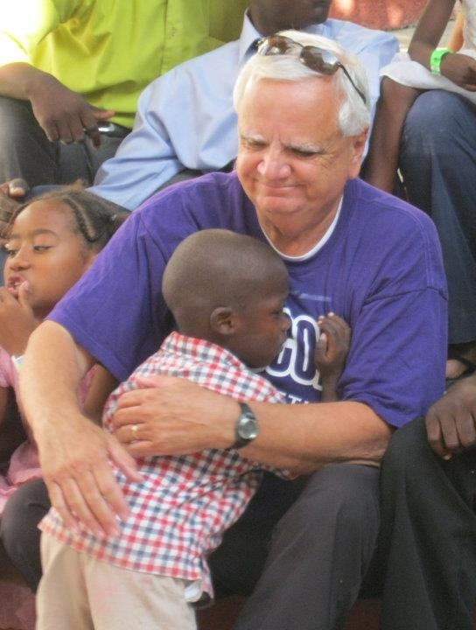
Rethinking the term “Missionary”

Slide 12
Plan for evangelism
Go tell someone!
Step #2

Slide 13
Plan for evangelism
Does KNOWING result in us SHOWING?
Step #2

Slide 14
Plan for evangelism
People seek Jesus for themselves!
Step #3

Slide 15
Plan for evangelism
The process repeats!
Step #4

Slide 16
Has KNOWING Jesus changed EVERYTHING for you?

