Slide 1
Big lessons from a little man! Luke 19

Slide 2
Who was Robert Wadlow?
He was the tallest man in recorded history.

Slide 3
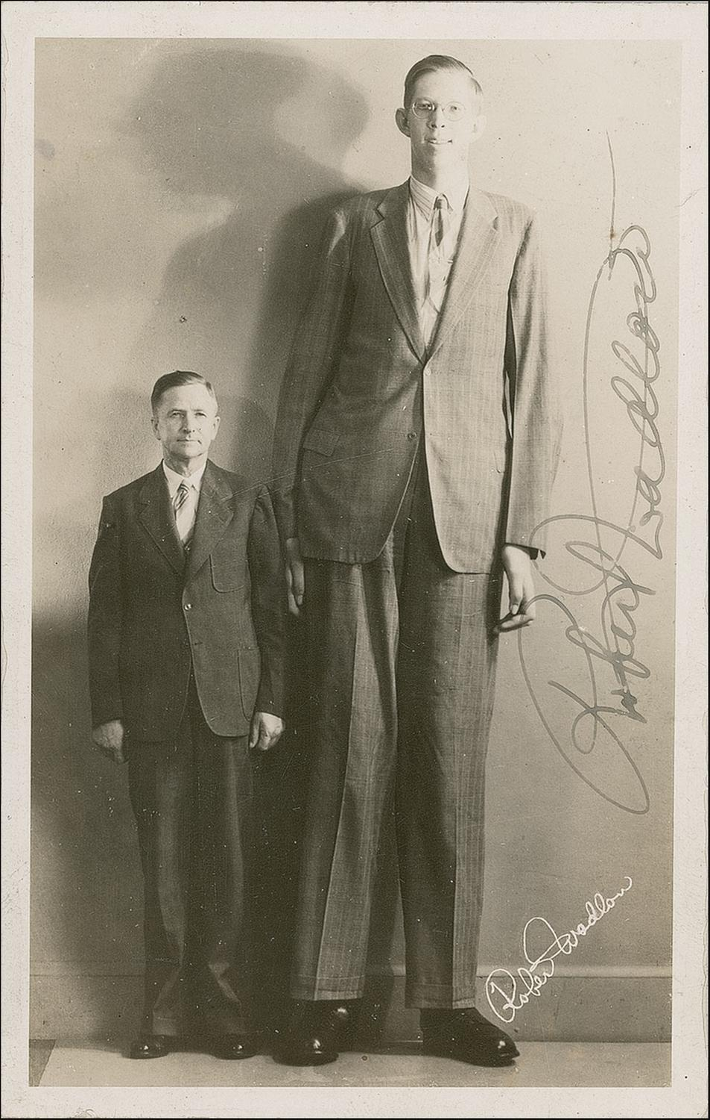
Robert Wadlow was recorded at a staggering height of 8 feet 11.1 inches tall.
In this photo, he is standing by his father who was almost six feet tall.

Slide 4
In Luke 19, we have a man who is remembered mostly for his stature. What we might forget sometimes are the lessons and examples he provides for us.

Slide 5
Zacchaeus was a wee little man, And a wee little man was he. He climbed up in a sycamore tree For the Lord he wanted to see.
And as the Savior passed that way He looked up in the tree and he said, 'Zacchaeus you come down, For I'm going to your house today!' For I'm going to your house today!

Slide 6
Zacchaeus reaffirms God’s idea that the heart is what is most important.
The Bible tells us specifically in Luke 19:3 that Zacchaeus was “small of stature.”
God has had this stance all along. God chose leaders this way in 1 Samuel 16:6-7 and Jesus condemned “religious leaders” who didn’t grasp this concept in Matthew 23:25-28
Christians must remember that God is most concerned with the heart and ACT accordingly.

Slide 7
Zacchaeus was concerned with doing the right thing.
It’s interesting that there are two theories about what kind of person Zacchaeus was. Luke 19:7-8
Regardless of which theory you like, it’s clear that after meeting Jesus, He was concerned with doing the right thing.
This is a very unpopular way of living in our culture. Christians must stand out for doing the right thing ALWAYS.
As Christians we must seek opportunities to do the right thing. James 4:17

Slide 8
Zacchaeus was willing to do anything to make genuine contact with Jesus.
What kind of things do people allow to prevent them from making contact with Jesus? Pride? Family? Bitterness? Anger? Selfishness?
Zacchaeus wasn’t going to let his short stature or what people said and thought about him keep him from making contact with Jesus.
We have to get over these things that keep us from “Looking to Jesus.” Hebrews 12:1-2. Luke 8:43

