Slide 1
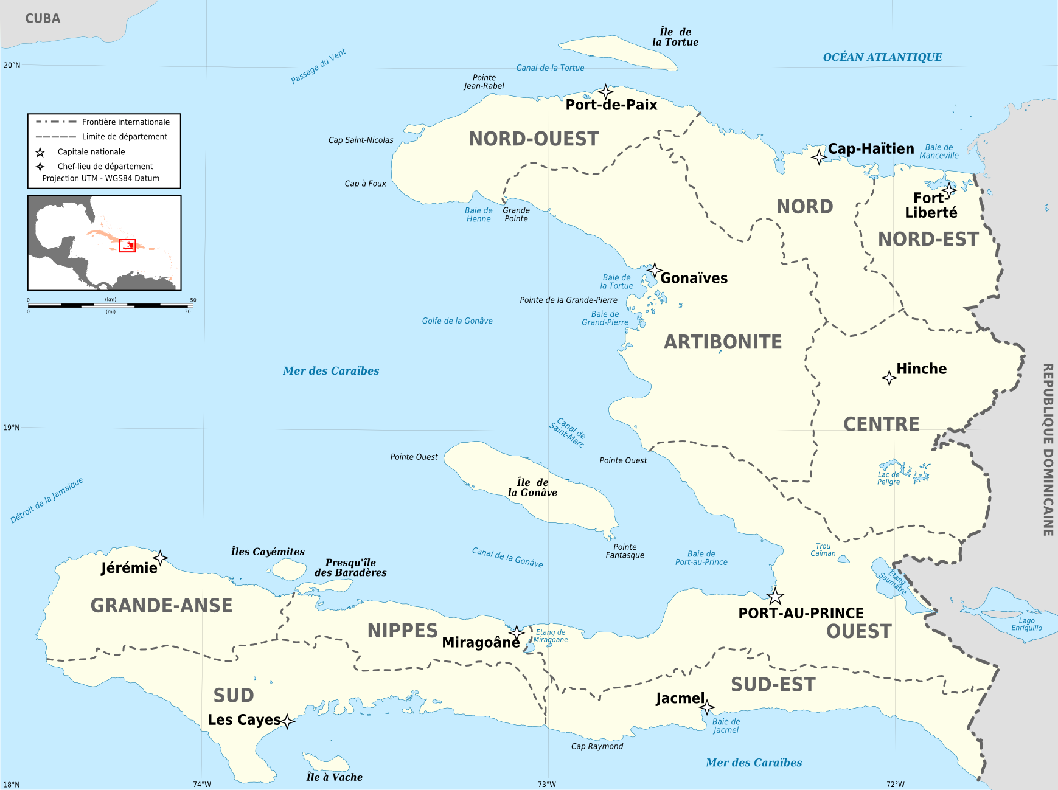
God gives the increase in Haiti

Slide 3
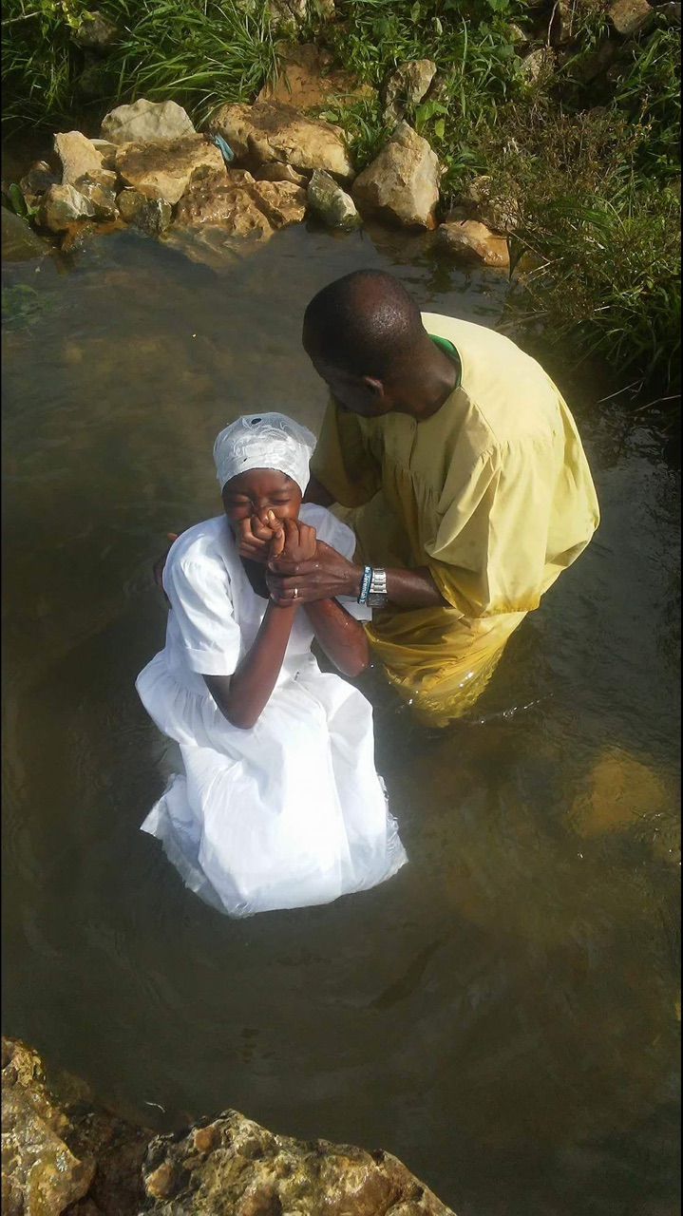

Slide 4
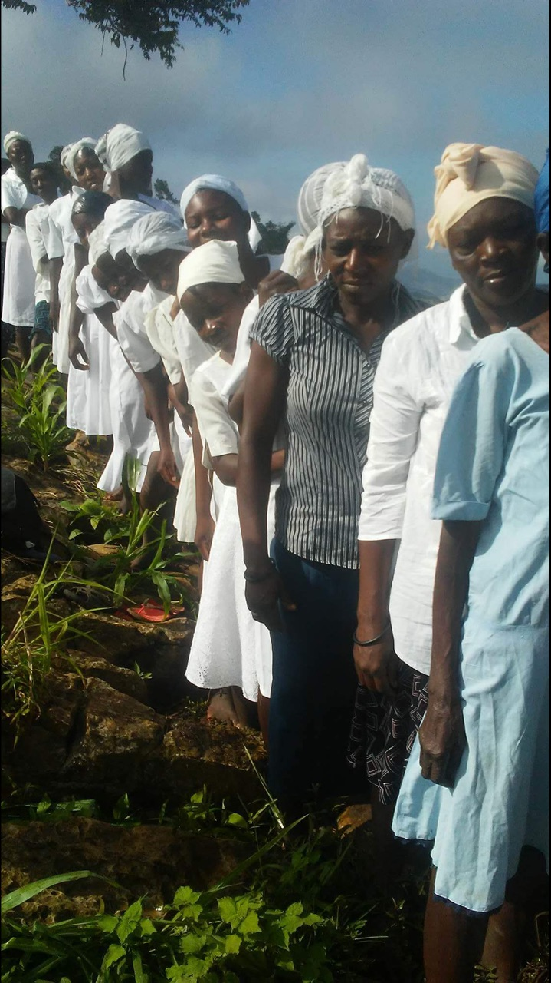

Slide 5
The Increase
Over two weeks ago- 34 baptized
Over a week ago- 58 baptized
Last Friday- 62 baptized

