Slide 1
HOLY
GOD
2

Slide 2
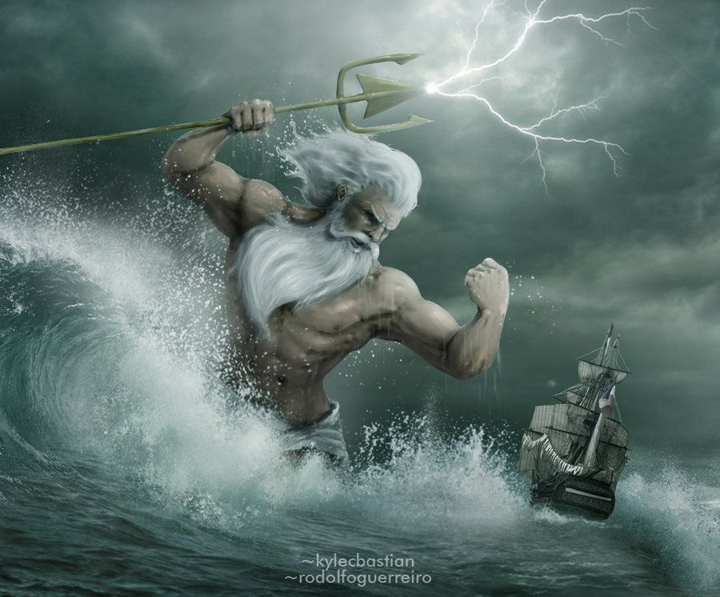
Greek
Poseidon
Roman
Neptune

Slide 3
1Ki 20:28
Then a man of God came and spoke to the king of Israel, and said, "Thus says the LORD: 'Because the Syrians have said, "The LORD is God of the hills, but He is NOT God of the valleys," therefore I will deliver all this great multitude into your hand, and you shall know that I am the LORD.'"

Slide 5
Genesis 1:1-2
In the beginning God created the heaven and the earth.
The earth was without form, and void; and darkness was on the face of the deep. And the Spirit of God was hovering over the face of the waters.

Slide 6
Genesis 1:6
Then God said, "Let there be a firmament in the midst of the waters, and let it divide the waters from the waters."

Slide 7
Genesis 1:7
And God made the firmament, and divided the waters which were under the firmament from the waters which were above the firmament: and it was so.

Slide 8
Genesis 1:9
And God said, Let the waters under the heaven be gathered together unto one place, and let the dry land appear: and it was so.

Slide 9
Job 38:8-9
Who shut in the sea with doors, When it burst forth and issued from the womb; When I made the clouds its garment, And thick darkness its swaddling band;

Slide 10
Job 38:10-11
When I fixed My limit for it, And set bars and doors; When I said, 'This far you may come, but no farther, And here your proud waves must stop!'

Slide 11
Genesis 2:4-6
This is the history of the heavens and the earth when they were created, in the day that the LORD God made the earth and the heavens, before any plant of the field was in the earth and before any herb of the field had grown.

Slide 12
Genesis 2:4-6
For the LORD God had not caused it to rain on the earth, and there was no man to till the ground; but a mist went up from the earth and watered the whole face of the ground.

Slide 13
Genesis 7:1-4
And the LORD said unto Noah… “For yet seven days, and I will cause it to rain upon the earth forty days and forty nights; and every living substance that I have made will I destroy from off the face of the earth…

Slide 14
Genesis 7:11
In the six hundredth year of Noah's life, in the second month, the seventeenth day of the month, the same day were all the fountains of the great deep broken up, and the windows of heaven were opened.

Slide 15
God showed his H2O power by…
Parting the Red Sea… and the Jordan River (twice)
By bringing water forth from a rock to quench the thirst of Israel in the wilderness.
By stopping the rain in the days of Elijah… and by allowing them again.

Slide 16
God showed his H2O power by…
When Jesus calmed the waters with the words, “Peace, be still.”
When Jesus walked upon the waters and bid Peter to come out to Him.
When Jesus turned the water to wine.

Slide 17
But the most amazing… The most unexpected… And the most powerful things God ever did with water…

Slide 18
John 11:35
Jesus wept!
A tear is a heart shaped drop of water

Slide 19
Luke 13:34
O Jerusalem, Jerusalem, the one who kills the prophets and stones those who are sent to her! How often I wanted to gather your children together, as a hen gathers her brood under her wings, but you were not willing!

Slide 20
God formed man of dust…
But not dust only!!! Our bodies are about 70% water.
No wonder James 4:14 says our life is “a vapor that appears for a little time and then vanishes away.”

Slide 21
John 4:10
Jesus answered and said to her, "If you knew the gift of God, and who it is who says to you, 'Give Me a drink,' you would have asked Him, and He would have given you living water."

Slide 22
Gives us NEW life…
We are “born again… of the water and the Spirit.” John 3:5-7

