Slide 1
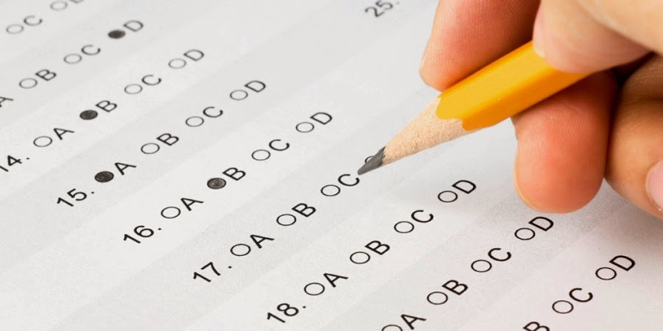
Tests of Faith
James 1-5

Slide 2
Tests of Faith
James gives an overview of his epistle in James 1:2-4.
He makes reference to “trials of various kinds” and “the testing of your faith.”
The letter then is a text book about what tests we will face to prove our faith.

Slide 3
Tests of Faith
THE TEST OF SMARTNESS (Wisdom)
James 1:5-11
It comes from God.
Recognize our lowly state.
THE TEST OF STEADFASTNESS
James 1:12-18
Under persecutions.
About our passions.
For our purpose.

Slide 4
Tests of Faith
THE TEST OF SUBMISSION
James 1:19-27
To the counsel of God through his word.
To God’s definition of religious.
The word “religion” in verses 26 and 27 means, “ceremonial observances.”
In other words this text is dealing with hypocrites.

Slide 5
Tests of Faith
James 1-5

Slide 6
Tests of Faith
THE TEST OF IMPARTIALITY
James 2:1-13
It is not Christian behavior to treat some people well and mistreat others.
It is wrong for us to develop improper evaluations of people due to appearance.
James says that this is not loving your neighbor as yourself and goes on to discuss the magnitude of this sin.

Slide 7
Tests of Faith
THE TEST OF COMPASSION
James 2:14-17
Difference between empathy and compassion.
Empathy- The ability to understand of be sensitive to the feelings and experiences of others. (James 2:15)
Compassion- sympathetic consciousness of others' distress together with a desire to alleviate it.
Jesus was moved with compassion.
Matt. 14:14- 5000 people.
Mark 1:41- Leper.

Slide 8
Tests of Faith
THE TEST OF ACTION/OBEDIENCE
James 2:18-26
Faith is made complete through action/works.
We hear many people say that “faith alone” saves you.
James 2:24 is the only text in the Bible that puts these two words side by side. What does it say? “…a person is justified by works and NOT by ‘faith alone.’”
A comparison is made to physical death and spiritual death.

Slide 9
Tests of Faith
James 1-5

Slide 10
Tests of Faith
THE TEST OF THE TONGUE
James 3:1-12
Oh boy! Here we go.
The tongue is described as “a fire, a world of unrighteousness.”
Two uses-
Blessing- Eph. 4:29; 5:4- Build up.
Cursing- Eph. 4:31- Tear down.

Slide 11
Tests of Faith
THE TEST OF MEEKNESS
James 3:13-18
A full understanding of the concept of meekness requires a study in word association.
The Greek word for meekness (prautes) is linked to mildness, gentleness, self-control, and humility.
It is a disposition that allows one to respond to any situation appropriately because of his/her relationship with God.

Slide 12
Tests of Faith
THE TEST OF MEEKNESS
Vine’s Expos. Dict. describes it this way, “An inwrought grace of the soul.”
Matt. 5:5.
It accepts the wisdom that is from above and puts it into practice.
How many of us operate more in the realm of jealousy and selfish ambition?

Slide 13
Tests of Faith
THE TEST OF WORLDLINESS
James 4:1-5:6
Covetousness- 4:1-5. Also Col. 3:5 (idolatry).
Pride/Arrogance- 4:6-17.
Failure to turn to God.- vss. 6-10.
Assuming the role of God in judging.- vss. 11-12.
Presumption of control/self-sufficiency.- vss. 13-17.
I’ve got time and money.

Slide 14
Tests of Faith
THE TEST OF WORLDLINESS
James 4-5:6
Wealth- 5:1-6
Fraud
Mistreat others to gain a dollar.
Luxury and self-indulgence
Fattened ourselves up for the slaughter like cattle.
We get so wound up in our possessions that we forget what is most important in life.

Slide 15
Tests of Faith
James 1-5

Slide 16
Tests of Faith
THE TEST OF PATIENCE
James 5:7-11

