Slide 1
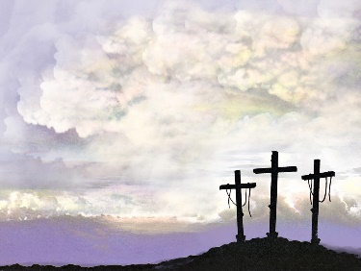
Composure
Luke 22:39-23:42

Slide 2
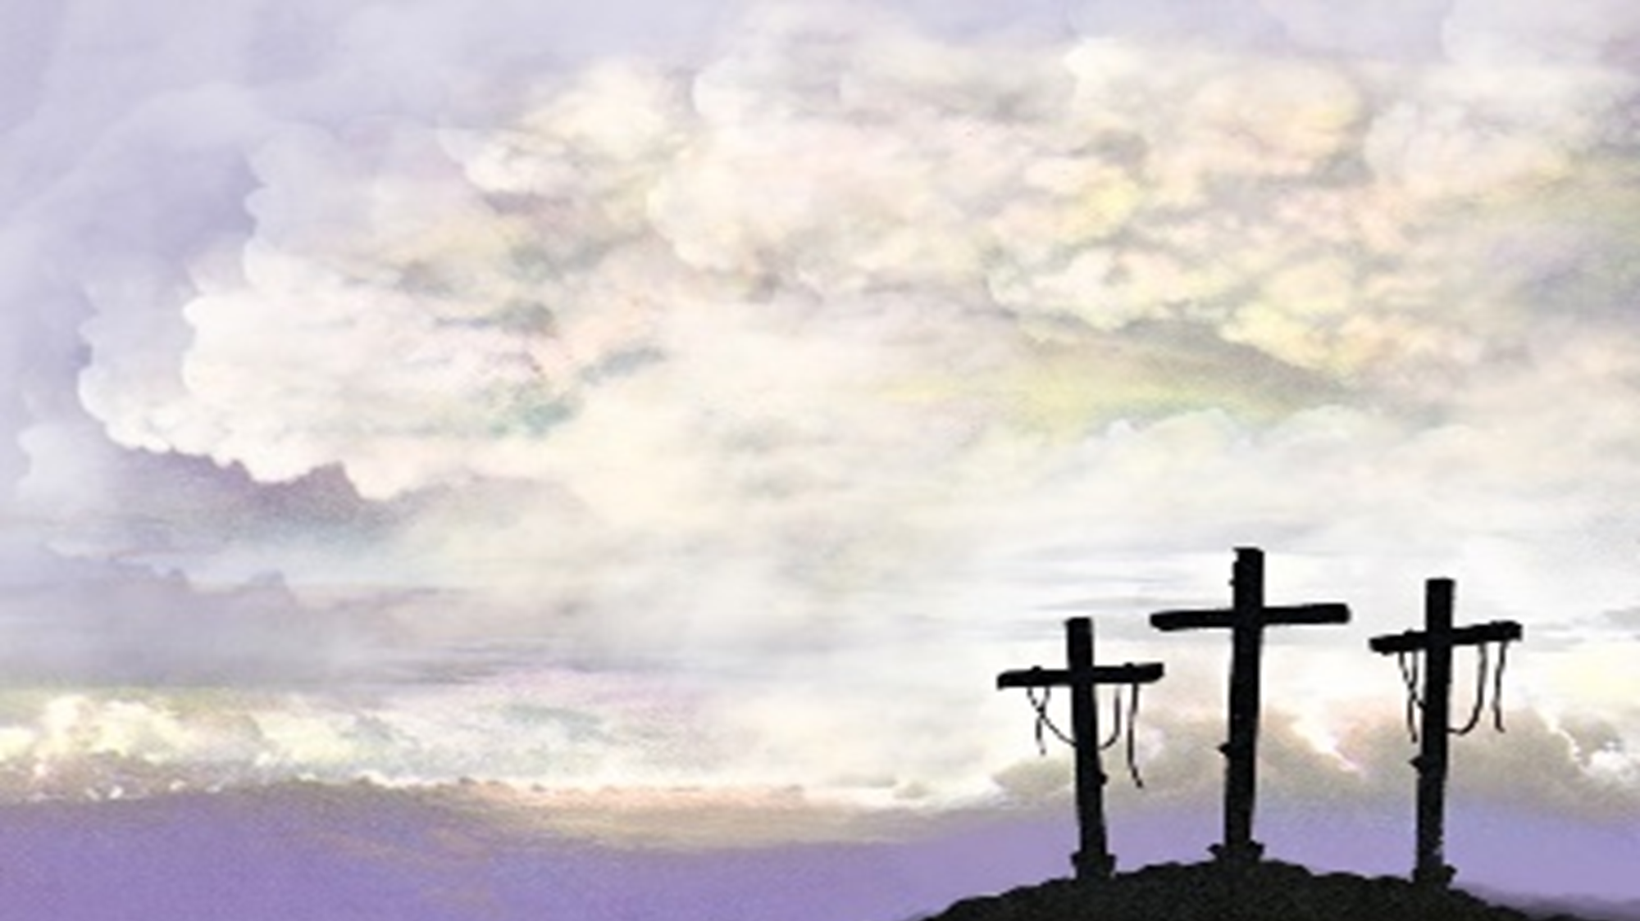
Composure
Jesus in the Garden of Gethsemane.
Luke describes him as being in “agony.” Sweat like great drops of blood falling down his face to the ground.
Matthew says that he was sorrowful and troubled even unto death and that he fell on his face.
Mark says that he was greatly distressed and fell on the ground.
The picture we have is a man distraught and hurting.

Slide 3
Composure
He went into the garden distraught, hurting, and afraid but, he came out in control and resolute.
From this point forward Jesus was completely in control, even in situations where most, if not all of us, would have lost our composure.
So, what’s the point? We will get to that. First, let’s look at all the times Jesus held his composure.

Slide 4
Composure
In dealing with the mob- Luke 22:47-53
In dealing with Peter’s denial- Luke 22:54-62
In dealing with the soldier’s who blindfolded and struck him- Luke 22:63-65
In dealing with the Council- Luke 22:66-70
In dealing with Herod- Luke 23:6-12

Slide 5
Composure
In dealing with Pilate- Luke 23:13-24
In dealing with the soldiers at the cross- Luke 23:32-38
In dealing with the criminals- Luke 23:39-43
In dealing with me!!!
It was my sin that held him there.

Slide 6
Composure
Jesus went into the Garden. He was strengthened by his Father.
If we will spend time with the Father, then we will be able to handle anything that the world places before us.
We can be composed and resolute like Jesus.

