Slide 1
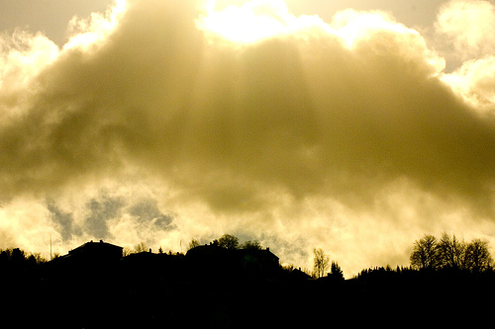
Partakers of the Divine Nature
II Peter 1:3-4

Slide 2
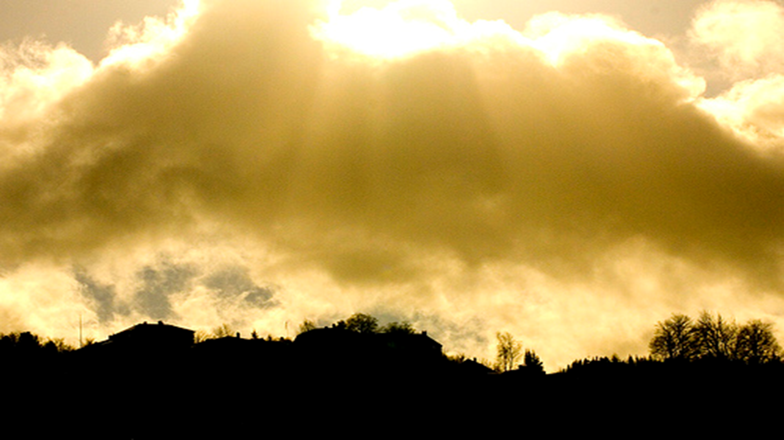
Partakers of the Divine Nature
Although, we will never be God, we can share in the divine nature.
Today, we want to discuss from our text the two ways God encourages this development.

Slide 3
Partakers of the Divine Nature
God has provided us with the…………
KNOW-HOW
II Peter 1:3
Jesus is the exact image of God- Col. 1:15
Jesus is the perfect example in life- I Peter 2:22
Jesus is the expression of truth. John 1:14; 14:6; See also John 15:26

Slide 4
Partakers of the Divine Nature
God has provided us with the…………
INCENTIVE
He has granted us precious and very great promises.
“Megistos”
Comes from the root word for mega, big or large
Means greatest or exceeding great- Eph. 3:20
“Timia” means valuable.

Slide 5
Partakers of the Divine Nature
What are some of these promises
Fellowship- I John 1:7, II Peter 1:4
Guidance- II Tim. 3:16-17, II Peter 1:4,10
Blessings- Eph. 1:3, II Peter 1:8,10
Eternal life- Heb. 9:15, II Peter 1:11

