Slide 1
SIMPLE Christianity
Micah 6:6-8
Deuteronomy 10:12-13

Slide 2
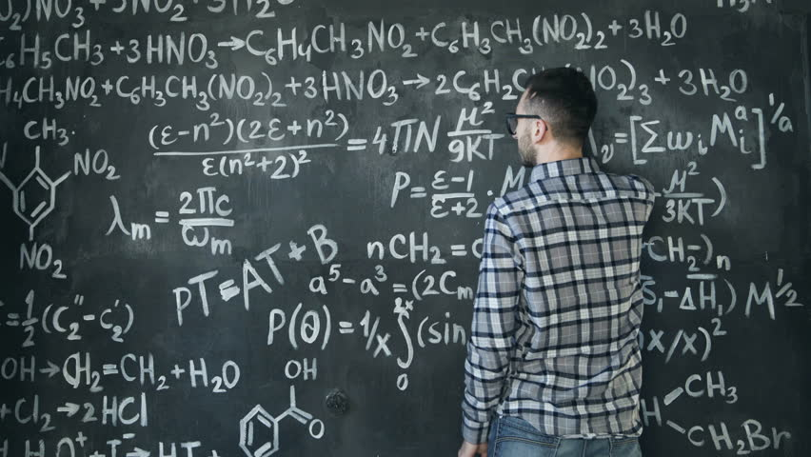

Slide 3
Christianity at it’s core is a simple theology.
Many times I’m afraid we are guilty of making it a bit harder than it truly is.
There are advanced concepts and doctrines which may take a longer amount of time and deeper study to master and develop faith in.
But in it’s simplest form Christianity is about loving God and loving ALL humans. Matthew 22:34-40

Slide 4
A Simpler Equation…
Love God (obeying Him and His word) + Love Others = Christianity

Slide 5
How can I be a SIMPLE Christian?
S – Smile Constantly. Proverbs 15:13
I
M
P
L
E

Slide 6
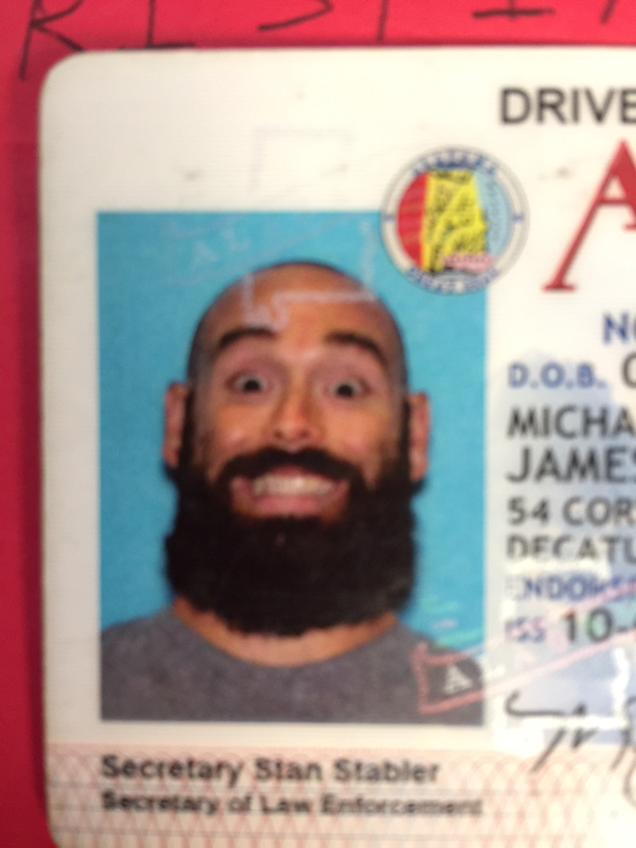

Slide 7
How can I be a SIMPLE Christian?
S – Smile Constantly.
I – Interact with everyone. Hebrews 10:24
M
P
L
E

Slide 8
How can I be a SIMPLE Christian?
S – Smile Constantly.
I – Interact with everyone.
M – Make it obvious. Joshua 24:14-15
P
L
E

Slide 9
How can I be a SIMPLE Christian?
S – Smile Constantly.
I – Interact with everyone.
M – Make it obvious.
P – Prioritize carefully. Matthew 6:33
L
E

Slide 10
How can I be a SIMPLE Christian?
S – Smile Constantly.
I – Interact with everyone.
M – Make it obvious.
P – Prioritize carefully.
L – Love with action. James 2:14-17
E

Slide 11
How can I be a SIMPLE Christian?
S – Smile Constantly.
I – Interact with everyone.
M – Make it obvious.
P – Prioritize carefully.
L – Love with action.
E – Encourage with enthusiasm. 1 Thess 2:11-12

