Slide 1
Marshall Keeble

Slide 2
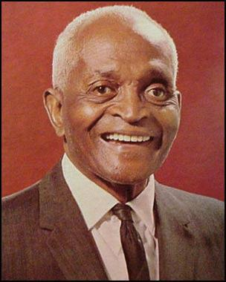
Marshall Keeble

Slide 3
Marshall Keeble
Born in Murphreesboro, TN in 1878.
Both of his parents were slaves.
He completed the 7th grade.
Never went to college.
Married Minnie Womack in 1896. She died in 1932.
Had 5 children
Two died in infancy, one son at 10.
One daughter is 1935, and his last child in 1964

Slide 4
Marshall Keeble
Married Laura Johnson in 1934. She was born in 1898 and died at 108 in 2007.
He began preaching in 1897 but only on occasion as he also worked in a soap factory and owned a grocery store.
That all changed in 1920 because of the generosity and foresight an extremely godly man.

Slide 5
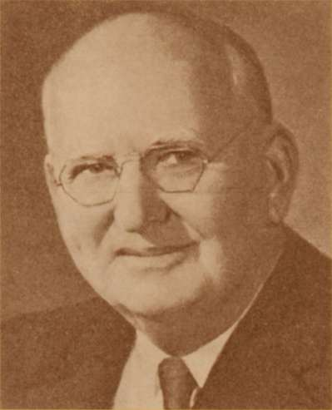
Marshall Keeble
A.M. Burton
Founder of the Life and Casualty Insurance Company.
Began supporting Bro. Keeble in 1920.
Supported him for the next 4 decades.

Slide 6
Marshall Keeble
His historical significance!
“Successfully bridged a racial divide in an important American religious movement prior to the Civil Rights Movement.” -Wikipedia.
According to historian Paul D. Phillips, Keeble embraced “the two-fold task of elevating Blacks by the proclamation of the Gospel and of establishing a bond of interracial fellowship through White support of his ministry.”

Slide 7
Marshall Keeble
His Spiritual Nature.
Quiet and meditative.
Compassionate and forgiving.
Perseverance and honest.
Peaceful and calm.
No one’s shortcomings were food for his conversation.
Pled with people for the necessity of commitment to Christ.

Slide 8
Marshall Keeble
Kingdom Contributions.
Well educated in the Scriptures despite only finishing the 7th grade.
Established over 200 congregations.
Baptized between 40,000-50,000 people.
Established several Christian schools including Southwest Christian College.

Slide 9
Marshall Keeble
Kingdom Contributions (cont.)
Never preached for a local congregation but continued preaching Gospel Meetings all over and in all types of establishments.
An incomparable debater
At 82 began traveling the world preaching-
Places included: Palestine, Nigeria, Ethiopia, India, Singapore, Korea, Hawaii, Los Angeles.

Slide 10
Marshall Keeble
Recognitions
Made an honorary chief of one Nigerian tribe.
Honored by Harding University with an honorary Doctorate of Law Degree- 1965.
Tennessee Governor Frank Clement presented him with the highest state honor- The Colonel Aide-de-Camp
In 2000 the Christian Chronicle named Marshall Keeble the most influential preacher among churches of Christ in the decade of the 1940s.

Slide 11
Marshall Keeble
He Preached his last sermon on April 17, 1968, 3 days before his death on April. 20, 1968 at age 89.
His preaching career spanned 71 years.
Over 3000 people attended his funeral.

