Slide 1
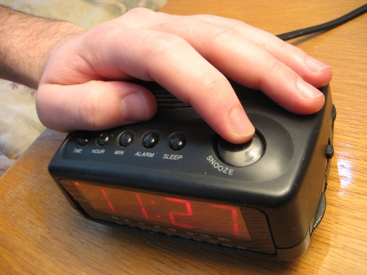
You Snooze, You Lose!
Romans 13:11-14

Slide 2
You Snooze, You Lose!
This statement means that if you are not alert and attentive, then you will not be successful.
Proverbs 20:13, “Love not sleep, lest you come to poverty.”
Tortoise and the hare moral is “slow and steady wins the race.”
Hitting snooze button is counter-productive.
Are we hitting the spiritual snooze button?

Slide 3
You Snooze, You Lose!
Why should we wake up…….?
BECAUSE OUR SALVATION IS NEARER
Romans 13:11
Salvation is used to describe the future reality of the Christian. A reality (the Judgment) that continues to draw near.
He encourages a vigilant faithfulness.
Time is running out if you need salvation.

Slide 4
You Snooze, You Lose!
Why should we wake up…….?
BECAUSE THE TIME TO WORK ON OURSELVES IS NOW
Romans 13:12-14
The light of the truth has emerged.
The more you continue in these decisions/behaviors, the more difficult it is to change.

Slide 5
You Snooze, You Lose!
Why should we wake up…….?
BECAUSE THERE IS A PROPER WAY TO DO THINGS
Romans 13:13
Contrary to the popular belief that there are no black and white concepts. There are absolutes!
Putting on Jesus Christ is right and proper.

