Slide 1
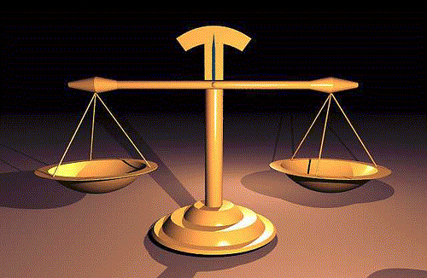
Weightier Matters of the Law
Matthew 23:23

Slide 2
Weightier Matters of the Law
Problems with the Scribes and Pharisees
Acted Pretentious-
Matt. 23:5-7
Matt. 23:25-28
Substituted man’s traditions for God’s commands-
Matt. 15:9
Mark 7:7
Majored in minors and minored in Majors-
Matt. 23:23-24

Slide 3
Weightier Matters of the Law
The Weightier Matters (The Majors)
JUSTICE
(Gr.) Krisis- “judgment, distinguishing, just dealing
James 2:1ff
MERCY
FAITHFULNESS
(Gr.) Pistis- “conviction, trust, fidelity”

Slide 4
Weightier Matters of the Law
The Minors of Faithfulness
Giving
Church Attendance
Instrumental music
Baptism

