Slide 2
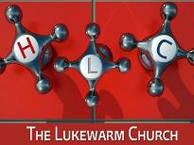
Revelation 3:14-22 "And to the angel of the church of the Laodiceans write, 'These things says the Amen, the Faithful and True Witness, the Beginning of the creation of God: ¹⁵ I know your works, that you are neither cold nor hot. I could wish you were cold or hot. ¹⁶ So then, because you are lukewarm, and neither cold nor hot, I will vomit you out of My mouth. ¹⁷ Because you say, 'I am rich, have become wealthy, and have need of nothing'--and do not know that you are…

Slide 3
Revelation 3:14-22
wretched, miserable, poor, blind, and naked-- ¹⁸ I counsel you to buy from Me gold refined in the fire, that you may be rich; and white garments, that you may be clothed, that the shame of your nakedness may not be revealed; and anoint your eyes with eye salve, that you may see. ¹⁹ As many as I love, I rebuke and chasten. Therefore be zealous and repent. ²⁰ Behold, I stand at the door and knock. If anyone hears…

Slide 4
Revelation 3:14-22
…My voice and opens the door, I will come in to him and dine with him, and he with Me. ²¹ To him who overcomes I will grant to sit with Me on My throne, as I also overcame and sat down with My Father on His throne. ²² He who has an ear, let him hear what the Spirit says to the churches." ' "

Slide 5
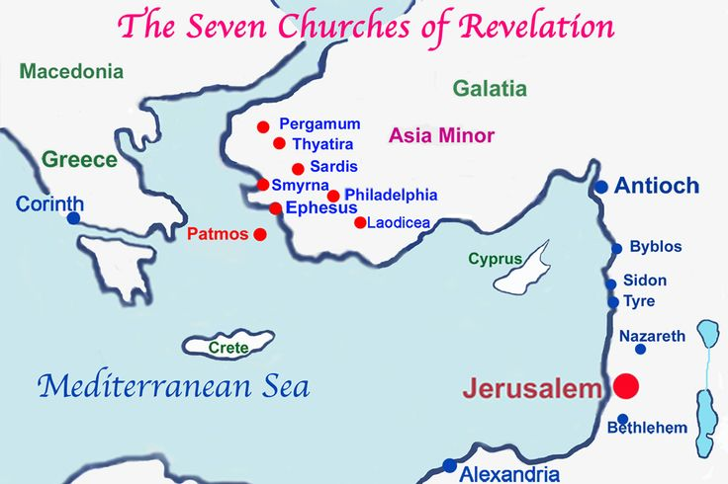
The Church With Heart Trouble
THE CIRCUMSTANCES
THE COMMENDATION
THE CRITIQUE
THE CORRECTION
THE CONCLUSION

Slide 6
BACKGROUND
RICHEST COMMERCIAL CENTER

Slide 7
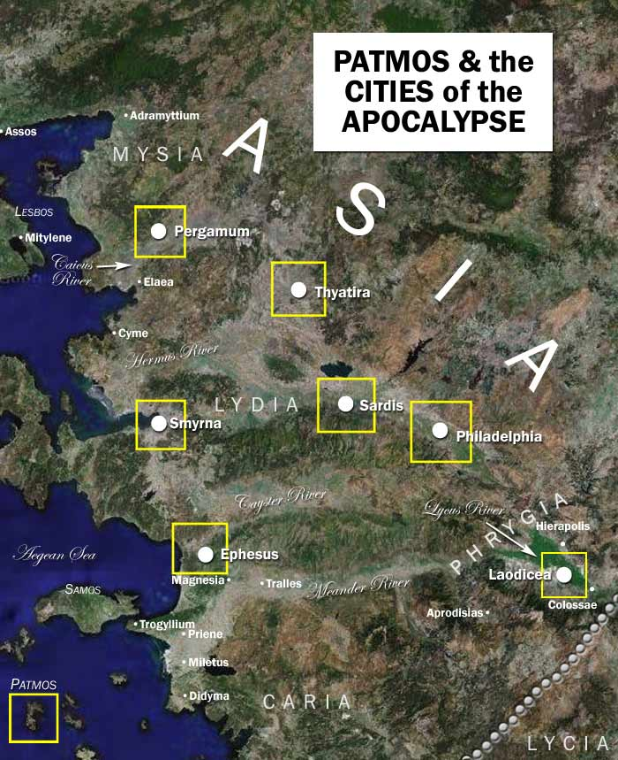

Slide 8
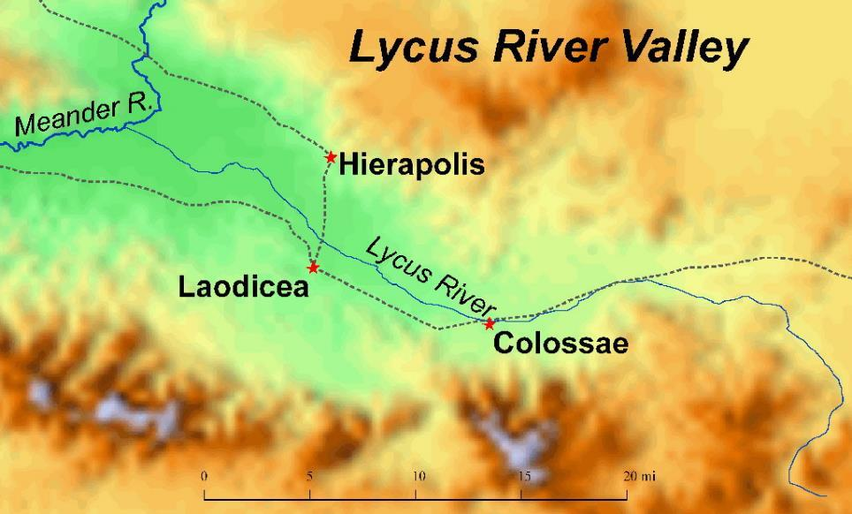

Slide 9
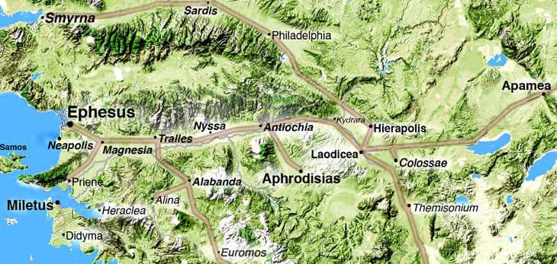

Slide 10
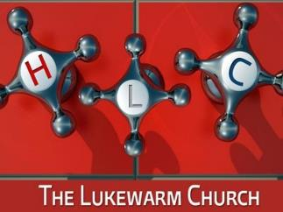
BACKGROUND
RICHEST COMMERCIAL CENTER
WEALTHY CITY

Slide 12
WEALTHY CITY
Revelation 3:17 Because you say, 'I am rich, have become wealthy, and have need of nothing'--…

Slide 13
BACKGROUND
RICHEST COMMERCIAL CENTER
WEALTHY CITY
CLOTH & CLOTHING INDUSTRY

Slide 14
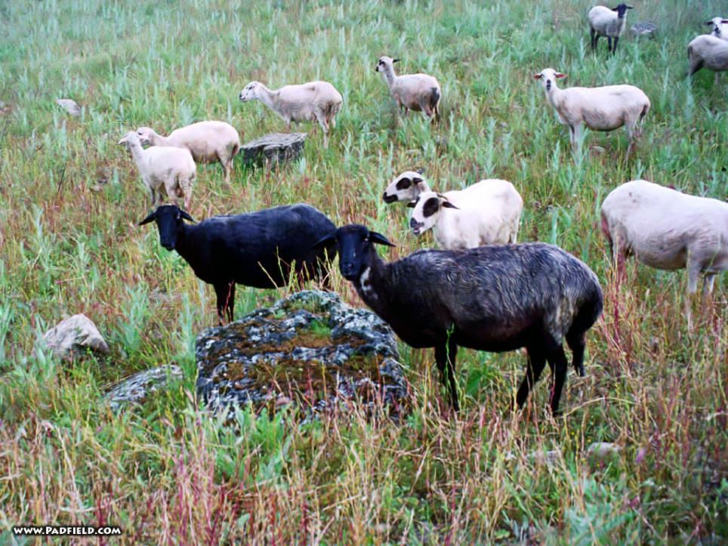
“Trimita”
“Trimitaria”

Slide 15
CLOTH & CLOTHING INDUSTRY
Revelation 3:18 …and white garments, that you may be clothed, that the shame of your nakedness may not be revealed; …

Slide 16
BACKGROUND
RICHEST COMMERCIAL CENTER
WEALTHY CITY
CLOTH & CLOTHING INDUSTRY
THE god MEN

Slide 17
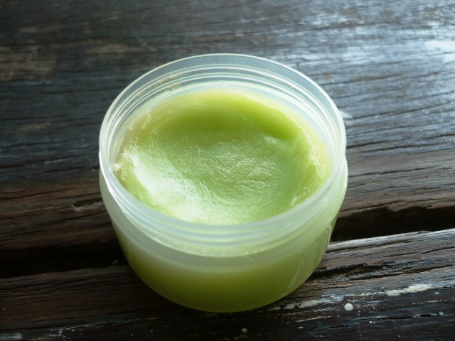

Slide 18
EYE SALVE
Revelation 3:18c …and anoint your eyes with eye salve, that you may see.

Slide 21
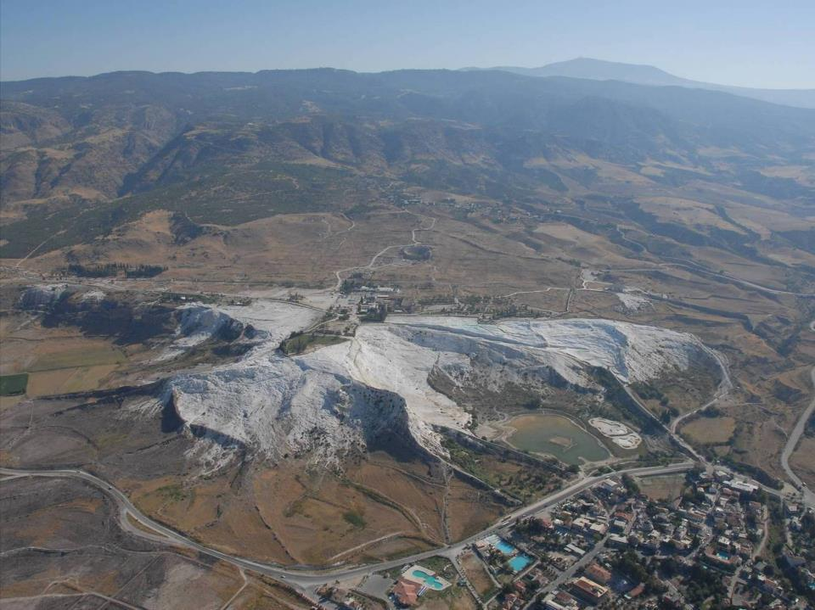

Slide 22
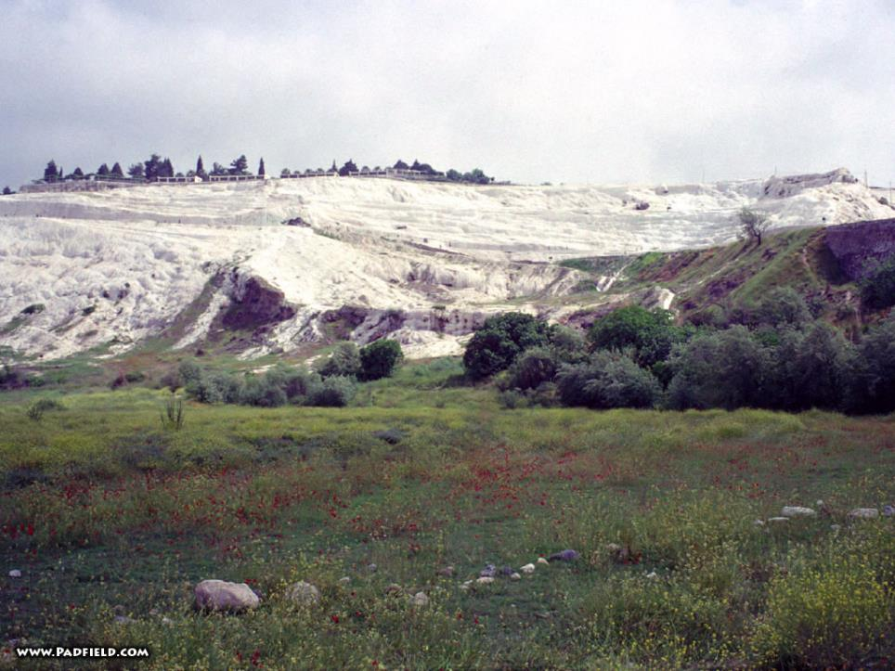

Slide 23
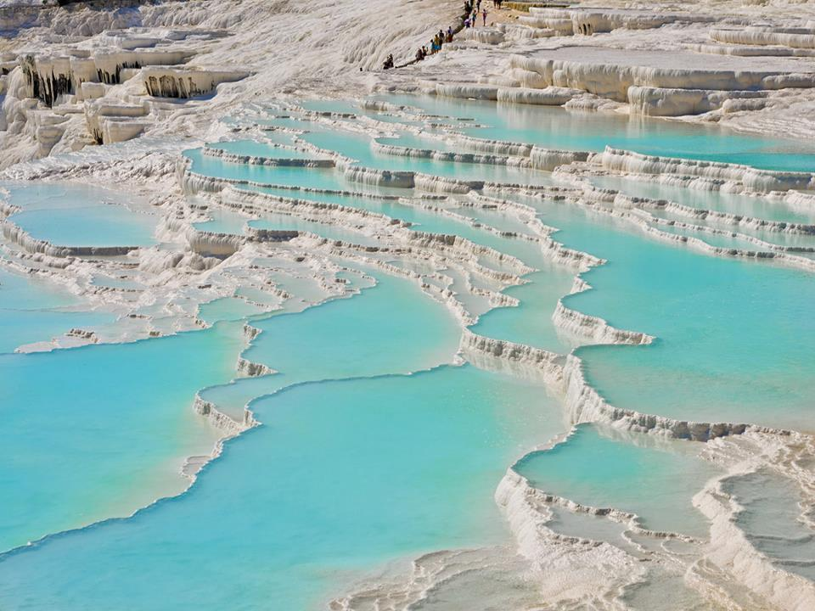

Slide 24
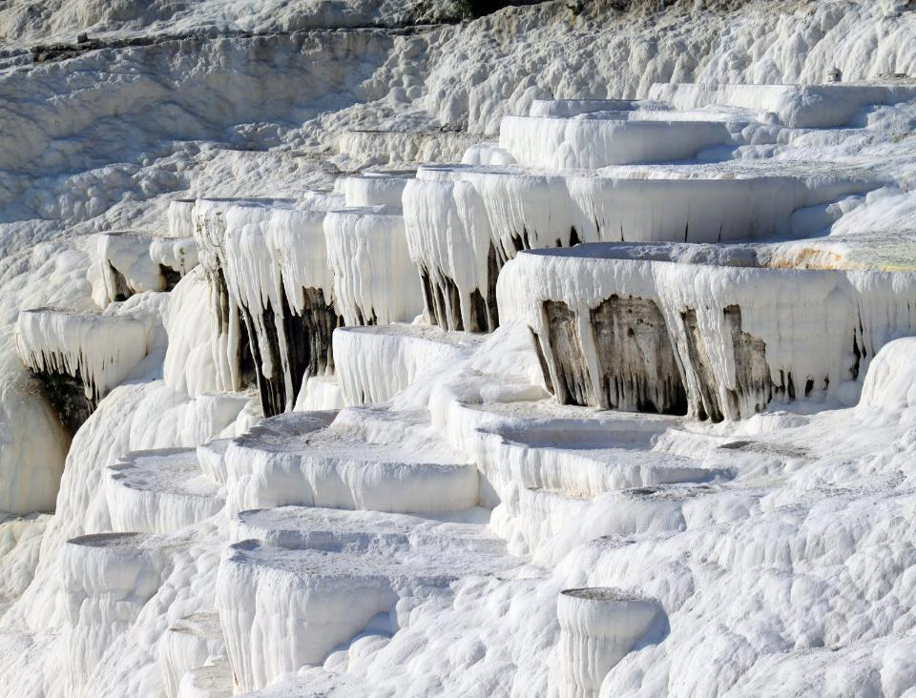

Slide 25
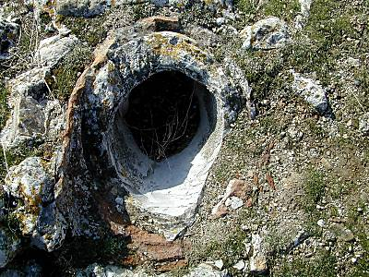

Slide 27
HOT SPRINGS
Revelation 3:15-16 I know your works, that you are neither cold nor hot. I could wish you were cold or hot. ¹⁶ So then, because you are lukewarm, and neither cold nor hot, I will vomit you out of My mouth.

Slide 28
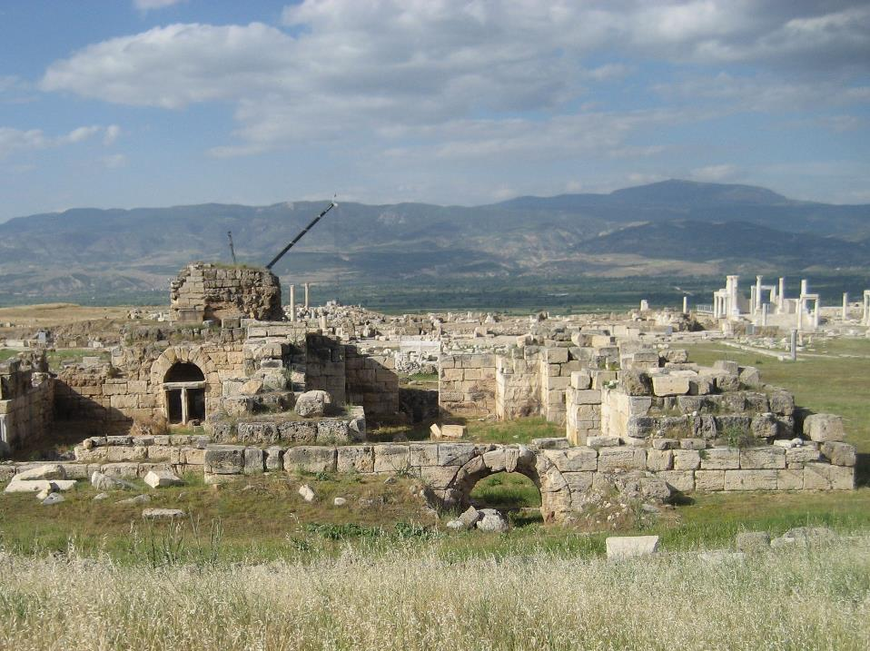

Slide 29
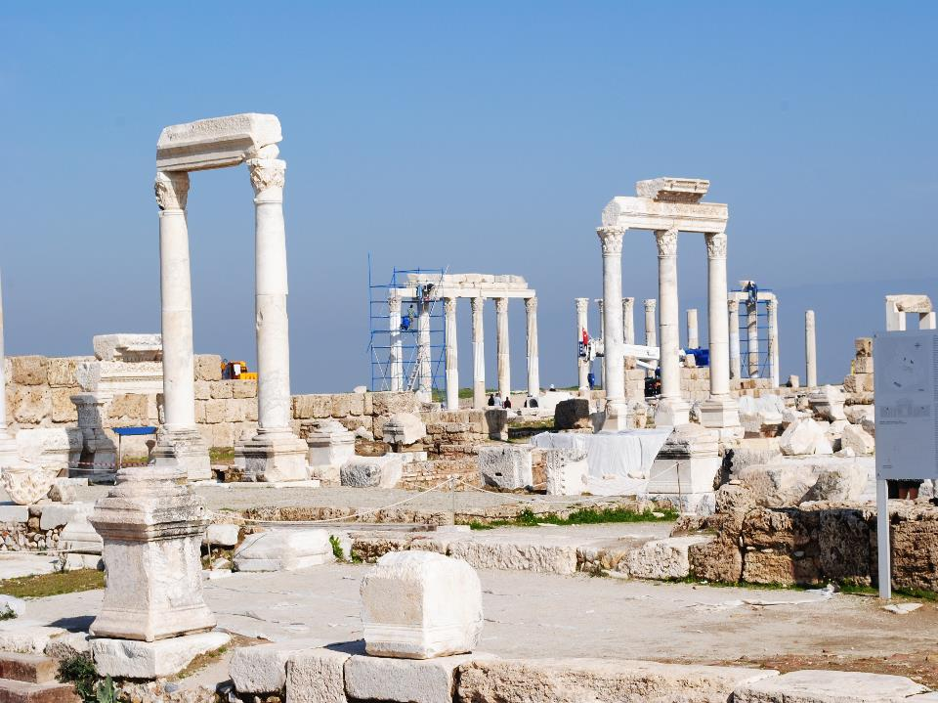

Slide 30
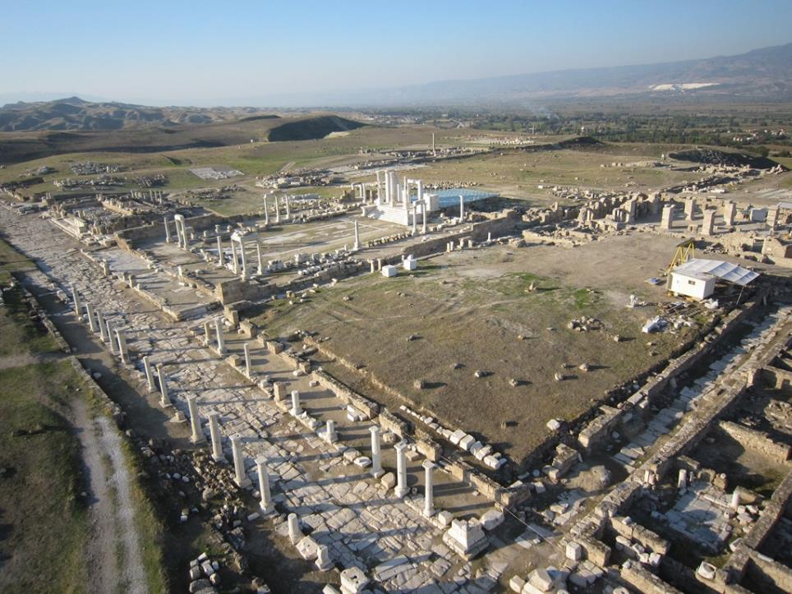

Slide 31
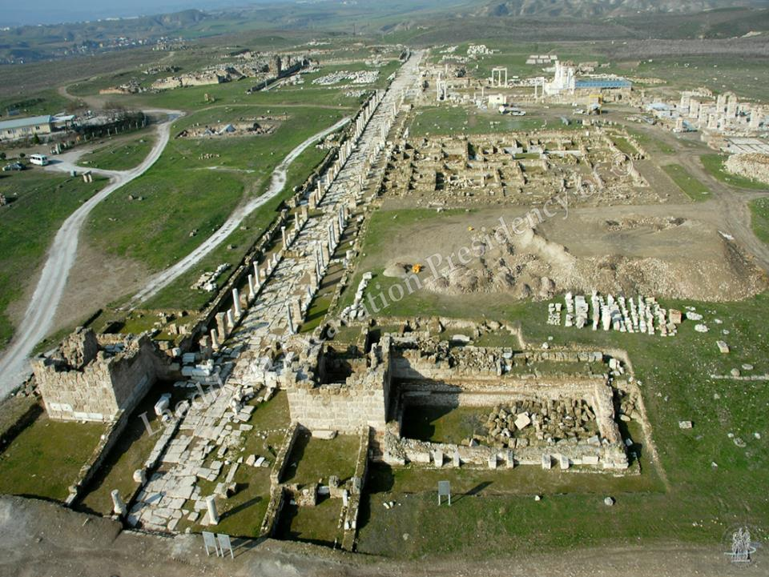

Slide 32
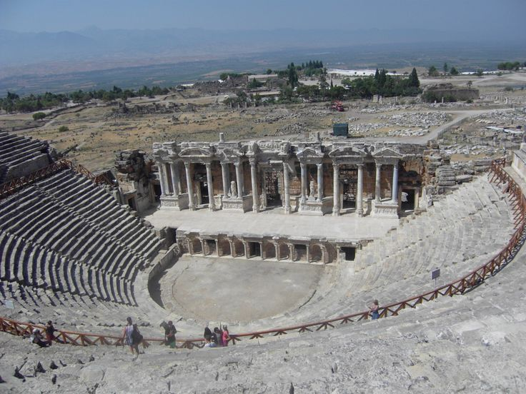

Slide 33
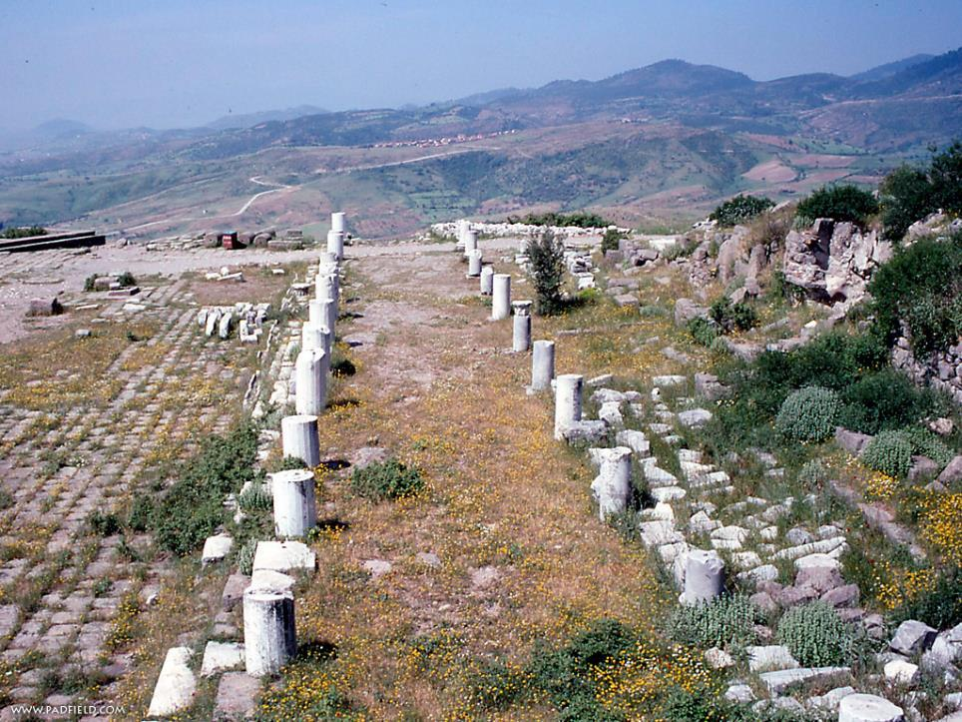

Slide 34
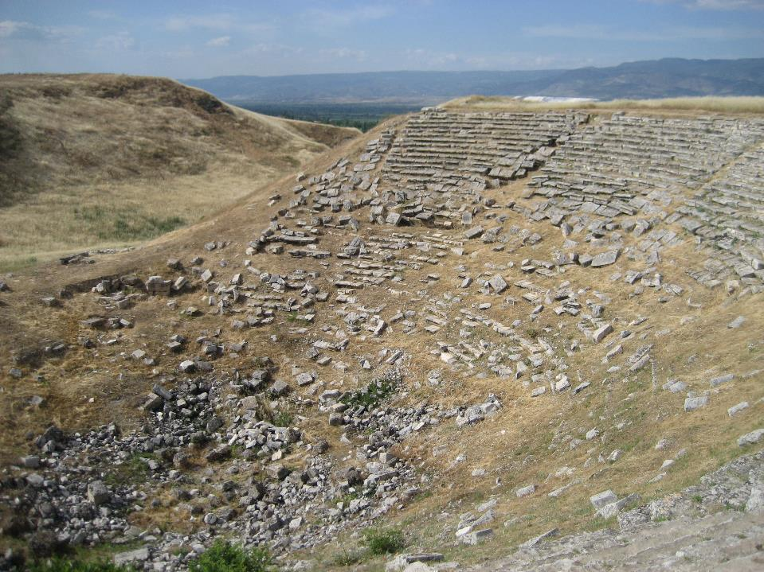

Slide 35
REVELATION 3:14
"And to the angel of the church of the Laodiceans write, 'These things says the Amen, the Faithful and True Witness, the Beginning of the creation of God:

Slide 36
REVELATION 3:14
THE CONFIRMING CHRIST
“The amen”

Slide 37
THE CONFIRMING CHRIST
2 Corinthians 1:20 For all the promises of God in Him are Yes, and in Him Amen, to the glory of God through us.
Christ is God’s confirmation that God will keep all of the promises in His Word.

Slide 38
REVELATION 3:14
THE CONFIRMING CHRIST
THE CONSISTENT CHRIST
“The faithful and true witness”

Slide 39
REVELATION 3:14
THE CONFIRMING CHRIST
THE CONSISTENT CHRIST
THE CONTROLLING CHRIST
“The beginning of the creation of God”

Slide 40
THE CONTROLLING CHRIST
John 1:1 In the beginning was the Word, and the Word was with God, and the Word was God. John 1:3 All things were made through Him, and without Him nothing was made that was made.

Slide 41
THE CONTROLLING CHRIST
Colossians 1:16-17 For by Him all things were created that are in heaven and that are on earth, visible and invisible, whether thrones or dominions or principalities or powers. All things were created through Him and for Him. ¹⁷ And He is before all things, and in Him all things consist.

Slide 42
THE LUKEWARM CHURCH
THE CHURCH
DESPERATE IN ITS CONDITION
DECEIVED BY ITS CONCEIT
THE LORD
DEFINITE IN HIS CORRECTION
DELIBERATE IN HIS CONCERN

Slide 43
THE CHURCH
DESPERATE IN ITS CONDITION

Slide 44
DESPERATE IN ITS CONDITION
A LUKEWARM CHURCH
Revelation 3:15-16 I know your works, that you are neither cold nor hot. I could wish you were cold or hot. ¹⁶ So then, because you are lukewarm, and neither cold nor hot, I will vomit you out of My mouth.
HOW CAN WE BE LUKEWARM?
WHY DOES THE LORD HATE LUKEWARMNESS?

Slide 45
DESPERATE IN ITS CONDITION
A LUKEWARM CHURCH
A LORD LESS CHURCH
Revelation 3:20 Behold, I stand at the door and knock. If anyone hears My voice and opens the door, I will come in to him and dine with him, and he with Me.

Slide 46
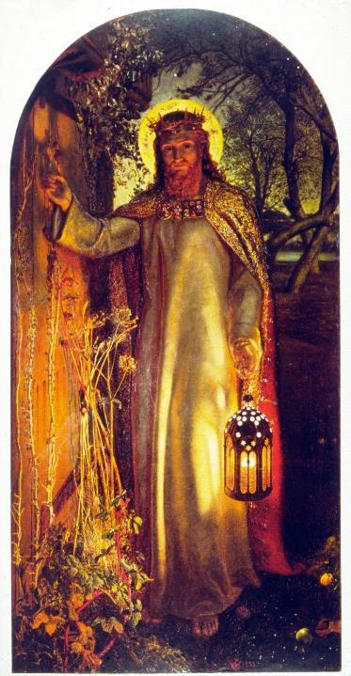

Slide 47
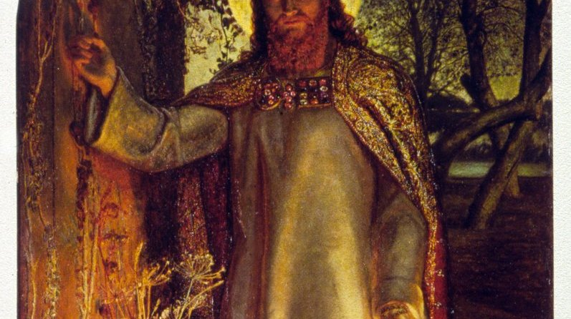

Slide 48
DESPERATE IN ITS CONDITION
A LUKEWARM CHURCH
A LORD LESS CHURCH
Revelation 3:20 Behold, I stand at the door and knock. If anyone hears My voice and opens the door, I will come in to him and dine with him, and he with Me.

Slide 49
THE CHURCH
DESPERATE IN ITS CONDITION
DECEIVED BY ITS CONCEIT

Slide 50
DECEIVED BY ITS CONCEIT
DECEIVED BY ITS ARROGANCE
Revelation 3:17a Because you say, 'I am rich, have become wealthy, and have need of nothing'--…

Slide 51
DECEIVED BY ITS CONCEIT
DECEIVED BY ITS ARROGANCE
DECEIVED BY ITS IGNORANCE
Revelation 3:17b …and do not know that you are wretched, miserable, poor, blind, and naked--

Slide 52
THE LUKEWARM CHURCH
THE CHURCH
DESPERATE IN ITS CONDITION
DECEIVED BY ITS CONCEIT
THE LORD
DEFINITE IN HIS CORRECTION
DELIBERATE IN HIS CONCERN

Slide 53
THE LORD
DEFINITE IN HIS CORRECTION

Slide 54
DEFINITE IN HIS CHARACTER
RENEWAL OF SPIRITUAL VALUES
Revelation 3:18a I counsel you to buy from Me gold refined in the fire, that you may be rich; …

Slide 55
DEFINITE IN HIS CHARACTER
RENEWAL OF SPIRITUAL VALUES
RENEWAL OF SPIRITUAL VIRTUE
Revelation 3:18b …and white garments, that you may be clothed, that the shame of your nakedness may not be revealed;…

Slide 56
DEFINITE IN HIS CHARACTER
RENEWAL OF SPIRITUAL VALUES
RENEWAL OF SPIRITUAL VIRTUE
RENEWAL OF SPIRITUAL VISION
Revelation 3:18c …and anoint your eyes with eye salve, that you may see.

Slide 57
Verse 19
As many as I love, I rebuke and chasten. Therefore be zealous and repent.

Slide 58
THE LORD
DEFINITE IN HIS CORRECTION
DELIBERATE IN HIS CONCERN

Slide 59
DELIBERATE IN HIS CONCERN
Revelation 3:20-22 Behold, I stand at the door and knock. If anyone hears My voice and opens the door, I will come in to him and dine with him, and he with Me. ²¹ To him who overcomes I will grant to sit with Me on My throne, as I also overcame and sat down with My Father on His throne. ²² He who has an ear, let him hear what the Spirit says to the churches." ' "

Slide 61
Revelation 3:14-22
The Lukewarm Church

