Slide 1
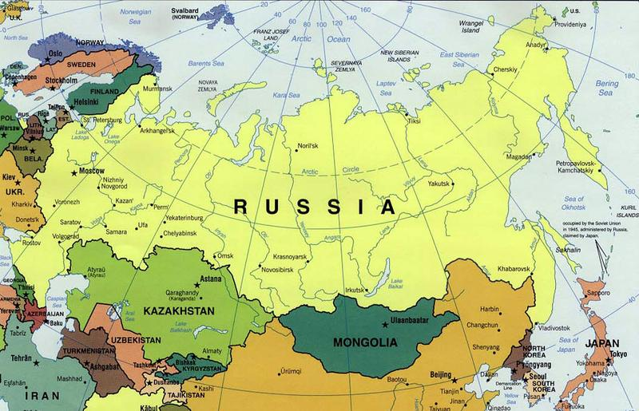
Russian Mission Trip

Slide 2
Syktyvkar Bible School

Slide 5
Griva Culture Center

Slide 6
Griva church of Christ

Slide 7
Kamyshin church of Christ

Slide 8
International Worship

Slide 9
Katya’s class

Slide 10
Tanya’s Class

