Slide 1
“He who has ears to hear, let him hear!!!!”
Matthew 11:15

Slide 2
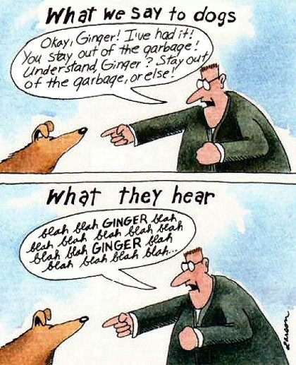
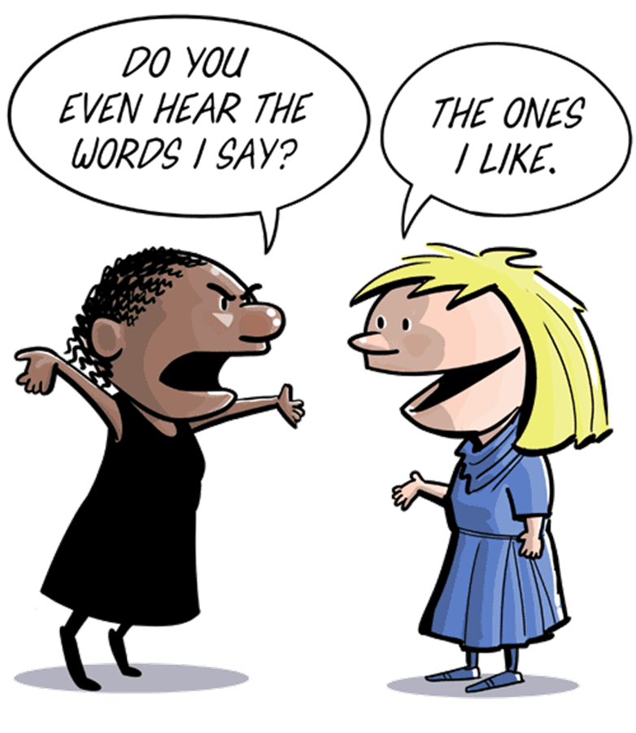

Slide 3
“He who has ears to hear, let him hear!!!!”
On several occasions, Jesus used this phrase in teaching the people.
David Lipscomb indicates “this expression demands special attention to these truths.”
Jesus in his infinite wisdom knew the things with which humanity would especially struggle?
In other words, PAY ATTENTION!!!

Slide 5
“He who has ears to hear, let him hear!!!!”
Take seriously……..
WHAT THE BIBLE SAYS
Matt. 11:11-15
John 8:31-32
John 12:48-50
II Peter 1:19

Slide 6
“He who has ears to hear, let him hear!!!!”
Take seriously……..
FAITHFULNESS TO GOD’S WILL
The parable of the sower illustrates this.
Discussion of the expectations of discipleship.
Matt. 13:9; Mark 4:9; Luke 8:8
Lamp and salt
Mark 4:23 and Luke 14:35

Slide 7
“He who has ears to hear, let him hear!!!!”
Take seriously……..
JUDGEMENT AND HELL
Matt.13:43
There is coming a day, regardless of how uncomfortable this subject is.
II Peter 3:3
Acts 17:30-31

