Slide 1
Growing Deeper with God:
By making the most of our time
Eph. 5:16

Slide 2
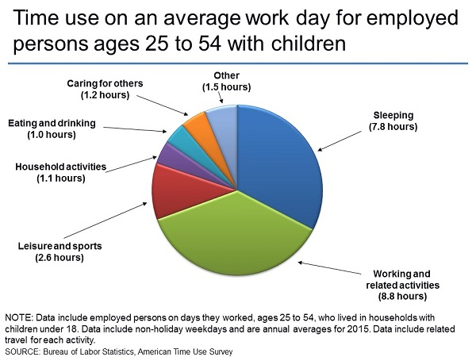

Slide 3
Growing Deeper with God:
Eph. 5:16- “Making the best use of the time, because the days are evil.”
Means “redeeming” or “purchase.”
Time is precious and valuable.
Ps. 90:12- “Teach us to number our days.”

Slide 4
Growing Deeper with God:
We will make the most of our time when………
HOLINESS IS OUR DETERMINATION
Eph. 4:24
I Peter 1:15-16
Heb. 12:14

Slide 5
Growing Deeper with God:
This is accomplished by determining to:
Give up our vices- Eph. 5:3
Conquer our shortcomings- 4:31
Practice virtues like kindness & forgiveness.
Express thanksgiving- Eph. 5:20
“Be the change you want to see in the world.”

Slide 6
Growing Deeper with God:
We will make the most of our time when………
HELPING IS OUR PASSION
Helping the church grow- Eph. 4:11-18
Helping the needy- Eph. 4:28
Helping the lost- Eph. 5:11-14

Slide 7
Growing Deeper with God:
Practical application:
Think of someone you can help.
Think of someone you can teach.
Think of how you can satisfy your boss and assist a co-worker.
Determine to do a mission trip.

Slide 8
Growing Deeper with God:
When we make the most of our TIME then we don’t have TIME for FOOLISHNESS.
Foolish talk- Eph. 5:4.
Foolish behavior- Eph. 5:15.
Foolish thoughts- Eph. 5:17.

