Slide 1
HEAVEN: Home Sweet Home
John 14:2

Slide 2
“If you lose Heaven, you lose everything. If you gain Heaven, you gain everything.”- Ellen White

Slide 3
“Clouds and Darkness surround us. Heaven is just, and the day of triumph will surely come when justice and truth will be vindicated.”- Mary Todd Lincoln

Slide 4
“As a Christian, Christ died so that we will have eternal life in Him in Heaven. What it looks like doesn’t matter, what it smells like doesn’t matter, as long as Jesus is there it will be Heaven to me.”- T.D. Jakes.

Slide 5
Heaven: Home Sweet Home
Meaning of the word Heaven:
Hebrew “Shaneh”- lofty, sky
Greek “Ouranus”- heaven or sky
The Latin form of this word is Uranus.
The seventh planet in our galaxy.
In order to understand Heaven we must dig deeper into the Scriptures.

Slide 6
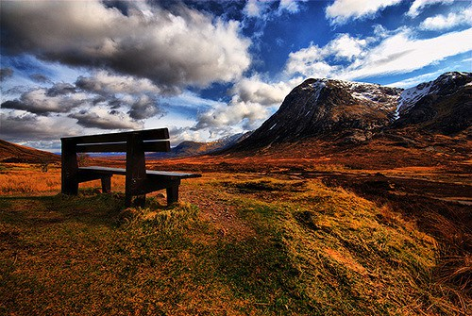
Heaven: Home Sweet Home
REST
Heb. 4
II Tim. 4:6-8
Heb. 12:1-3

Slide 7
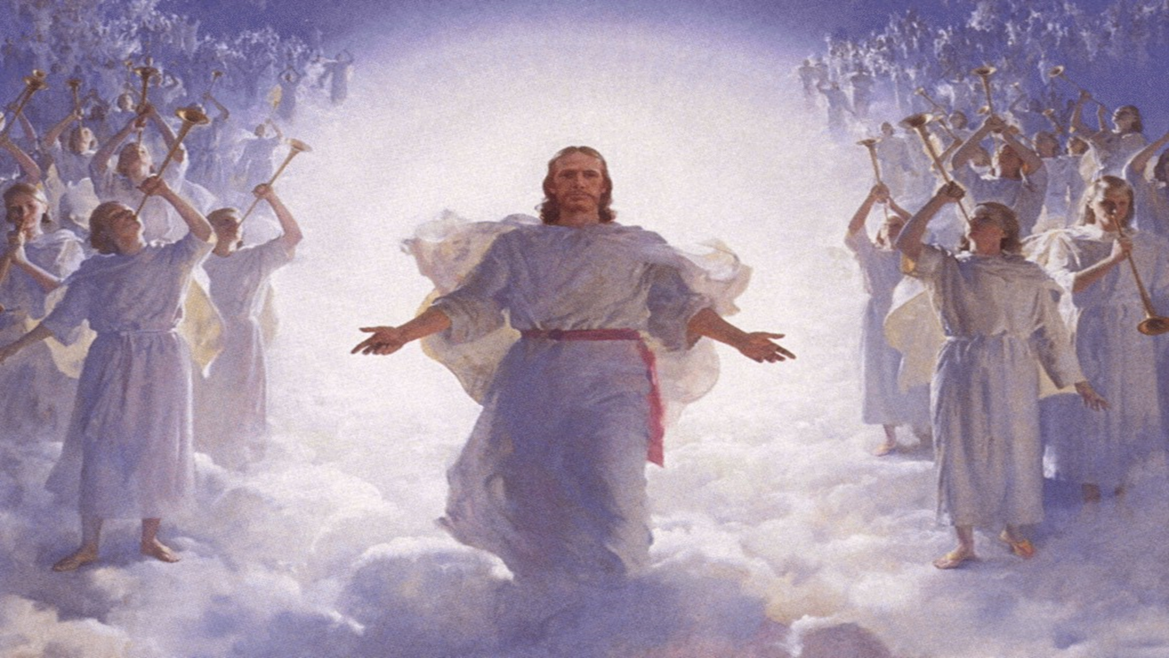
Heaven: Home Sweet Home
REUNION
I Thess. 4:17-18
John 14
Heb. 12:22-23

Slide 8
Heaven: Home Sweet Home
Relief and release
Romans 8:18-25
Matt. 25:21
“Joy is the serious Business of Heaven.”- C.S. Lewis

