Slide 1
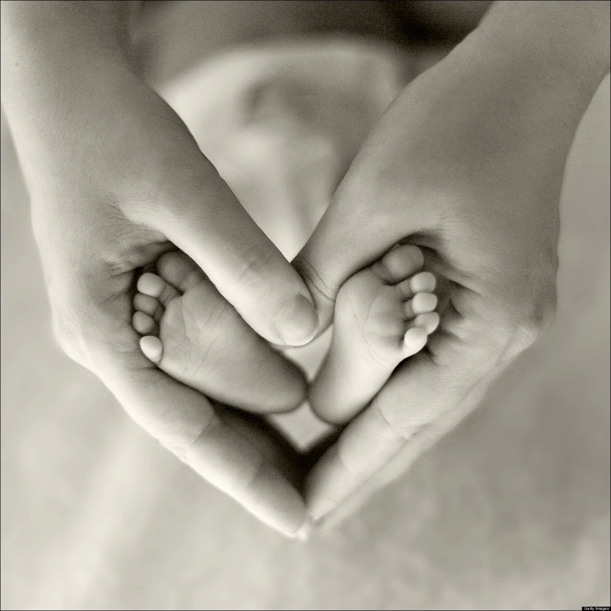
Mother Modeling
Titus 2:3-5

Slide 2
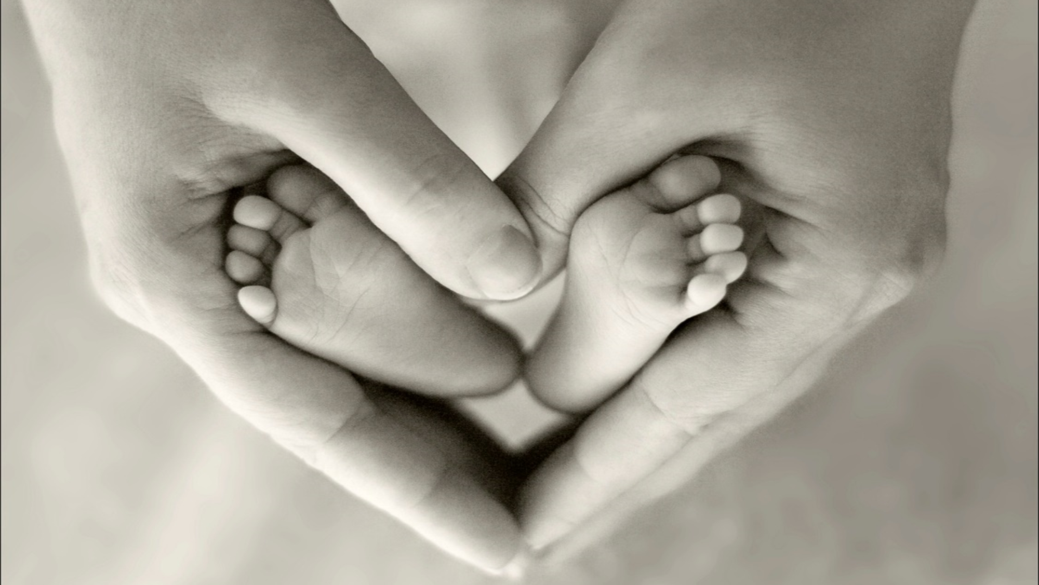
Mother Modeling
Paul’s discussion of a woman’s family responsibilities.
There is so much significance to a mother’s role in the family.
How does God see that role?

Slide 3
Mother Modeling
Moms, are we teaching our children……………….
MATURITY
Sober
Self-controlled
Discreet
Only used once in N.T. and means “safe (sound) in mind.”

Slide 4
Mother Modeling
Moms, are we teaching our children……………….
CHARITY
Love husband.
Love children.
PURITY
II Cor. 11:2
I Peter 3:2

Slide 5
Mother Modeling
Moms, are we teaching our children……………….
GOODNESS
OBEDIENCE
Has been translated submissive.
To be subordinate.
Titus 2:9

