Slide 1
“My God?”
Ruth 1:16

Slide 2
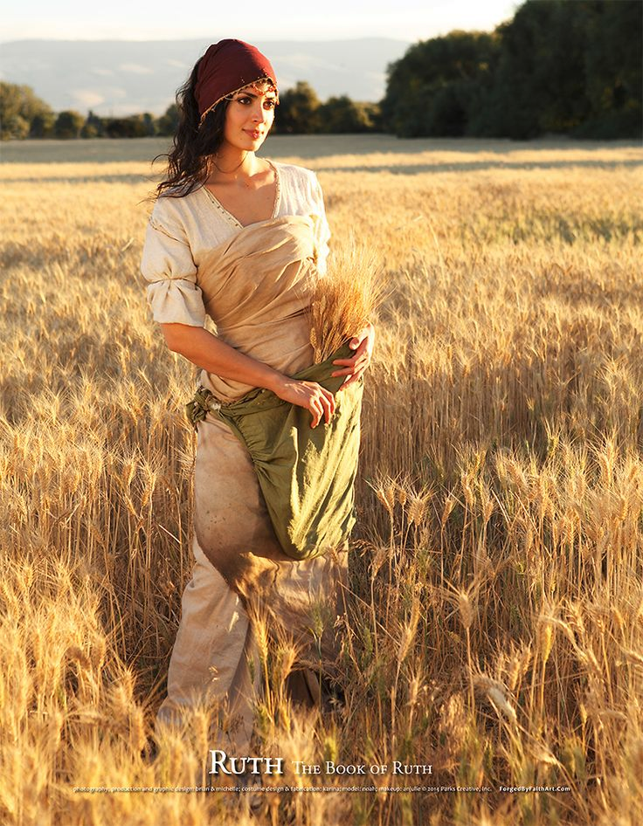
“My God?”
Back story of Ruth:
Time of the judges.
Elimelech leaves Israel with family for Moab.
Elimelech dies.
Two sons marry Moabite women.
Sons die ten years later.

Slide 3
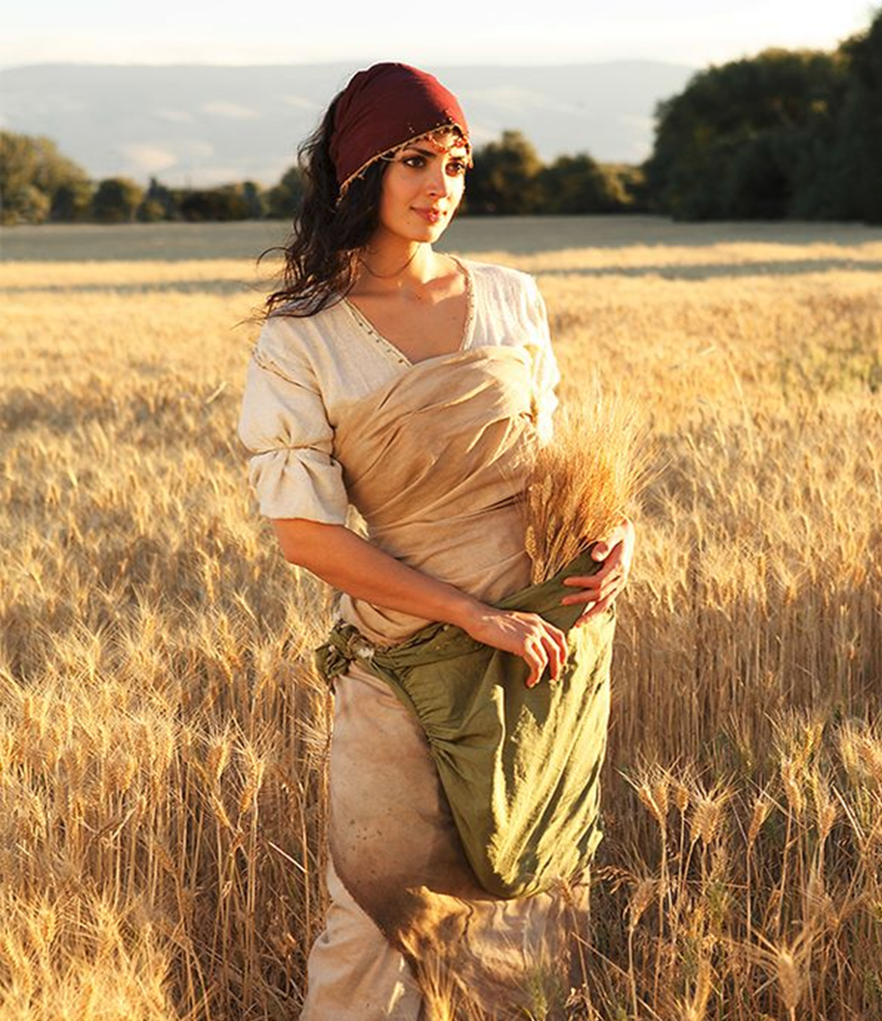
“My God?”
The current situation has left Naomi “bitter.”
She surmises that “the hand of the Lord has gone out against me.”
Enter Ruth 1:16
Why would a Moabite woman choose to serve the God of Naomi?

Slide 4
“My God?”
FALSE PERCEPTION:
When things go wrong then God is to blame.
Why do people choose to step away from God?

Slide 5
“My God?”
Asked to accept a difficult truth.
Matt. 19:16-22, John 6:66
Experience some type of difficult tragedy.
Death of a loved one
Prayer for healing to no avail.
Encounter some difficult set-back. Job/income, cruelty

