Slide 1
Distracted Worship
How to Get Focused!

Slide 2
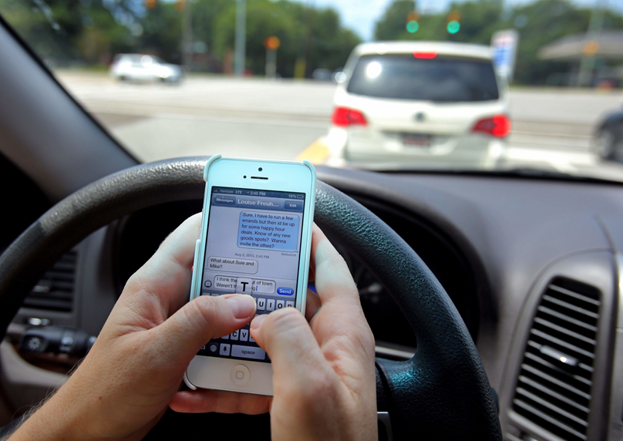
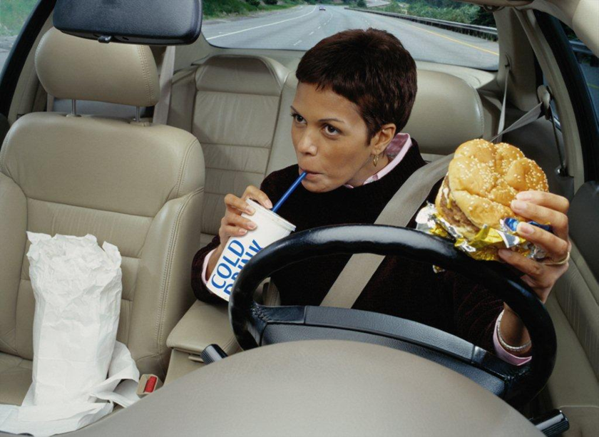
Distracted Worship
We hear a lot about DISTRACTED DRIVING.

Slide 3
Distracted Worship

Slide 4
Distracted Worship
Does this ever happen to you in worship?
What are some things that run through your mind?

Slide 5
Distracted Worship
How can we develop focus in Worship?
STILL your mind
Quiet your mind- Ps. 119:15-17, Phil. 4:6-7
SET your mind
Col. 3:5; Ps. 57:7; Heb. 12:18-28; I Cor. 9:7
SUPPLY your mind
Ps. 1:1-2; Phil. 4:8

