Slide 1
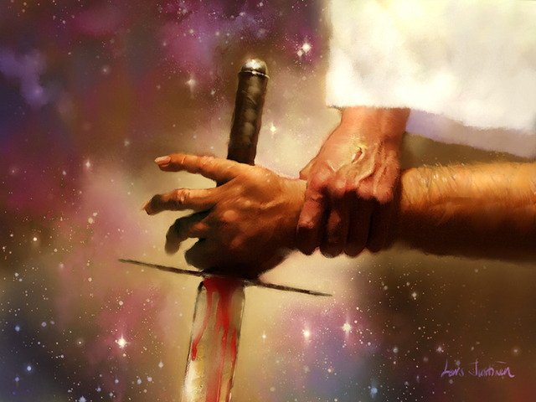
Destroy and Deliver
Hebrews 2:14-15

Slide 2
Destroy and Deliver
“Since therefore the children share in flesh and blood, he himself likewise partook of the same things, that through death he might DESTROY the one who has power of death, that is, the devil, and DELIVER all those who through fear of death were subject to lifelong slavery”

Slide 3
Destroy and Deliver
Isaiah prophesies about this event- Is. 25:7-8. INCLUDED ARE THE….
WHERE
WHAT
What a soothing passage for Christians.
Two reasons are given that we should analyze.

Slide 4
Destroy and Deliver
DESTROY THE DEVIL
DEATH has been the weapon of satan.
To Destroy the DEVIL, Christ had to DIE.
Jesus took the Devil’s WEAPON.
Not completely gone or powerless
Still alive and vindictive
He has been and still is a “MURDERER.” (john 8:44).

Slide 5
Destroy and Deliver
DELIVER THE DEAD
Romans 5:12
Eph. 2:1-6
Jesus has removed the FEAR.
Jesus replaces ANXIETY with ANTICIPATION, the PANIC with PEACE, and the DEPARTURE with DELIGHT.
“live like I was LIVING.”

