Slide 1
A WISE MAN
Proverbs 30:1-5

Slide 2
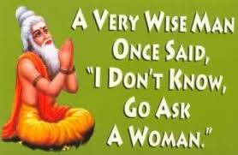

Slide 3
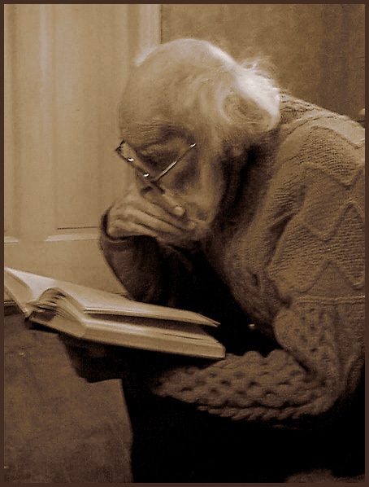
A Wise Man
Understands his limited knowledge
Prov. 30:1-4
I Cor. 8:2
Prov. 1:7
Prov. 3:3,5
Job 38-41

Slide 4
A Wise Man
Recognizes strength and truth
Proverbs 30:5-7
Purity- Ps. 119:140
Protection- Eph. 6:16
Permanent- Rev. 22:18-19

Slide 5
A Wise Man
Anticipates his human tendencies
Proverbs 30:7-9
Lying
Vanity
Desperation

Slide 6
A Wise Man
Sees the world for what it is
Prov. 30:10-14
The injustice
The hypocrisy
The evil

