Slide 1
What do you think about Christ?
MATTHEW 22:42

Slide 3
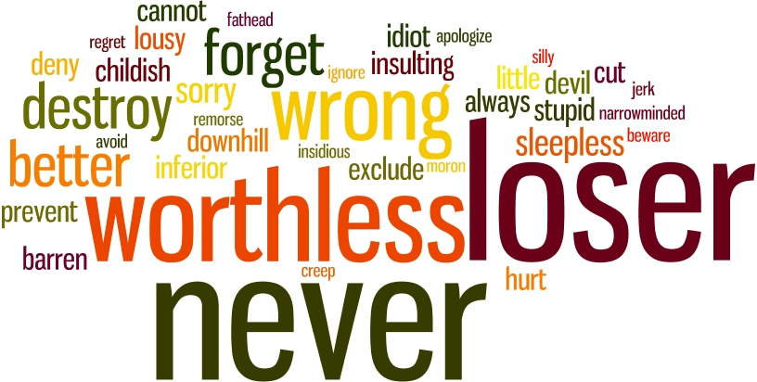

Slide 4
What do you think about Christ?
Matthew 27:42-43
Here are a few things they thought:
POWERLESS
FAILURE
FRAUD
UNDESIRABLE

Slide 5
What do you think about Christ?
But the real question today is…
What do you think about him?
Is He your SAVIOR?
Is He your CHAMPION?
Is He your LORD?

