Slide 1
Jesus Walks on Water
John 6:16-21

Slide 2
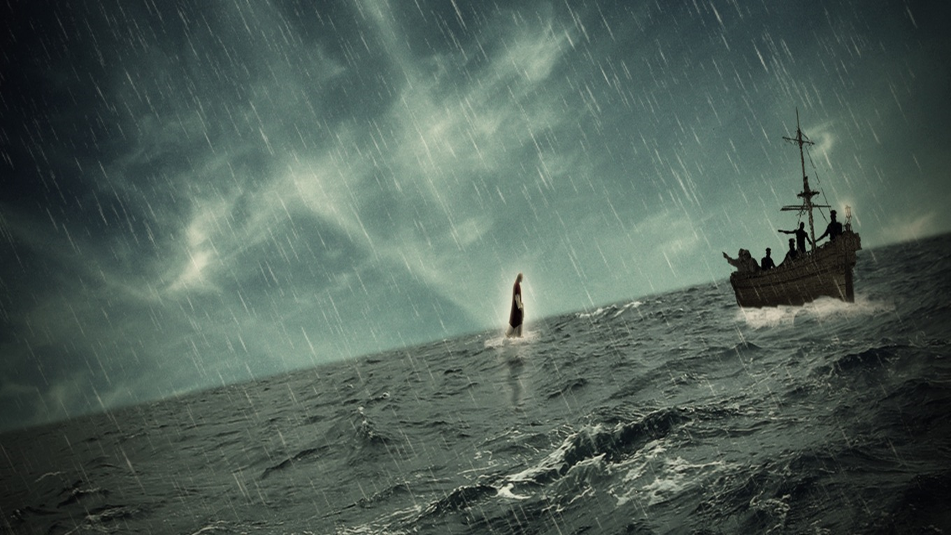
Jesus Walks on Water
Have you ever observed something that made your jaw drop?
There are some amazing stories of the things Jesus did.
People often say about folks they love and respect, “He/she walks on water.”
But to actually witness this would be astounding.

Slide 3
Jesus Walks on Water
This story teaches us…….
JESUS DOES AMAZING THINGS TO BE NEAR HIS PEOPLE
John 6:19
“O Listen to our wondrous story”\
Phil. 2:5-8
James 4:8

Slide 4
Jesus Walks on Water
This story teaches us…….
JESUS CALMS THE STORMS OF LIFE WHEN WE LET HIM IN OUR BOAT
John 6:20
Matt. 11:28-30
Rev. 3:20

Slide 5
Jesus Walks on Water
This story teaches us…….
JESUS WILL DELIVER US TO THE PLACE WE NEED TO GO
John 6:21
Immediate response will lead to an immediate result.
Acts 16:32, Col. 1:13
John 14:1-4

