Slide 1
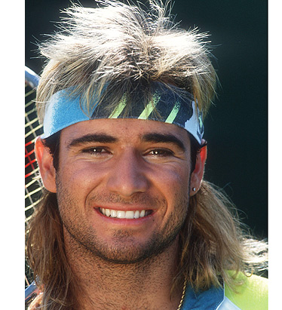
Image is everything!
Andre Agassi

Slide 2
Image is everything!
Text: Col. 3:2-17
Consider the concept of this background picture from Genesis 1:26-27 and the Hebrew understanding.
Are you a “monster” or a “minister?” Can people tell the difference in you?
How are we perceived?

Slide 3
Image is everything!
Image is everything when it comes to….
INFLUENCING THE WORLD
Matt. 5:14-16
Acts 13:47
Phil. 2:12-17

Slide 4
Image is everything!
Image is everything when it comes to….
MY HOPE FOR HEAVEN
Col. 3:2-17
How is this accomplished?
By allowing the “word of Christ to dwell in us richly…”
II Cor. 3:18

Slide 5
Image is everything!
Image is everything when it comes to….
MY ETERNAL GLORY
Romans 8:29
I Cor. 15:49
I am going to be transformed to be just like Jesus. Not almost but completely!

