Slide 2
Philip Goad Vice President of University Advancement www.hcu.edu pgoad@hcu.edu

Slide 3
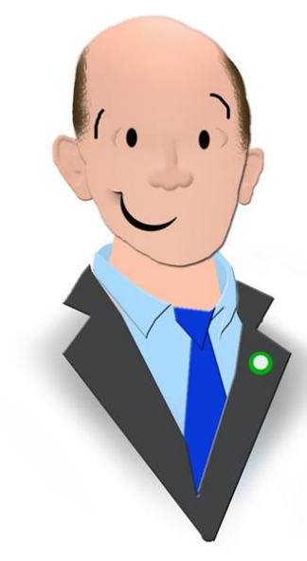
THANK YOU FLINT!

Slide 4
Reserve your place today!

Slide 5
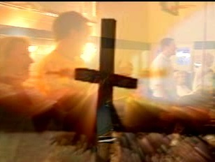
POINTING THE WAY TO FELLOWSHIP

Slide 6
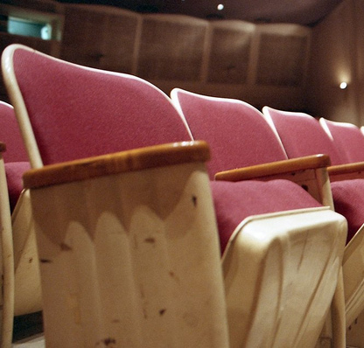
MISSING…
Most of us can point to a specific seat that used to be occupied by a person who is no longer in with us.

Slide 7
WHAT GOD WANTS…
No one to perish
No one to fall away or to be hardened by the deceitfulness of sin
Community… God’s plan for securing the saved!

Slide 8
THE BIG IDEA…
As family, each one of us has an important role in promoting the kind of strong Christian fellowship where we are actively helping each other go to heaven!

Slide 9
VALUABLE INFORMATION…
“When we left, no one asked why. No one visited or called.”

Slide 10
WHERE PEOPLE ARE…
Some people seem to want God but not the church.
Some people think it’s too risky to admit weakness.

Slide 11
WHERE PEOPLE ARE…
Some are consumers first.
Some are just barely hanging on.

Slide 12
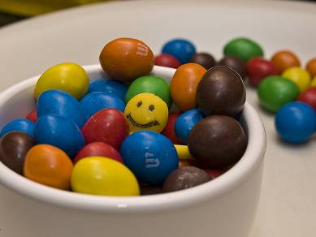
WHERE PEOPLE ARE…
Some are desperately trying to fit in.

Slide 13
DOING COMMUNITY WELL…
Acts 2 paints the picture of people who are DEVOTED to God and to each other!

Slide 14
DOING COMMUNITY WELL…
Church at 3 levels:
Celebration – worship assembly
Congregation – potentially the size of a large Bible class (60 max)
Cell – 10-12 people who help me live out my faith

Slide 15
CLOSE ENOUGH TO CARE?
10% - NO close friends
10% - Just one or two
30% - Close friends? Yes, but no real visiting in the last 12 months
50% - Close friends? Yes, but time spent together is always something other than spiritual

Slide 16
CLOSE ENOUGH TO CARE?
Only 10% of those surveyed said they have close, personal friendships within the church where at least SOME of the time spent together is on activities that will help each other grow spiritually.

Slide 17
DOING COMMUNITY WELL…
Powerful Key Statistic:
50 recent converts still faithful – all had 7 or more friendships
50 recent converts fallen away – all had 3 or fewer friendships

Slide 18
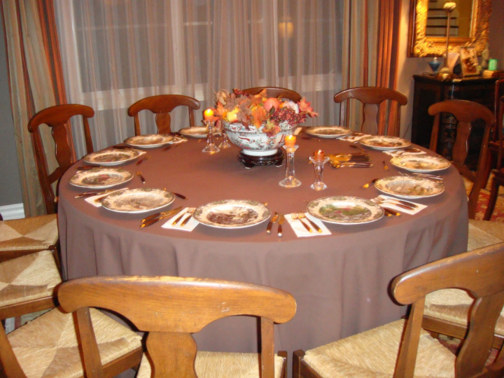
MOST POWERFUL RELATIONSHIP BUILDER?
“We are having more babies than you people are having, but the main thing is that we have found that we make one convert for every two people we have into our homes for a meal.”

Slide 19
THE BIG IDEA…
As family, each one of us has an important role in promoting the kind of strong Christian fellowship where we are actively helping each other go to heaven!

