Slide 2
O Lord, How Majestic is your Name
Text: Psalm 8
Majestic or Excellent defined
Hebrew word “Addiyr” –wide or large (powerful)
Also construed as: excellent, famous, gallant, glorious, goodly, lordly, mighty, noble, principal, worthy.

Slide 3
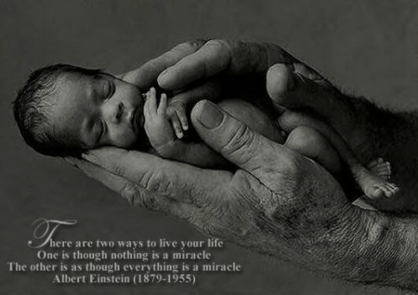
O Lord, How Majestic is your Name
God’s name is majestic because of the ……………
TESTIMONY OF BABES
Could be a literal meaning- Ps. 139:13-16
Could be a figurative meaning-
Matt. 21:12-16
I Cor. 1:25-27
Matt. 11:25

Slide 4
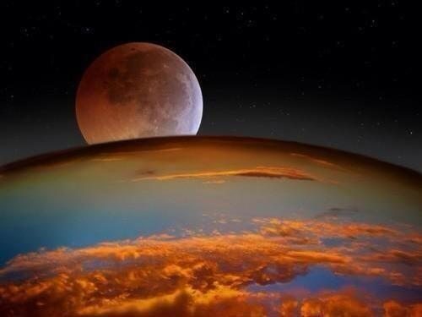
O Lord, How Majestic is your Name
God’s name is majestic because of the ……………
BRILLIANCE OF HIS CREATION
Gen. 1:1
Ps. 19:1-6
Ps. 111:2-3
Romans 1:20

Slide 5
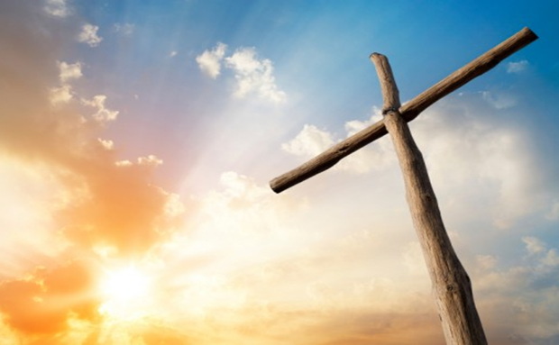
O Lord, How Majestic is your Name
God’s name is majestic because of the ……………
CARE HE HAS FOR MAN
Think about your place as part of this vast universe.
Romans 5:8
I Peter 5:7

Slide 6
O Lord, How Majestic is your Name
God’s name is majestic because of the ……………
GLORY HE HAS GIVEN TO MAN
Little Lower than the angels.
Gave him dominion.
Has now made us co-workers with him in salvation.

