Slide 1
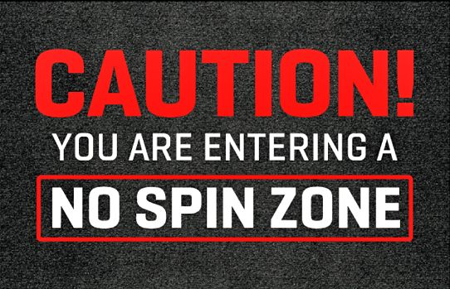

Slide 2
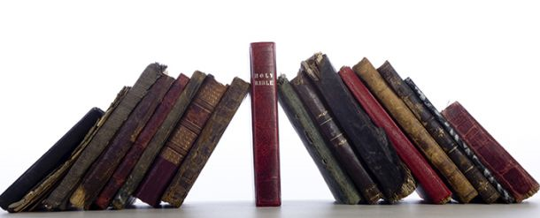
NO-SPIN ZONE
Text: Acts 20:27-32
Bill O’Reilly and the no-spin zone
People can spin things to make them sound good.
Example of 8 year old quarterback.
There have been many SPIN DOCTORS in the past and just as many these days.
The Bible is a no spin zone.

Slide 3
NO-SPIN ZONE
Known Spin doctors include:
Pharisees and Scribes
Matt. 15:12
Matt. 19
Matt. 23:5,16,25
Matt. 5- Jesus set the record straight

Slide 4
NO-SPIN ZONE
Known Spin doctors include:
Leaders of the first century church
Acts 20:26-32
II Tim. 3:1-9; 13-14
II Tim. 4:1-5

Slide 5
NO-SPIN ZONE
Known Spin doctors include:
Many current leaders
In the World
Political leaders
Media
In Religion
False teachers/preachers
Unfaithful elders

