Slide 2
pre-co-cious: adj.
1. matured beyond normal for one’s age, esp. in mental capacity, talent, etc.

Slide 4
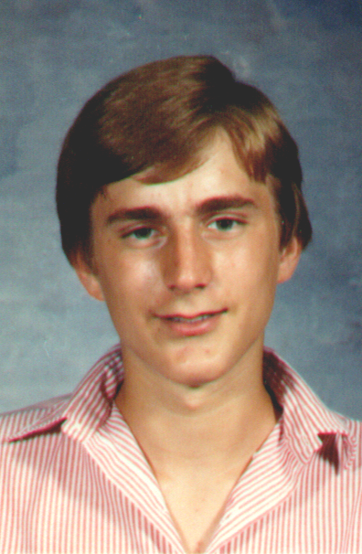
All I Need to Know About Infatuation
I Learned in
9th Grade

Slide 5
What I Learned About Infatuation
Infatuation happens to everyone. And every infatuation seems innocent enough at the beginning.

Slide 6
From the Story of the Prodigal Son
Luke 15:11-13 (NKJV) ¹¹ Then He said: "A certain man had two sons. ¹² And the younger of them said to his father, 'Father, give me the portion of goods that falls to me.' So he divided to them his livelihood. ¹³ And not many days after, the younger son gathered all together, journeyed to a far country…

Slide 7
1 John 2:15-16 (NKJV)
¹⁵ Do not love the world or the things in the world. If anyone loves the world, the love of the Father is not in him.
¹⁶ For all that is in the world--the lust of the flesh, the lust of the eyes, and the pride of life--is not of the Father but is of the world.

Slide 8
1 John 2:17 (NKJV)
¹⁷ And the world is passing away, and the lust of it; but he who does the will of God abides forever.

Slide 9
What I Learned About Infatuation
The thrill of infatuation lies in the hope that it is leading to something wonderful.

Slide 10
What I Learned About Infatuation
The illusion of infatuation is that each infatuation feels equally valid… equally harmless.

Slide 11
What I Learned About Infatuation
The deception of infatuation lies in the belief that you are now, and will always be, in control of the situation.

Slide 12
1 Timothy 6:9-10 (NKJV)
⁹ But those who desire to be rich fall into temptation and a snare, and into many foolish and harmful lusts which drown men in destruction and perdition.
¹⁰ For the love of money is a root of all kinds of evil, for which some have strayed from the faith in their greediness, and pierced themselves through with many sorrows.

Slide 13
From the Story of the Prodigal Son
SIN CAN…
…take you farther than you wanted to go.
…cost you more than you were willing to pay.
…keep you longer than you wanted to stay.
Luke 15:13-16 (NKJV)
¹³ …journeyed to a far country…
¹⁴ …when he had spent all…
¹⁶ …And he would gladly have filled his stomach with the pods that the swine ate, and no one gave him anything.

Slide 14
What I Learned About Infatuation
The reward of infatuation lies in whether or not the object of you infatuation is worthy.

Slide 15
James 4:4 (NKJV)
⁴ Adulterers and adulteresses! Do you not know that friendship with the world is enmity with God? Whoever therefore wants to be a friend of the world makes himself an enemy of God.

Slide 16
Romans 6:16 (NKJV)
¹⁶ Do you not know that to whom you present yourselves slaves to obey, you are that one's slaves whom you obey, whether of sin leading to death, or of obedience leading to righteousness?

