Slide 2
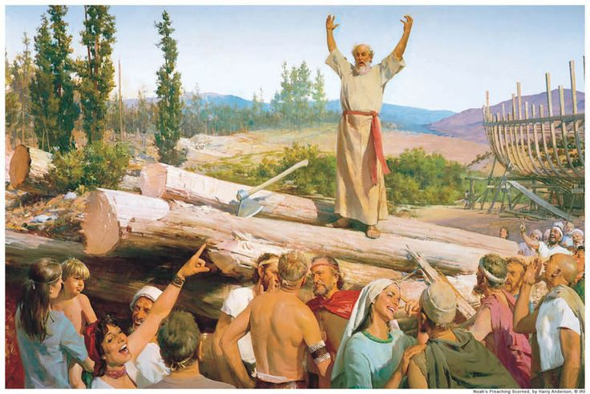
A Godless Generation
JUDGES 2:8-12
Apostasy has always been a problem.
What are the consequences of a Godless generation?
Three methods of keeping God’s true religion ALIVE!!!!!

Slide 3
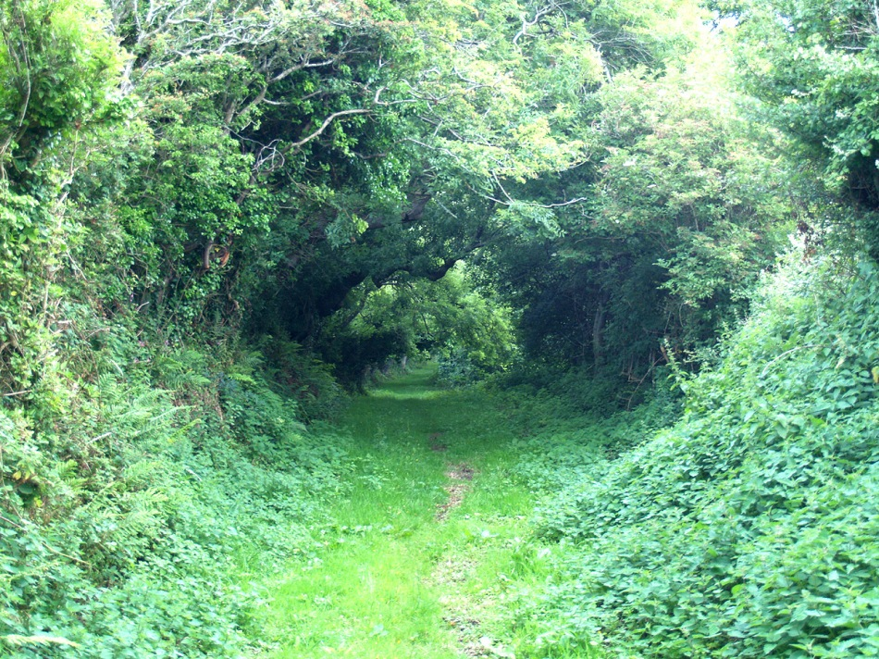
JEREMIAH 6:16
“Thus says the LORD, Stand ye in the ways, and see, and ask for the old paths, where is the good way, and walk therein, and you shall find rest for your souls. But they said, We will not walk therein.”

Slide 4
Deut. 6:6-7
Tragic example of Eli
God’s confidence in Abraham
Joshua’s family
N.T. emphasis- Eph. 6:4, II Tim. 1:15

Slide 5
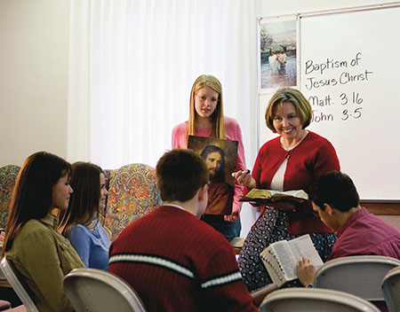
Faithful Teachers
Deut. 31:12
Aaron’s instructions
Ezra’s Purpose
Christian Duty

Slide 6
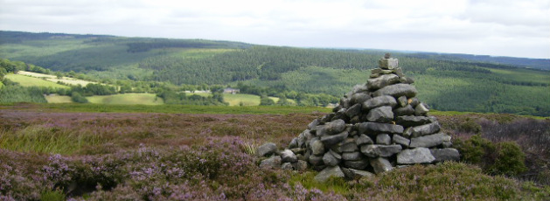
Remember God’s landmarks
Old Testament
Joshua and 12 stones
Sabbath Day
Passover
New Testament
1st Day of the week
Lord’s Supper and Baptism

Slide 7
