Slide 1
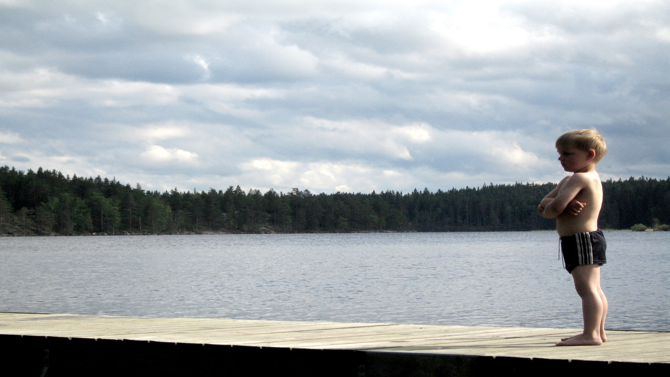
How to build COURAGE
Build courage through……..
EXHORTATION FROM GOD’S WORD
Joshua 1:6-9
I Cor. 16:13
Ps. 118:6, Matt. 10:28, Heb. 13:6

Slide 2
How to build COURAGE
TEXT: Deut. 31:1-8, 23
Admit it! We have all been this kid.
Obviously, the opposite of courage is fear.
So then how do we overcome fear.
Combat fear with faith.

Slide 3
How to build COURAGE
Build courage through……..
EXAMPLES FROM GOD’S WORD
II Kings 6:16
Daniel 3
Acts 27:9-25
John 14, Matt. 26:36ff

Slide 4
How to build COURAGE
Build courage through……..
EXPERIENCING GOD’S WORD
Romans 10:17
Phil. 2:12
James 2:22,26
Practice something so much that it brings peace.

