Slide 1
THE
PRICE
OF
freedom

Slide 3
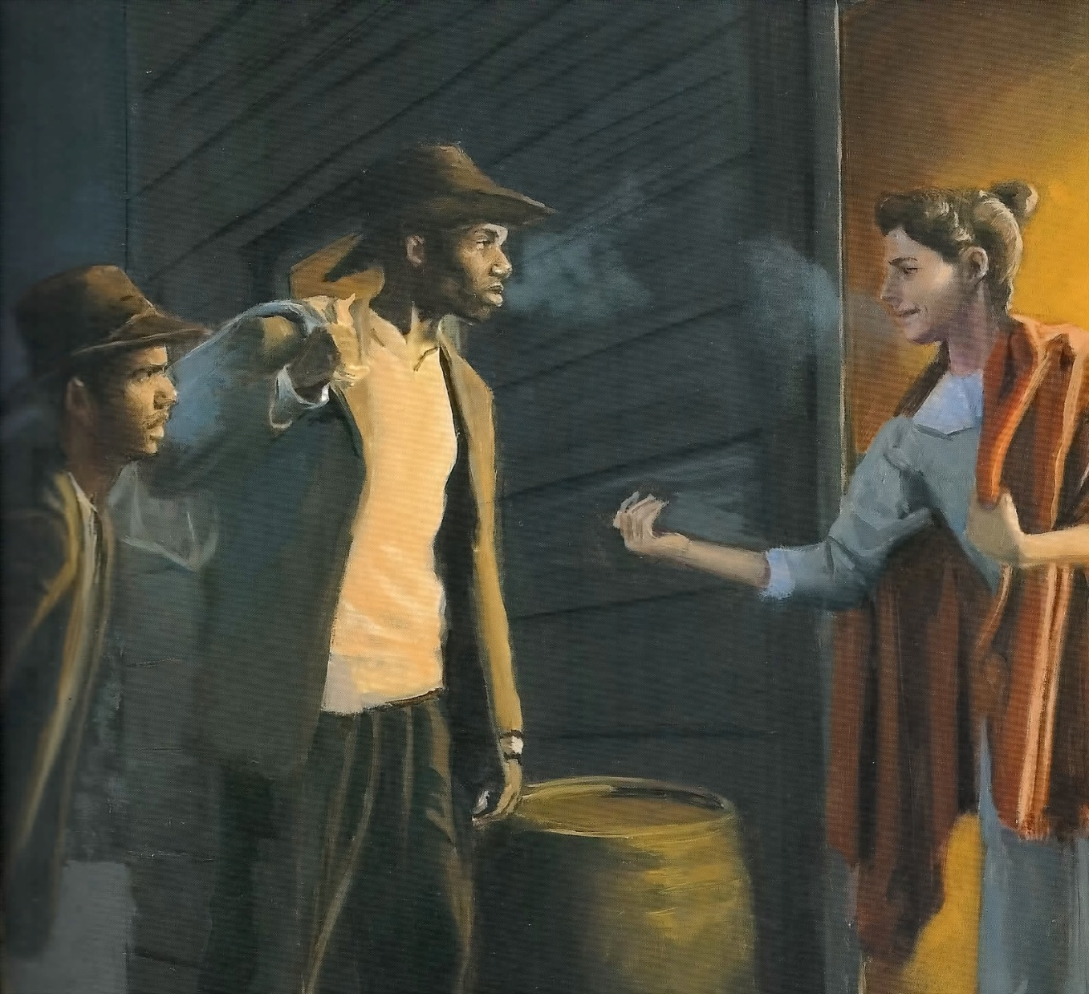

Slide 4
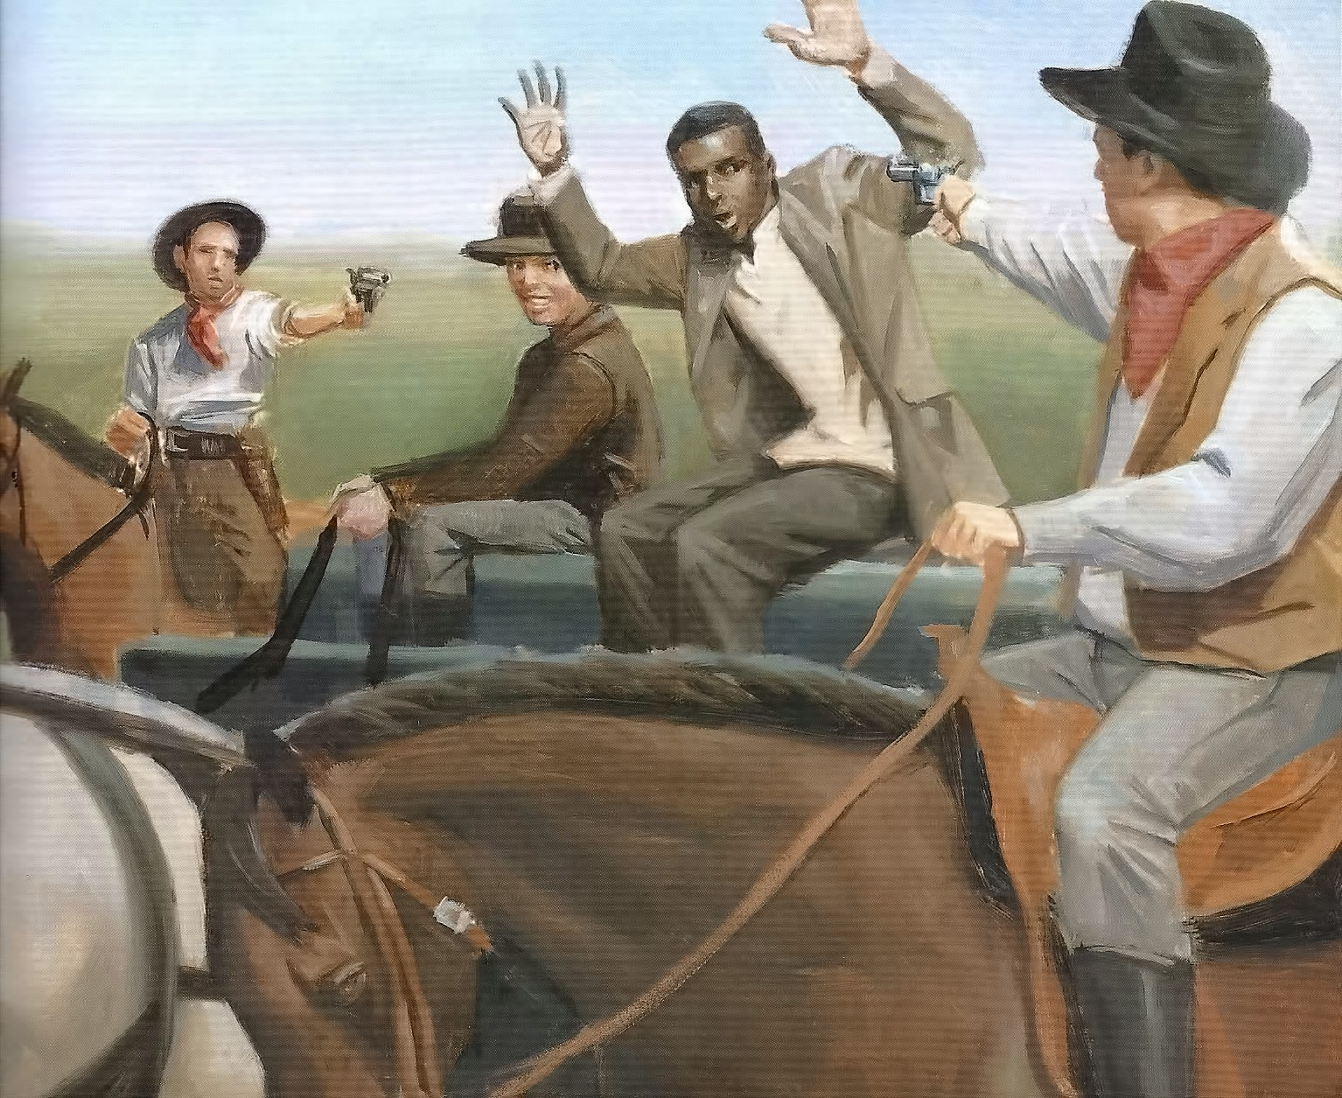

Slide 5
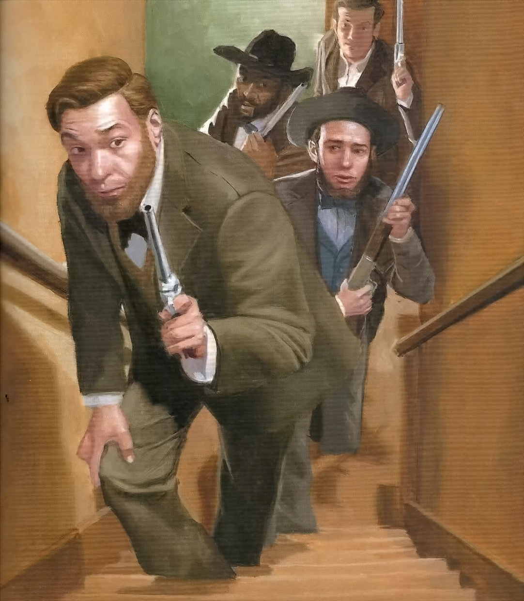
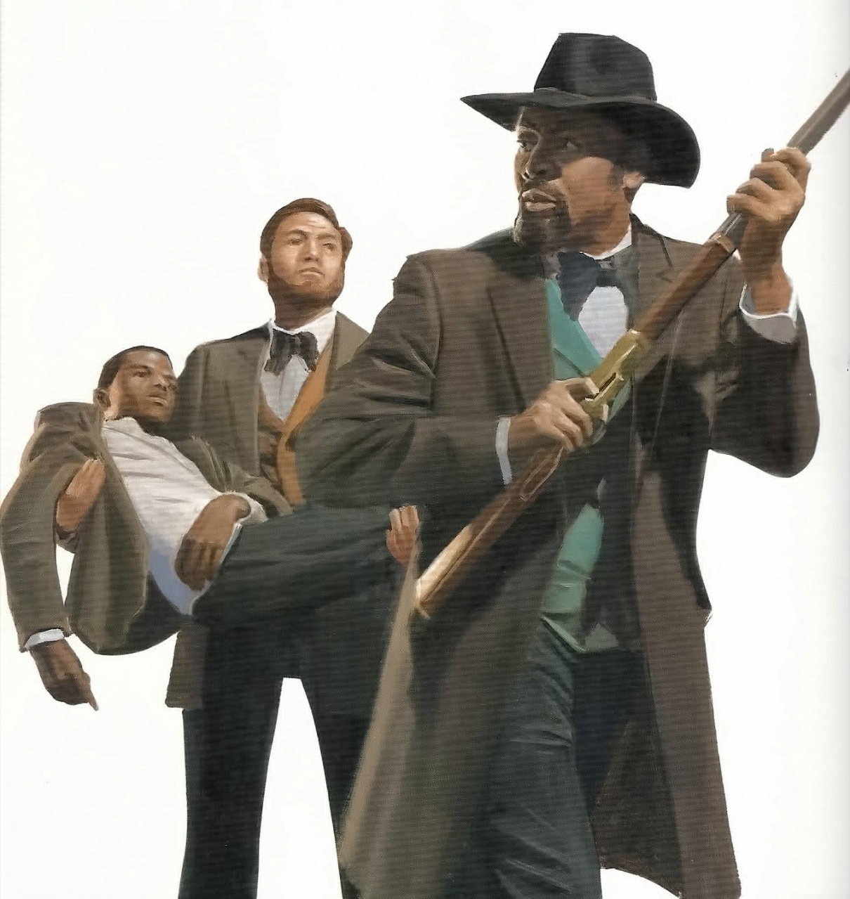

Slide 6
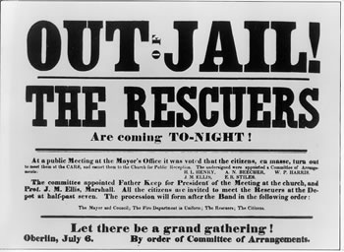

Slide 7
Slavery Exists Today
Romans 6:16 (NKJV) ¹⁶ Do you not know that to whom you present yourselves slaves to obey, you are that one's slaves whom you obey, whether of sin leading to death, or of obedience leading to righteousness?

Slide 8
Some Escape
Romans 6:17-18 (NKJV) ¹⁷ But God be thanked that though you were slaves of sin, yet you obeyed from the heart that form of doctrine to which you were delivered. ¹⁸ And having been set free from sin, you became servants of righteousness.

Slide 9
Those Who Escape Need Help to Stay Free
As with the Underground Railroad, individuals play their part.
But there is also a community committed to spiritual freedom… the church!

Slide 10
Satan Doesn’t Give Up on Regaining His Former Slaves
There is no statute of limitations on Satan’s hope of returning folks to slavery.

Slide 11
How Committed a Community are We?
Some, like the Boyntons, don’t share that commitment.
How many of us who do are willing to place ourselves at risk in order to be Rescuers?

Slide 12
There Will Be a Grand Gathering

