Slide 1
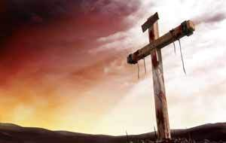
NO ATONEMENT FOREVER!!
Text: I Samuel 3:11-14
This passage records a frightening message.
It would make the ears tingle.
Means to rattle as with teeth chattering.
II Kings 21:12 and Jeremiah 19:3
There would be no atonement for Eli’s house.

Slide 2
NO ATONEMENT FOREVER!!
God’s fury is directed at those who……..
COMMIT SIN IN HIS NAME
How had Hophni and Phinehas sinned?
Priests who didn’t know the Lord.
Perverted the worship of God.
Engaged in immoral activity with women.

Slide 3
NO ATONEMENT FOREVER!!
God’s fury is directed at those who……..
They took advantage of the people for wealth.
They were a stumbling block for the people religiously.
Consider the parable of the wheat and tares.
Acts 20:29-30

Slide 4
NO ATONEMENT FOREVER!!
God’s fury is directed at those who……..
IGNORE WICKEDNESS
Why did his sons not know the Lord?
What could he have done about their sin?
HE COULD HAVE REMOVED THEM!!!!!

Slide 5
NO ATONEMENT FOREVER!!
God’s fury is directed at those who……..
WHO WILLFULLY CHOOSE TO DO EVIL
Heb. 10:26-29
There is a point at which this happens today.
Don’t harden your heart but make a change.

