Slide 1
BECAUSE HE LOVED ME SO
Text: John 3:16
Happy Valentine’s Day to everyone.
What an awesome opportunity to talk about love and the one who defines it.
I John 4:8- “God is love.”
Tonight, I want to examine a few different manifestations of Jesus’ love for us.

Slide 2
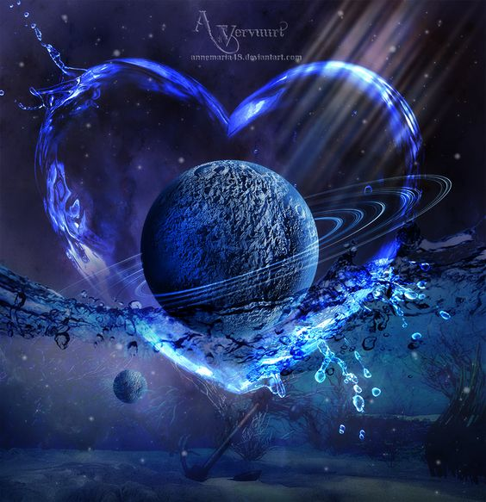
BECAUSE HE LOVED ME SO
His love is manifested………
IN HIS CREATION OF THE WORLD
I John 4:7, 19
His love for us has been evidenced from the beginning.
He created beings capable of loving him and be-ings loved by him. See what he created for us?

Slide 3
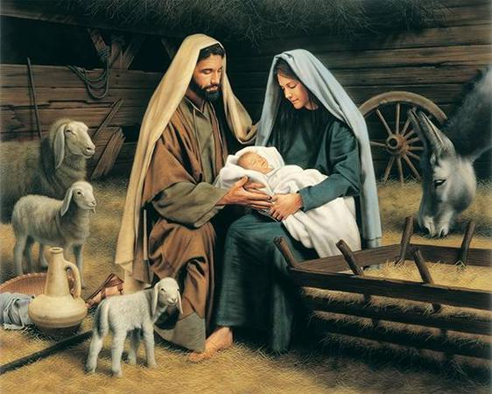
BECAUSE HE LOVED ME SO
His love is manifested………
IN HIS COMING TO EARTH
We sing a song “Why did my Savior come to earth?”
Humbled himself.
Chose a lowly birth.
Where men his grace would not receive.

Slide 4
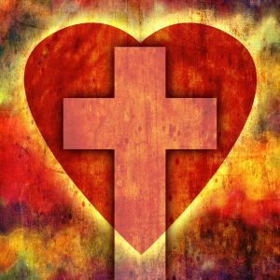
BECAUSE HE LOVED ME SO
His love is manifested………
IN HIS DEATH
The overcoming of it as the song suggests
The Concept of Death
The Concern of Death
The Consequences of Death

