Slide 2
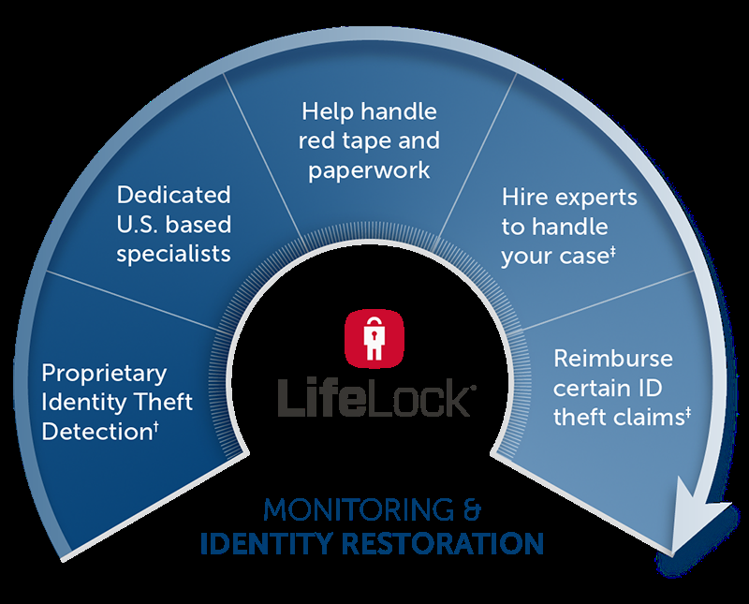
Identity Theft
Numerous companies advertise their ability to keep this from happening to you.
Has anyone tonight been a victim of identity theft?
19 victims of this crime every minute.
Evil devices.

Slide 3
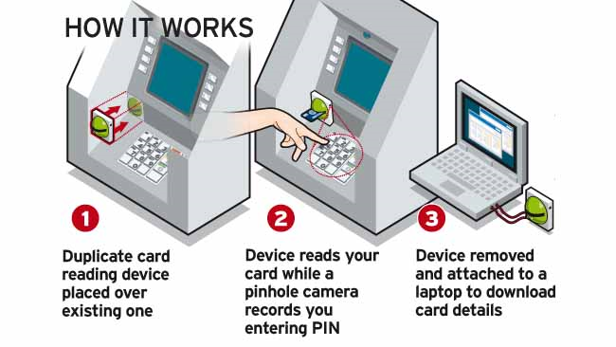

Slide 5
Identity Theft
SATAN WANTS US TO FORFEIT OUR IDENTITY
Matthew 4:3,6
Notice Satan’s approach to Jesus, “If you are the Son of God.”
Jesus didn’t have an identity crisis. He knew who he was and what he was.

Slide 6
Identity Theft
SIN IS SATAN’S PLAN TO GET US TO FORFEIT OUR IDENTITY.
I John 3:8-10
I John 5:18-20
John 10:3-5, 27
A son of God does not answer to Satan’s call.

Slide 7
Identity Theft
How to avoid spiritual identity theft:
Romans 8:14
II Cor. 6:14-18
Gal.3:26-27

