Slide 1
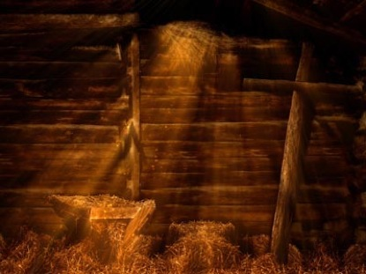
52 Weeks of Christmas
Text: Acts 20:7
ETYMOLOGY OF THE WORD “CHRISTMAS”
Has come to mean a celebration of Jesus’ birth.
Word Study reveals
Christ means- Anointed one
Mas means- feast, festival, mass
Better meant to celebrate Jesus’ death.

Slide 2
52 Weeks of Christmas
CHRISTMAS TREE ANALOGY
The true Christmas tree is better represented as the cross.
Acts 5:30
Gal. 3:13
I Peter 2:24
The true spirit of Christmas is observed each week in the celebration of Jesus’ death on the cross.

Slide 3
52 Weeks of Christmas
CHRISTMAS TREE GIFT
Christians have accepted this gift.
I Cor. 1:18
Col. 1:20; 2:13-15
Eph. 2:13-16
I Peter 2:24
If you are not a Christian then your gift remains unopened.

Slide 4
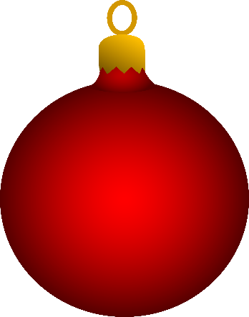
Chris

