Slide 1
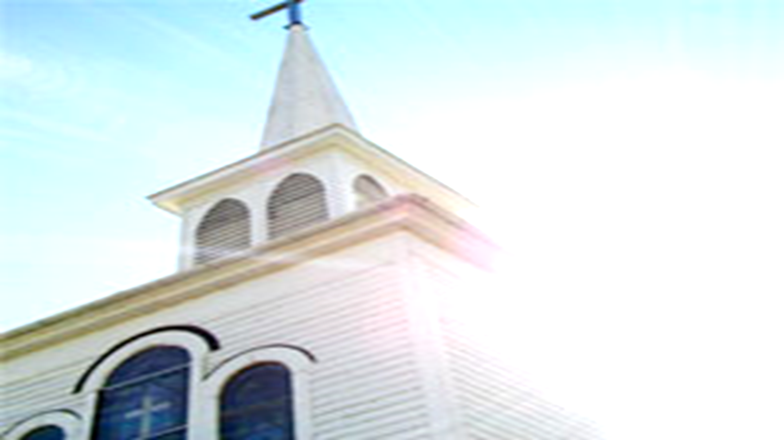
A Church for which God is Thankful
Acts 17:1-4
What does a church so described look like?
For an idea consider First Thessalonians.
Paul speaking on behalf of God in this epistle discusses:
What he appreciates about this congregation.
That for which they seemed to excel.

Slide 2
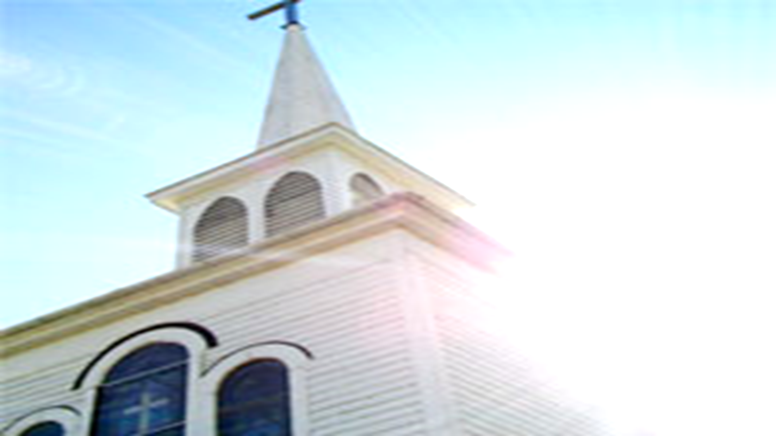
A Church for which God is Thankful
Thankful for a church that…………..
Is Living its Faith
I Thess. 1:2-3,9
I Thess. 4:1
Is Steadfast in its convictions
I Thess. 1:5-6
Acts 17:1-13
I Thess. 2:14-16

Slide 3
A Church for which God is Thankful
Thankful for a church that…………..
Is Mission Minded
I Thess. 1:6-8
Honors the Bible
I Thess. 2:13
Excels in Brotherly Love
I Thess. 4:9-10

Slide 4
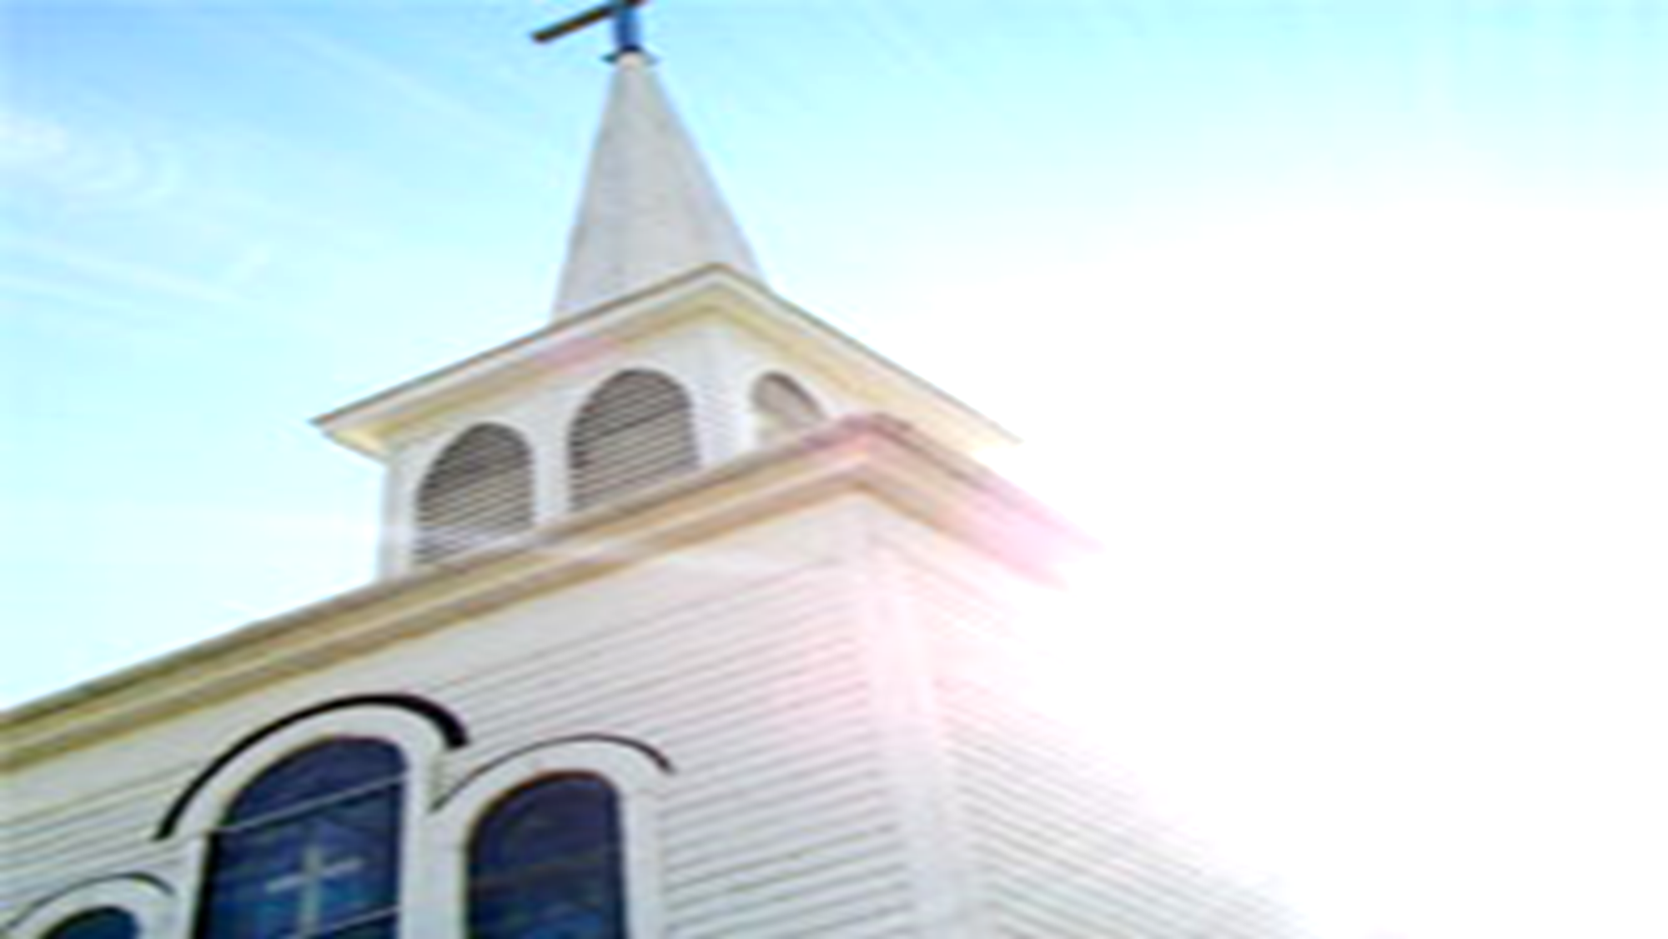
A Church for which God is Thankful
Thankful for a church that…………..
Gives thanks in all circumstances
I Thess. 5:18
Admonishes and encourages those with spiritual struggles
I Thess. 5:14
Is Prepared for the Return of Christ
I Thess. 5:1-3
Eph. 5:25-27

