Slide 1
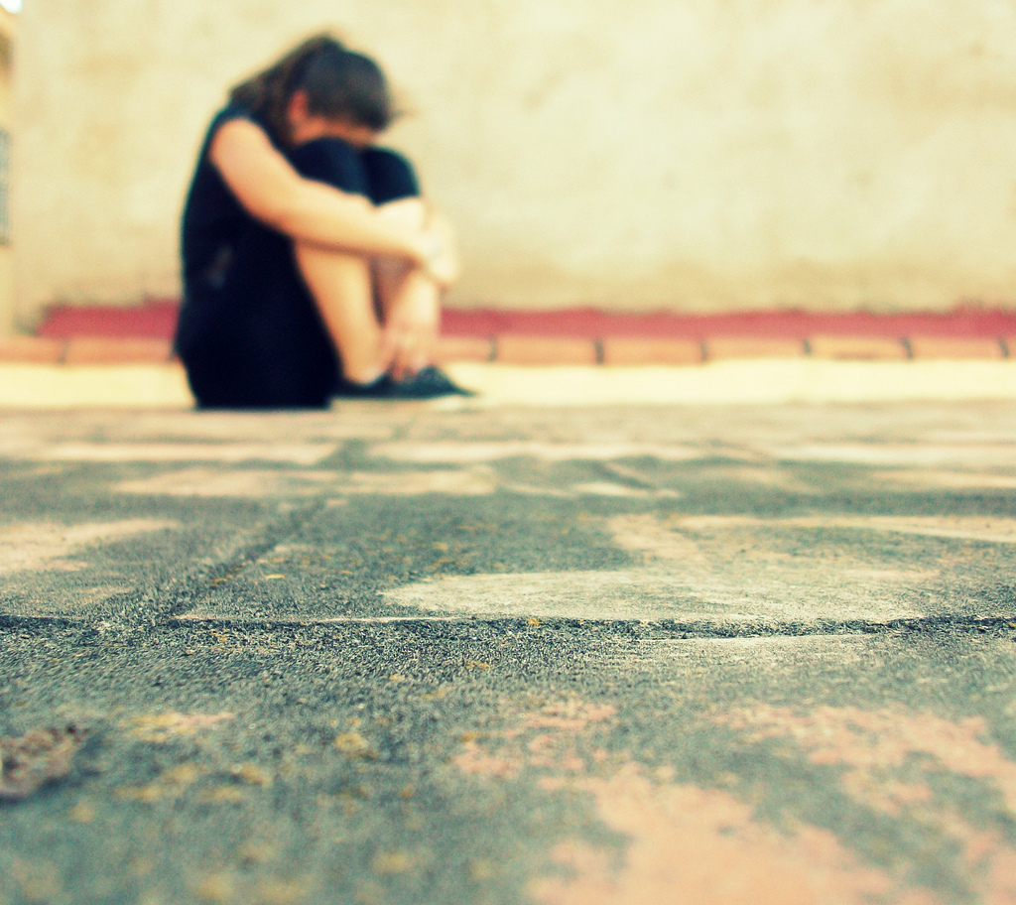
Why people lose their faith when they suffer?
Text: Judges 6:13
We will explore three reasons to this question today.
These thoughts are not intended to be an exhaustive list of reasons to our question.
But, hopefully, these thoughts will help us in remain faithful during unfortunate times.

Slide 2
Why people lose their faith when they suffer?
We lose our faith because…
OUR UNDERSTANDING OF GOD’S BLESSINGS ARE MISUNDERSTOOD
First, God’s blessings are attributed to our goodness.
If I will be good then I will get blessings.
The gospel of prosperity mentality.
Job 21:7-16

Slide 3
Why people lose their faith when they suffer?
We lose our faith because…
OUR UNDERSTANDING OF GOD’S BLESSINGS ARE MISUNDERSTOOD
Second, we associate God’s blessings with material things.
The “material success” for “spiritual service” theory.
Have you ever considered the possibility that all our material advantages may not be blessings!

Slide 4
Why people lose their faith when they suffer?
We lose our faith because…
OUR UNDERSTANDING OF SUFFERING IS SKEWED
First, we think that we should be excused from it.
As sinners we deserve to suffer.
Genesis 3-4
Second, we forget that it could be to our benefit.
James 1:3

Slide 5
Why people lose their faith when they suffer?
OUR UNDERSTANDING OF SIN’S EFFECT IS LACKING
First, we don’t appreciate how terrible it is.
Second, sometimes the consequences are delayed.
Eccl. 8:11
We have adopted a “statute of limitations” mentality to our sinful actions.

