Slide 1
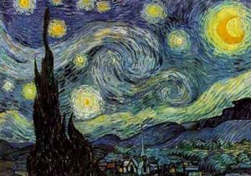
Starry Night
1889
Most famous painting

Slide 2
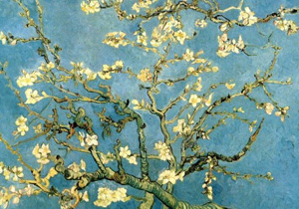
Branches with almond buds
1890

Slide 3
Potato Eaters 1885- First major work

Slide 4
Wheatfield with Crows- 1890

Slide 5
Café Terrace on the Place du Forum- 1888

Slide 6
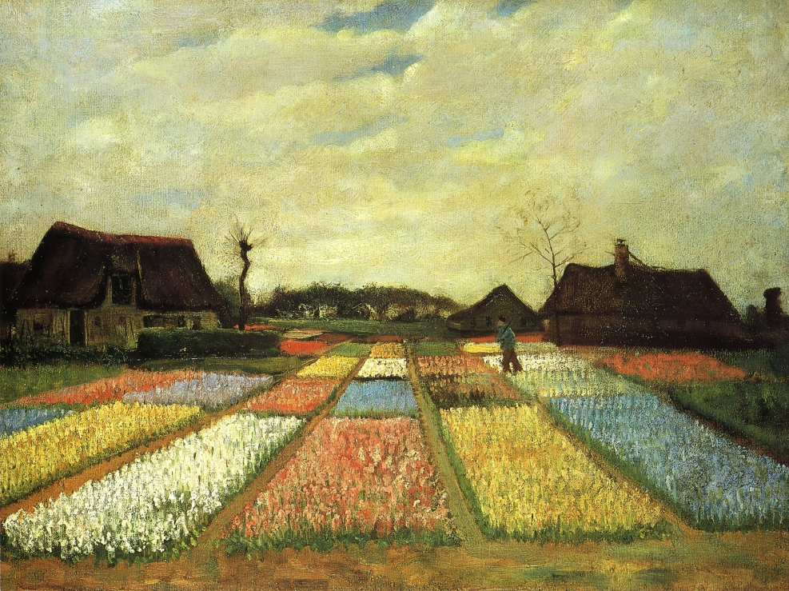
Bulb fields
1883

Slide 7
The Red Vineyard at Arles 1888
The only portrait that he sold during his lifetime.

Slide 8
What more could have been done
Vincent Van Gogh.
Considered the 2nd greatest Dutch painter after Rembrandt.
Believed to have produced around 2100 pieces of art.
Three of his family members were art dealers.
He worked for an art dealer.
Mother was an amateur artist.
Yet, in his life he only sold one painting.

Slide 9
What more could have been done
Text: Isaiah 5:4
“What more could have been done for my vineyard, that I have not done in it? When I looked for it to yield grapes, why did it yield wild grapes?
The context of this verse is God’s complaint against Judah and Jerusalem.
What had God done for his people?
Consider verses 1-2

Slide 10
What more could have been done
I Corinthians 3:9- Paul makes reference to the church being a vineyard.
What has God done for his vineyard (Church)?
GIVEN HIS SON TO SANCTIFY HER- Eph. 5:25
GIVEN HIS WORD TO CLEANSE HER- Eph. 5:26
GIVEN ALL SPIRITUAL BLESSINGS THROUGH HER- Eph. 1:3, 22-23.
What more could have been done for his vineyard?

