Slide 1
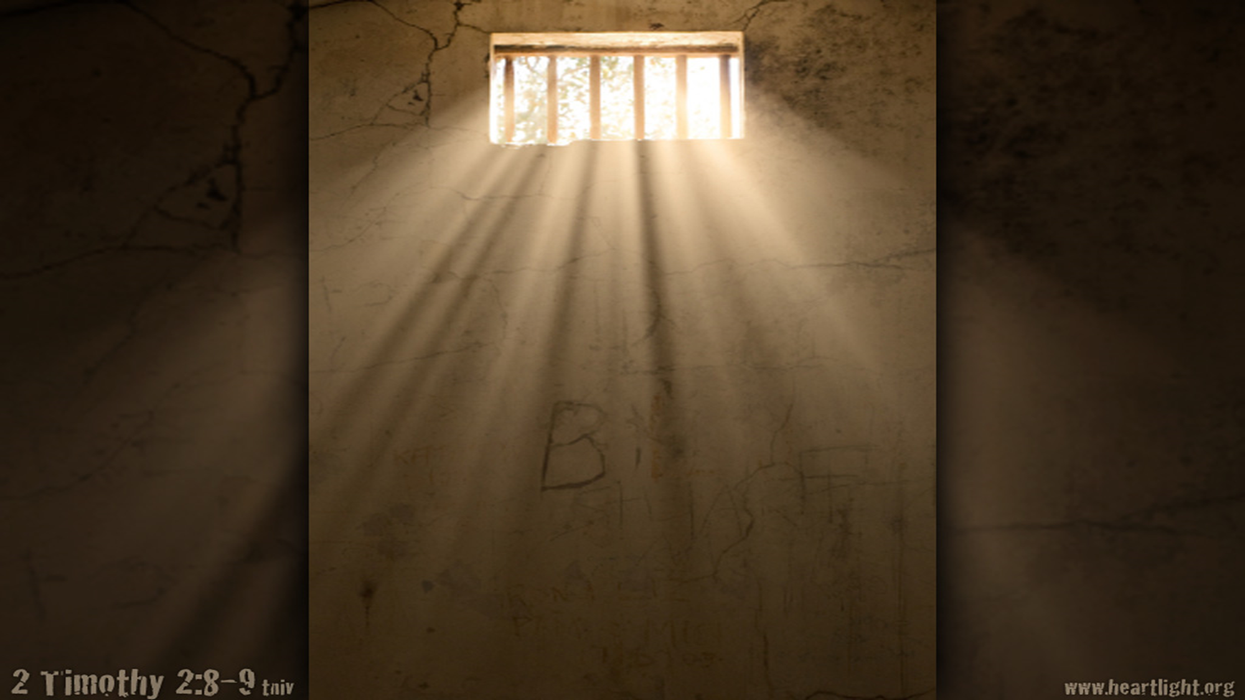
What Paul thought about before his death
Text: II Tim. 4:6-8
We generally listen attentively to the last words of those about to die.
Tonight, we will consider what Paul had on his mind shortly before his death.
Paul thought about his…………….

Slide 2
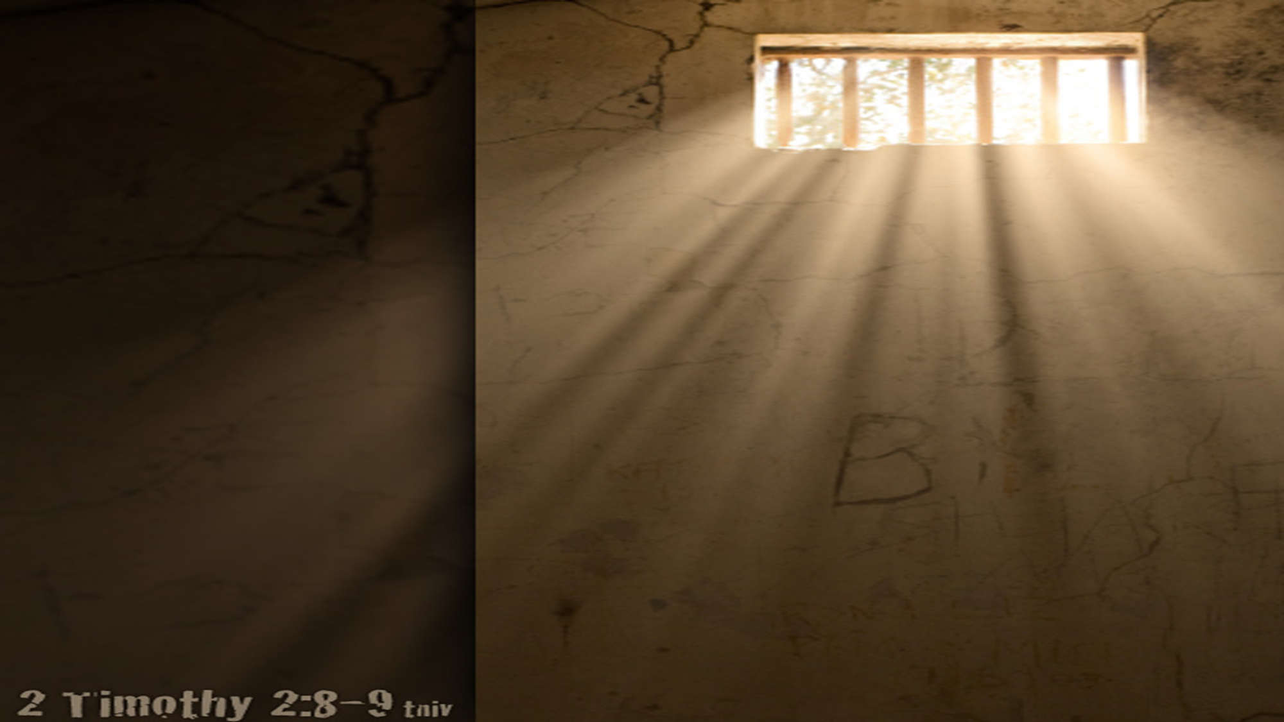
What Paul thought about before his death
LIFE
Paul knew the plan was already in motion for his execution.
II Tim. 3:10-11
Acts 23:1; 24:16
He fought, finished and was faithful

Slide 3
What Paul thought about before his death
REWARD
Crown of righteousness
I Peter 5:4, Rev. 2:10, James 1:12
Confidence
Reward
Fellowship with Christ- John 14:3, Phil. 1:21-23
Honor from Christ- Luke 12:37
Likeness of Christ- Phil. 3:20-21, Col. 3:4

Slide 4
What Paul thought about before his death
LORD
The righteous judge
Acts 17:31
Ps. 9:7-8; 67:4; 96:10,13
The Second Coming
II Peter 3:12

