Slide 1
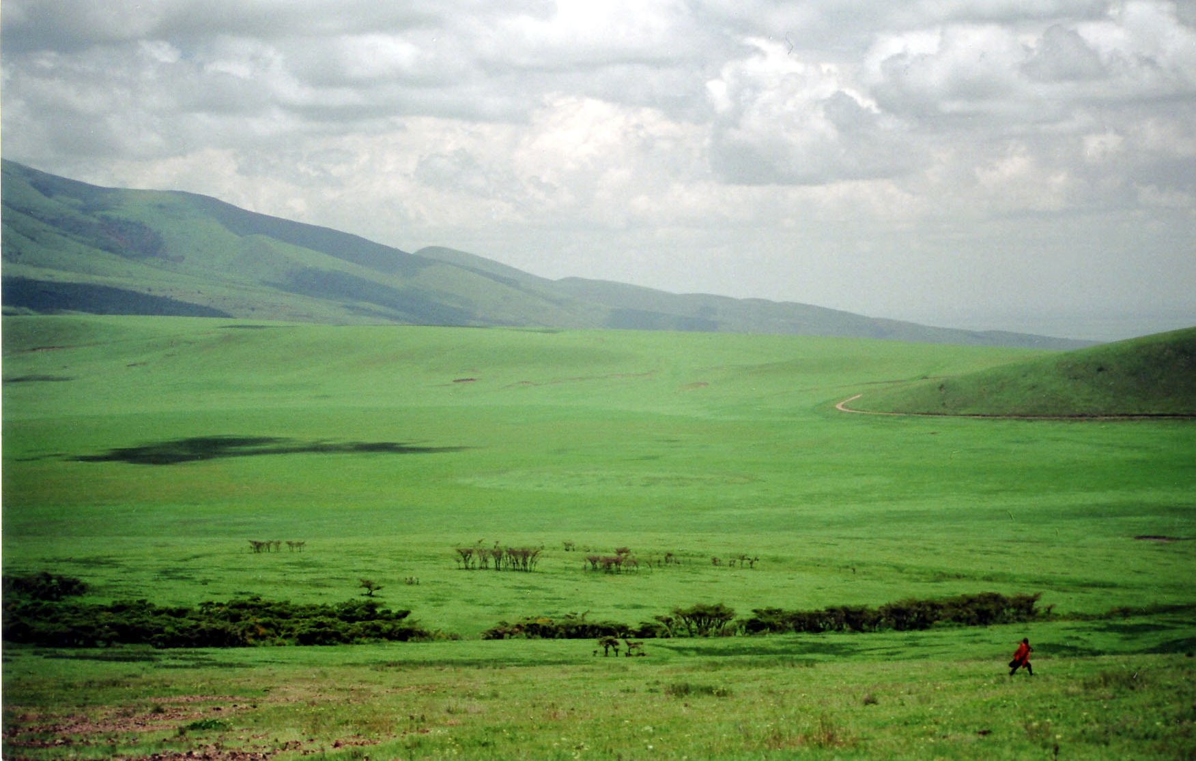
Sermon on the Plain
Luke 6:24-26
The content of Luke 6 is very similar to the content found in the Sermon on the Mount in Matthew 5-7.
Several speculations exist about this event.
Some suggest that the two passages are referring to the same event.
Others suggest that these are two different occasions in which Jesus shared teachings that were common to his ministry.

Slide 2
Sermon on the Plain
On this occasion, Luke records that Jesus stood in the plain.
What is unique about Luke’s account of Jesus’ teachings is that he also includes a section on “woes.”
This is the focus of our study today.
Most commentators agree that this word “woe” is not an expression of anger or condemnation of the people but an expression of sorrow and warning.

Slide 3
Sermon on the Plain
Jesus wanted to warn people about........
SPIRITUAL POVERTY AMID WORLDLY SUCCESS
He makes a point to analyze:
FORTUNE- Luke 6:24-25
We become so enwrapped with material things.
Col. 3:2
We become so disengaged with the problems of the world.
Amos 6:1-6
If the problems of the world aren’t affecting me then who cares.

Slide 4
Sermon on the Plain
Jesus wanted to warn people about........
SPIRITUAL POVERTY AMID WORLDLY SUCCESS
He makes a point to analyze:
FUN- Luke 6:25
You have heard it said about some people “that they think everything is all fun and games.”
There is a time for serious behavior.
There is a time for discussing serious things.
Eccl.3:1-8

Slide 5
Sermon on the Plain
Jesus wanted to warn people about........
SPIRITUAL POVERTY AMID WORLDLY SUCCESS
He makes a point to analyze:
FAVOR- Luke 6:26
Notice also the context in 6:22
At some point Christians there has to be some separation from, some distinction to, some animosity towards the world. James 4:4
Consider Jeremiah 26:8, Amos 7:10-13

